Slide 1
Uzbekistan
By Yaw Abofari

Slide 2
Music
The common music people play in Uzbekistan is Rap, Rock, and Contemporary music. The people in Uzbekistan also play string and wind instruments. Some of the string instruments are called Dutor, Tor, and Rubob. Some of the wind instruments are Karnay and Nay. The Uzbek people are well-known for their songs.

Slide 3
Uzbekistan
Uzbekistan is a great country. The capital of Uzbekistan is Tashkent. It is located in East Asia. It covers 425,400 square kilometers. It is 22,000 square kilometers of water. It's total area 447,400 square kilometers. Uzbekistan became an independent state in 1991.

Slide 4
Language
The term Uzbek can be used to refer both to the Uzbek language or people of native Uzbek origin. The most common language people speak in Uzbekistan is Uzbek. Uzbek belongs to the Eastern Turkic, or Karluk, branch of the Turkic language family.

Slide 5
Culture
Uzbekistan mainly practice Islam. The Arabs had the greatest influence on Uzbek customs and traditions. Culture of Uzbekistan is one of the brightest and original cultures of East Asia. Uzbekistan is also well known for their Arts and Crafts.

Slide 6
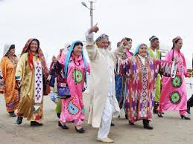
Culture

Slide 7
Temperature
Uzbekistan has a very good climate with hot summers and cool winters. The average temperature for summer is 104 F. The average temperature for winter is 28 F. The coldest month is January. The hottest month is July and August.

Slide 8
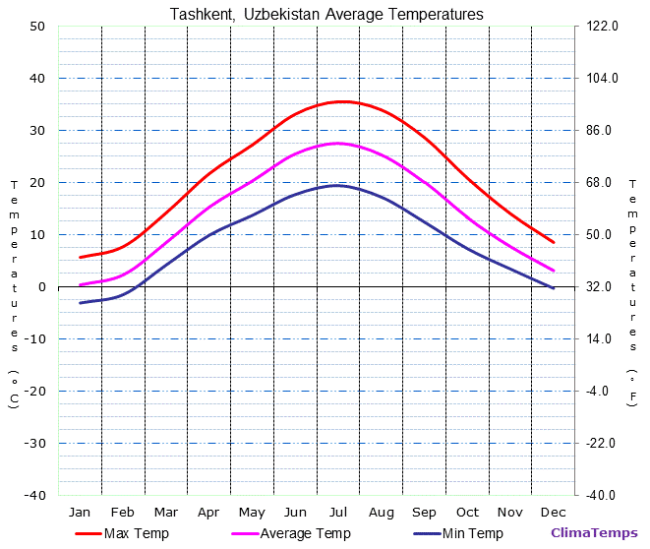
Temperature

Slide 9
Natural Resources
Uzbekistan has a lot of natural resources and is a very wealthy country. Uzbekistan's natural resources are Petroleum, Natural gas, Gold, Uranium, Coal, Copper, and Zinc. Uranium, Copper, and Gold are the country chiefs minerals.

Slide 10
Government
The Constitution of the Republic of Uzbekistan was adopted on December 8, 1992. Islam Karamazov was the first president in Uzbekistan. He was elected president in 1990. The president is elected for 7 years. Parliament (Oliy Majlis) of the Republic of Uzbekistan consists of two Chambers: The Senate and The Legislative Chamber.

Slide 11
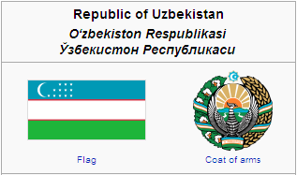

Slide 12
People
There about 28 million people who live in Uzbekistan. About 80% of the peoples ethnic group are Uzbek. Other ethnic groups include Russian 5.5%, Tajik 5%, Kazakh 3%, Karakalpak 2.5%, and Tatar 1.5%.The education in Uzbekistan has 99% literacy. About half of the population in Uzbekistan are under 19 years old. Nearly three quarters of people in Uzbekistan are younger than 21 years old.

Slide 13
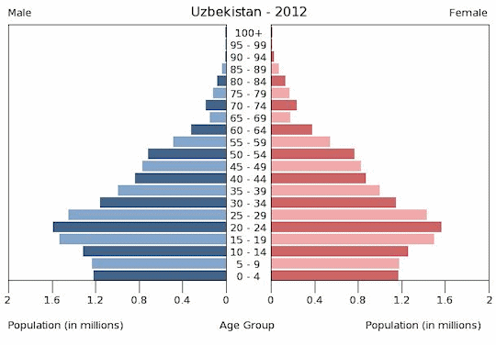
Population and group

Slide 14
Family
In the early 1990s, 40 percent of all Uzbek families had seven or more children. After marriage women have traditionally gone to live with their husband’s family. Extended families living together are more common in rural areas. Men like to gather at local tea houses called Chaykhana. Uzbek woman work hard to keep their families going.

Slide 15
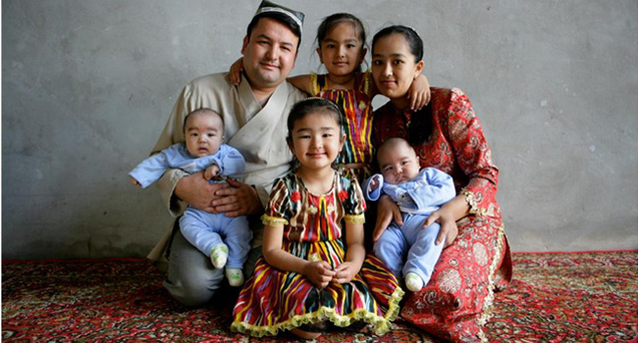
Uzbek family

Slide 16
Conclusion
Uzbekistan republic borders Afghanistan the Turkmen, Kazakh, and the Tadzhik. Tashkent is the capital. Economic activities include growing cotton, rice and stock ( sheep and goat raising). Oil, natural gas, and coal, are the major resources. The Uzbek, who are Sunni Muslim people, are the majority of the population. It was largely under Russian control by 1873. In 1918 it became part of the Soviet Union. It became independent in 1991.

