Slide 1
Southwest Asia’s
Prominent
Religions
Judaism, Christianity,
and Islam (Sunni & Shia)

Slide 2
Standards
SS7G8 The student will describe the diverse cultures of the people who live in Southwest Asia (Middle East).
c. Compare and contrast the prominent religions in Southwest Asia (Middle East): Judaism, Islam, and Christianity.
d. Explain the reason for the division between Sunni and Shia Muslims.

Slide 3
Southwest Asia’s
Prominent
Religions
Judaism, Christianity,
and Islam (Sunni & Shia)

Slide 4
Monotheism
Judaism, Christianity, & Islam are prominent religions practiced in Southwest Asia.
90% of the region’s population practices Islam, 4% are Christian, and 2% follow Judaism.
Followers of each practice monotheism, a belief in one god.
What else do they have in common?

Slide 5
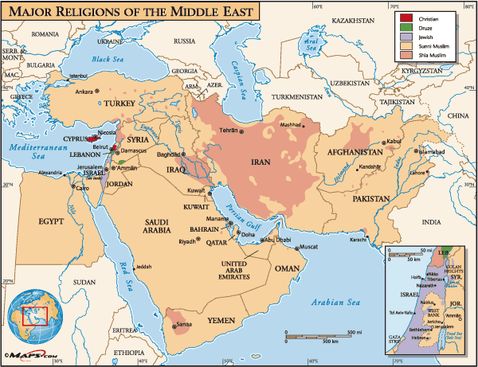

Slide 6
Similarities
They all originated in Southwest Asia.
Each can trace their roots to Abraham as the father of their faith.
Jerusalem is the holiest city in the world for Jews and Christians, and the third holiest city for Muslims.
All three have an important messenger, book of teachings, and holidays.

Slide 7
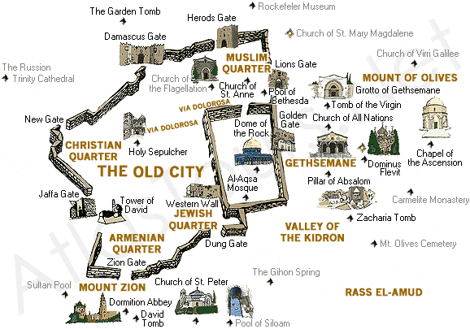
Jerusalem

Slide 8
Judaism

Slide 9
Judaism
Judaism began around 1800 BCE when God spoke to Abraham.
Jews believe that they descended from Abraham and Sarah, the first people to worship Yahweh (God).
Abraham lived in the city of Ur along the Euphrates River (in what is now Iraq).

Slide 10
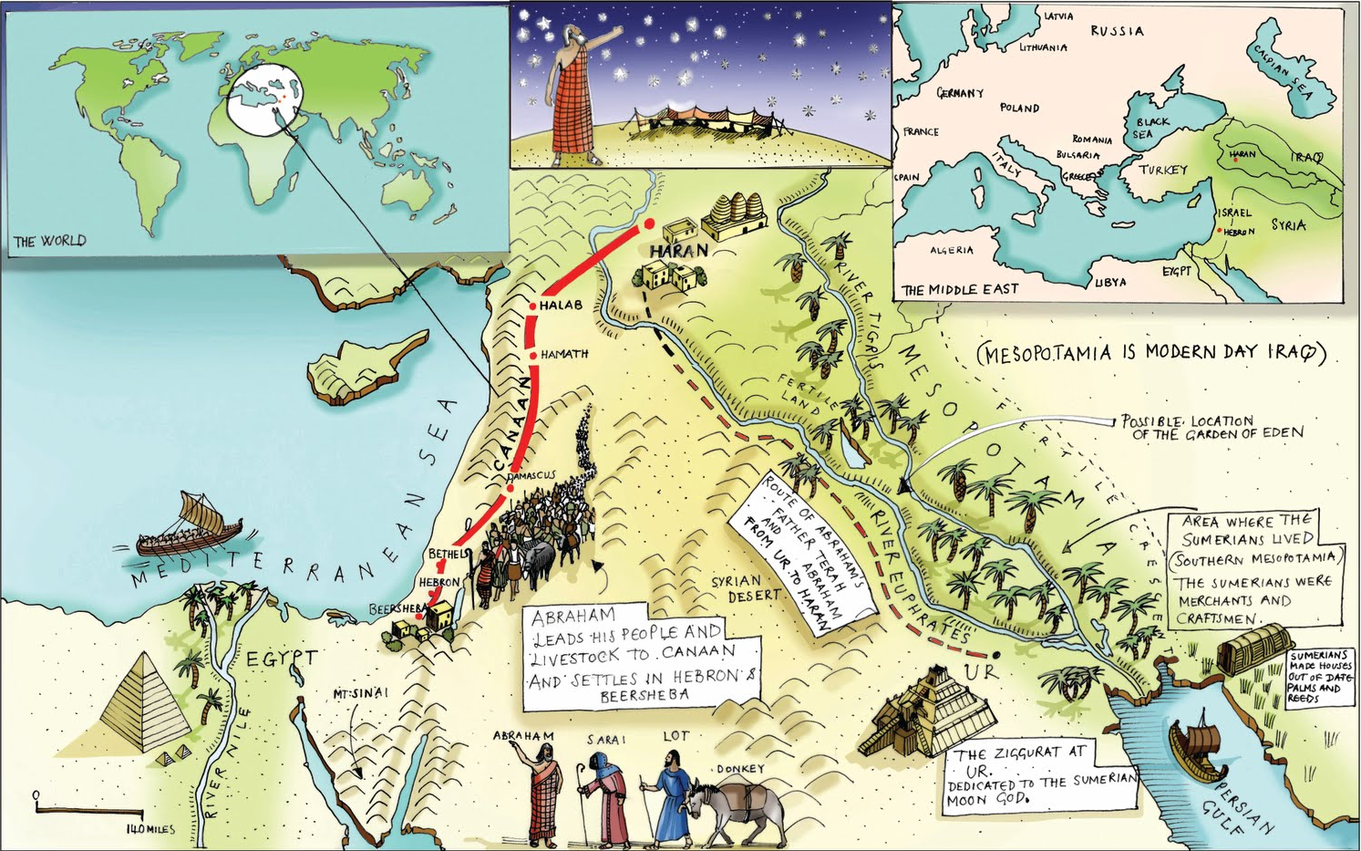
Abraham’s Journey

Slide 11
Moses
Moses is considered a great prophet (a person who receives messages from God).
Moses led Israelites out of Egypt and away from slavery to Israel.
Jews believe that God gave Moses the Ten Commandments, a code of moral law to live by.
The Ten Commandments are found in the Jewish holy book called the Torah, which are the written laws of the Jews.

Slide 12
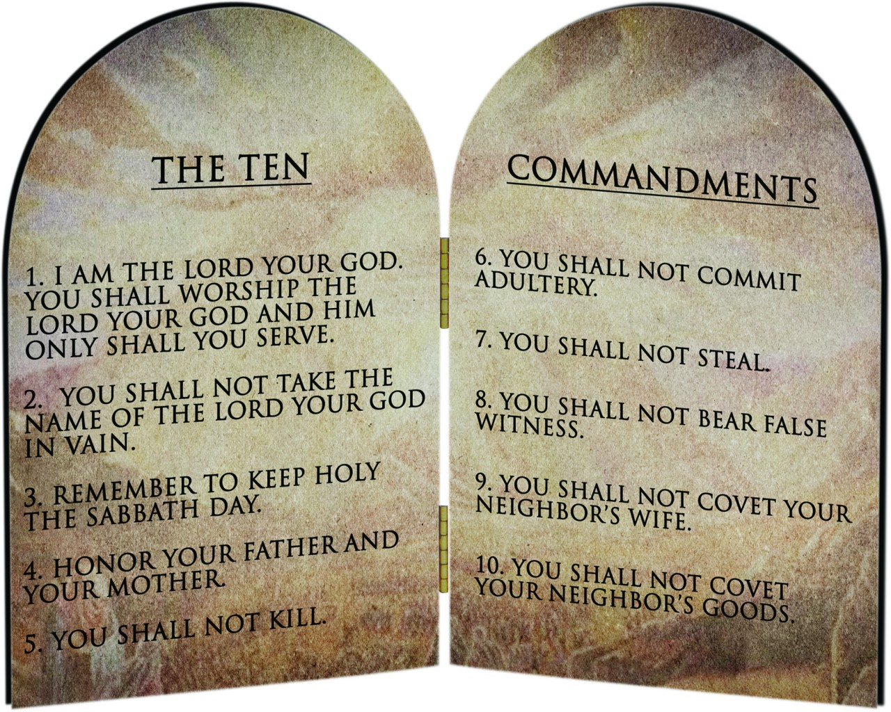

Slide 13
Jerusalem
The Israelites (now called Hebrews) claimed the city of Jerusalem and built a holy temple there.
Between 700-500 BCE, Roman invaders captured Jerusalem and destroyed the temple.
Today, the only remaining part of the temple is the Western Wall, known as the Wailing Wall.
It is one of the most sacred sites recognized by the Jewish faith.

Slide 14
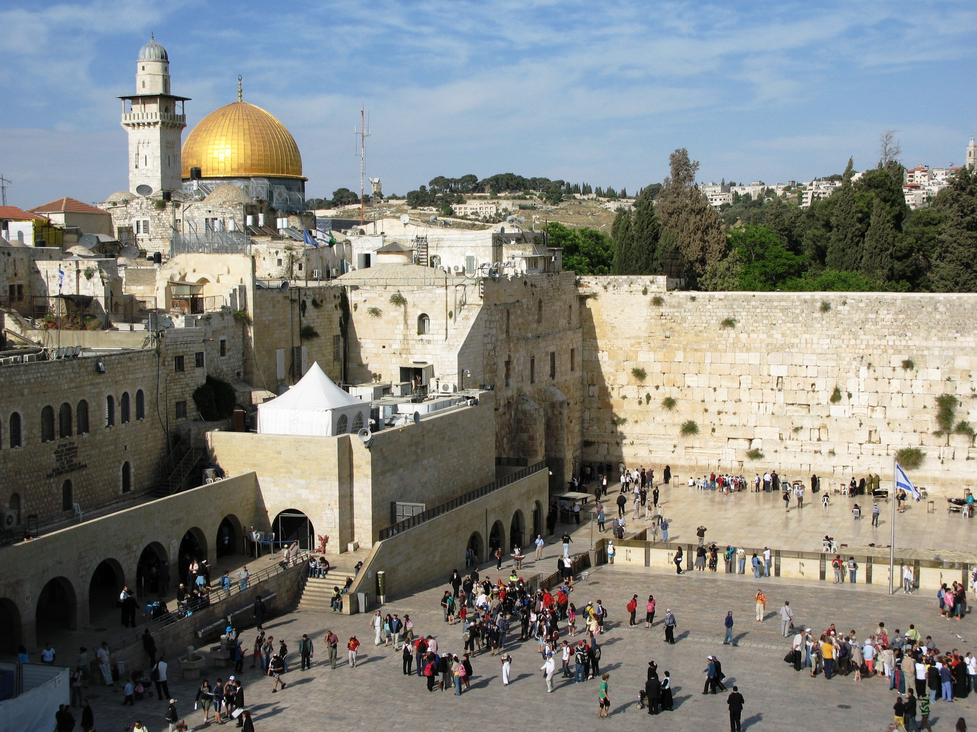
Western Wall

Slide 15
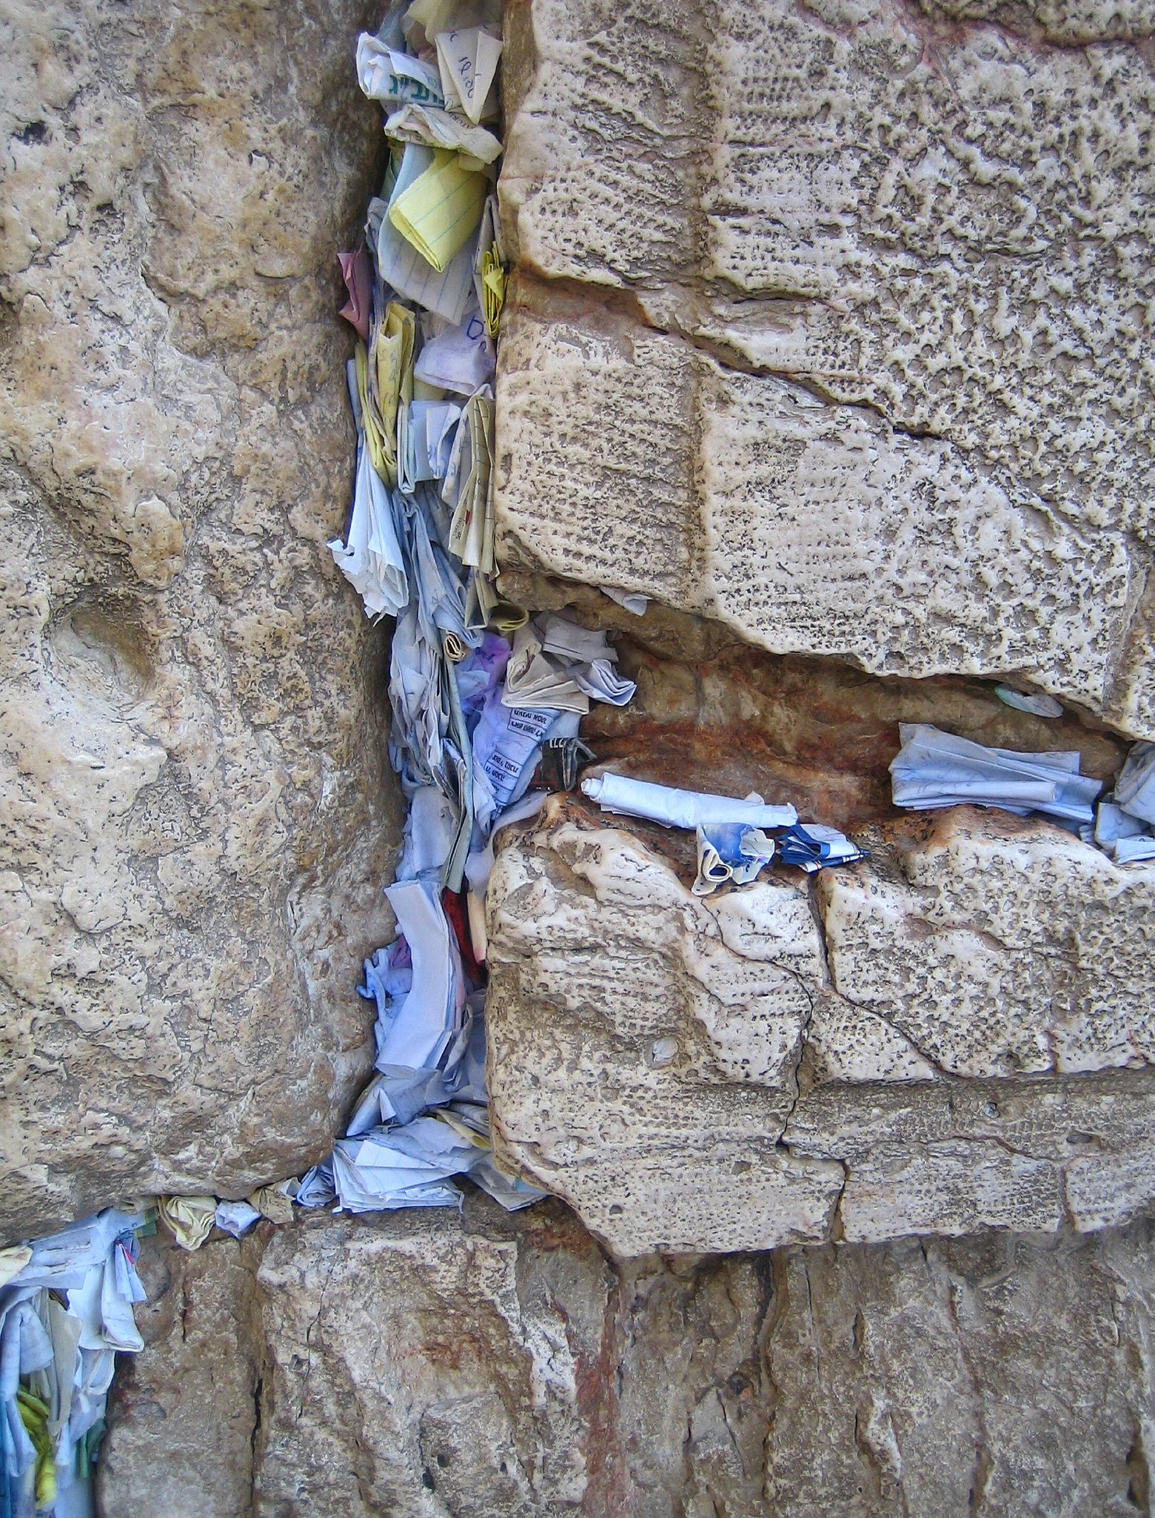
Prayers & wishes stuck into cracks of the Western Wall

Slide 16
Diaspora
Jews were forced out of Israel and moved to many places all over the world.
This is called diaspora, or spreading out of Jews.
The Jewish people did not return to their homeland until the modern state of Israel was created in 1948.

Slide 17
Judaism
There are over 15 million followers worldwide.
Jews worship in synagogues and temples.
They believe that a messiah (savior) will lead them to the Promised Land.
Jews believe in justice and righteousness.
“What is hateful to you, do not to your neighbor.”

Slide 18
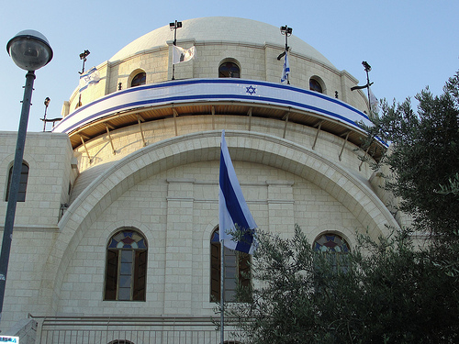
Hurva Synagogue, Jerusalem

Slide 19
Holy Book
The sacred book is called the Tanuch, and it is a collection of writings compiled over a period of time.
There are three parts to the book:
Torah – this is the most sacred part, it contains what Moses delivered to the Israelites
Eight books of psalms and proverbs
Talmud – writings on Jewish law, history, and folklore

Slide 20
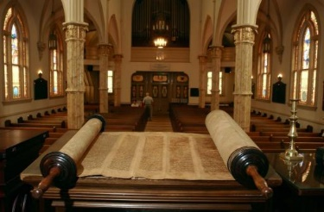
The Torah

Slide 21
Holidays
Hanukkah celebrates a victory where the Jews were able to keep their religion after being captured by Greeks.
Jews were able to keep the Temple lit for 8 days despite only having enough lamp oil for 1 day.
Passover celebrates the exodus of the Hebrews from Egypt.

Slide 22
Holidays
Rosh Hashanah celebrates the Jewish new year.
Yom Kippur is known as the “Day of Atonement” (asking for forgiveness of sins).
It is the holiest day for Jews.
No work is allowed on this day and much of the day is spent in synagogue.
Many Jews fast during this day.

Slide 23
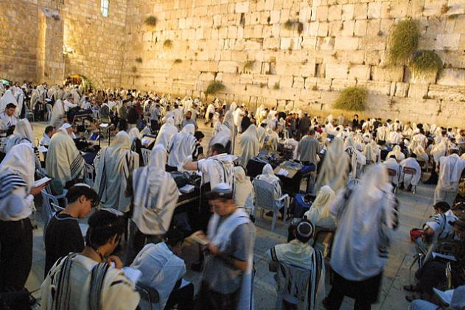
Prayers at the Western Wall during Yom Kippur

Slide 24
Christianity

Slide 25
Christianity
Christianity has its roots in Judaism.
Christians believe in Jesus, a carpenter who began to travel and teach new ideas about Judaism around 30 CE.
He believed that the old laws of Judaism should be replaced by a simple system based on love and kindness.

Slide 26
Jesus
Jesus performed miracles and after people saw the results, they became followers.
He laid his hands on people and could heal them.
Jesus used parables (stories that teach lessons) to link his teachings to people’s everyday lives.
Jesus soon gained a large following.

Slide 27
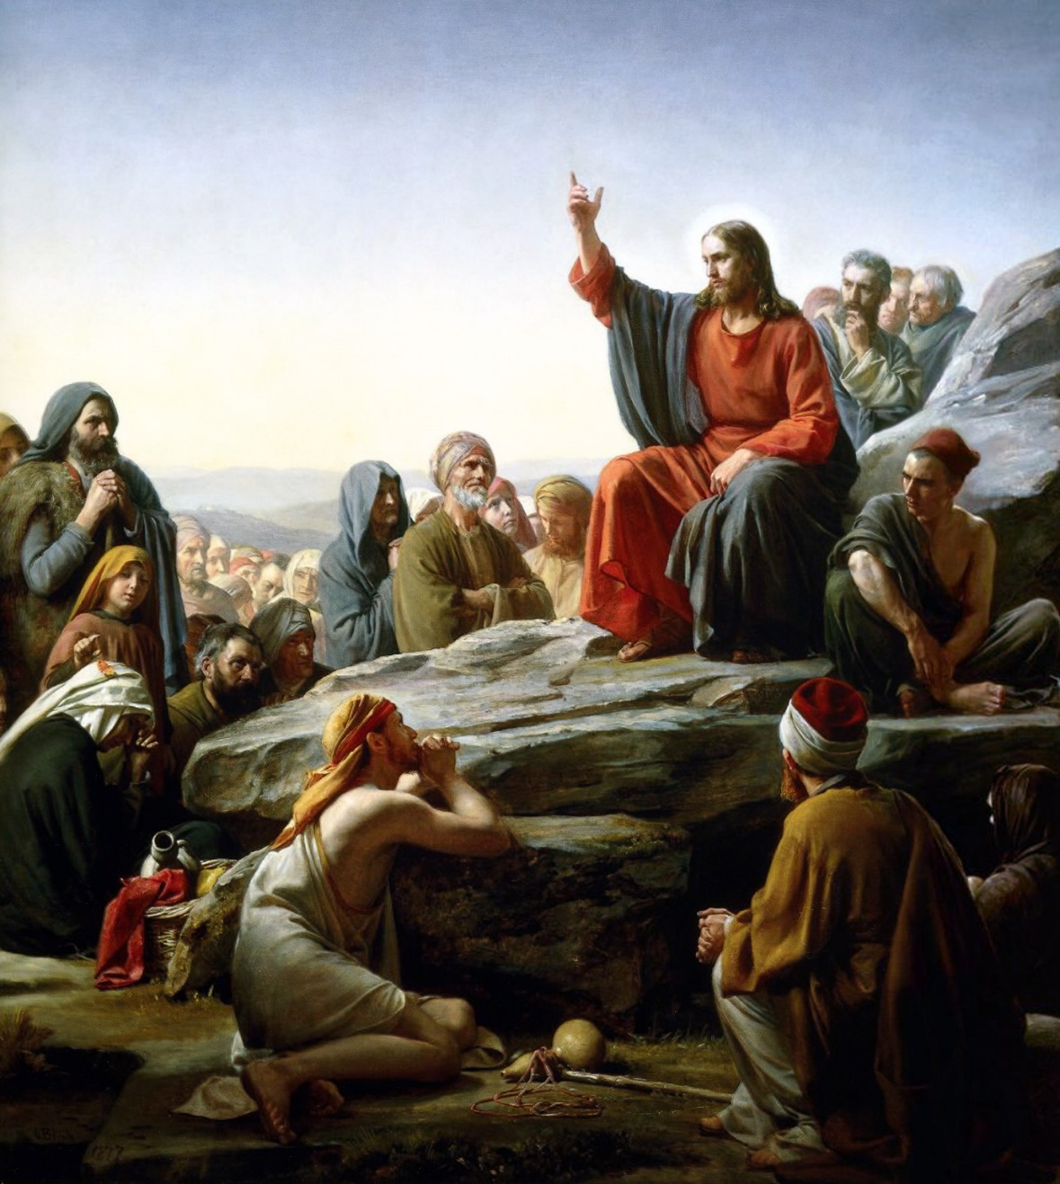
Sermon on the Mount –
Carl Bloch, 1890

Slide 28
Messiah
Jesus was not popular with Jewish leaders.
They did not want him to threaten their power and had the Romans arrest him.
Jesus was crucified at the age of 33.
Christians believe that Jesus rose from the dead and went to heaven three days later.
They saw the Resurrection as a sign that Jesus was the Messiah (or savior).
This date, 33 CE, is the beginning of Christianity.

Slide 29
Christians
There are about 2.1 billion Christians worldwide.
Christians are grouped by many denominations.
Examples include Catholicism, Orthodoxy, and Protestantism.
All denominations of Christians follow the teachings of Jesus.
Christians worship in churches and chapels.

Slide 30
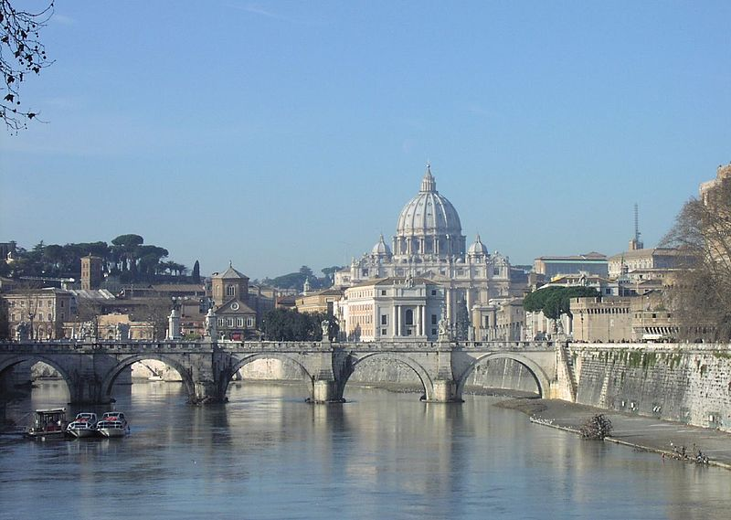
St. Peter’s Basilica, Vatican City
(Built from 1506-1626 with Michelangelo among the architects)

Slide 31
Holy Book
The Bible is the main holy book for Christians.
It consists of:
The Old Testament -- contains the Ten Commandments
The New Testament -- about Jesus and his teachings

Slide 32
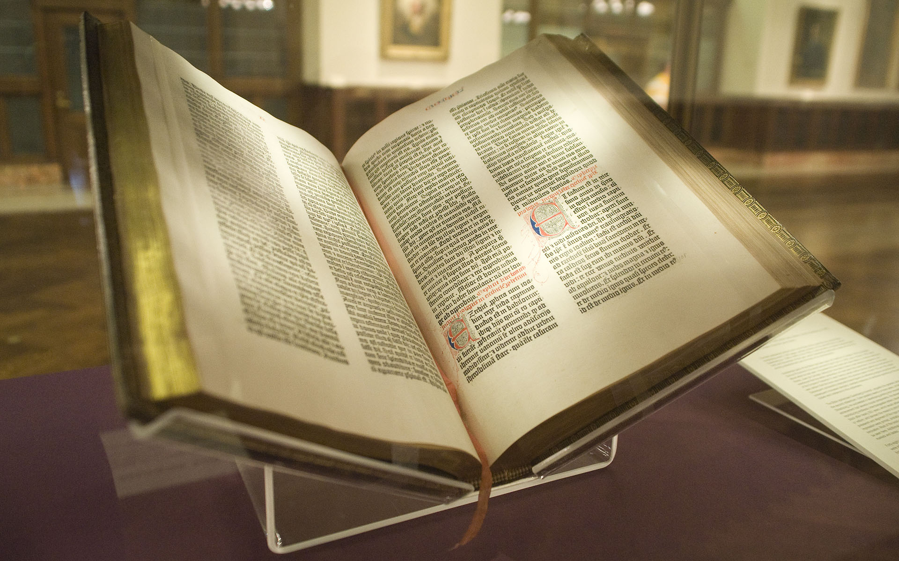
Gutenberg Bible – 1450s
(The first printed book)

Slide 33
Holidays
Christmas is the celebration of the birth of Jesus and is observed on December 25th.
Easter celebrates the death and resurrection of Jesus.

Slide 34
Islam

Slide 35
Islam
Islam began around 622 CE in Southwest Asia.
In Arabic, Islam means “surrender to the will of Allah” (God).
Followers of Islam are called Muslims, and the founder is Muhammad.
Muslims believe that there is only one god (Allah) and that Muhammad is the last and greatest prophet of Islam.
Other prophets include Abraham, Moses, & Jesus.

Slide 36
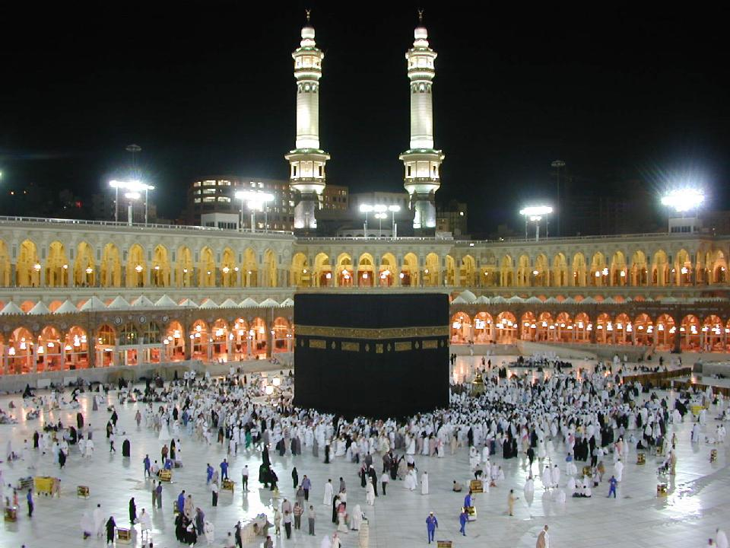
The Kaaba at al-Haram Mosque (Mecca, Saudi Arabia) is the center of Islam.

Slide 37
Muhammad
In 610 CE, Muhammad was an Arab merchant in Mecca who was concerned about how rich merchants refused to help the needy.
He went to meditate on this in the Cave of Hira.
While there, Muhammad received a message from the angel Gabriel, the messenger of Allah.
Muhammad became known as a prophet of Allah, and he continued to receive messages until his death.
These messages form the basis of Islam and were eventually written into the Qur’an (the Muslim holy book).

Slide 38
Muhammad
Eventually, others began to listen to Muhammad’s messages and this angered Mecca’s rulers.
They threatened to kill Muhammad, so he & several hundred of his followers fled to nearby Medina.
Muhammad became a political and spiritual leader in Medina.
Eventually, all of the Arabian Peninsula came to accept Muhammad’s teachings and turned to Islam.

Slide 39
Followers
Muhammad died in 632 CE, but Islam continued to spread.
Muslim armies conquered empires throughout Southwest Asia, Northern Africa, and the Iberian Peninsula (Europe).
Today, there are 1.2 billion Muslims worldwide.
1 in every 5 people in the world is Muslim.
It’s the second largest religion in the world (behind Christianity).

Slide 40
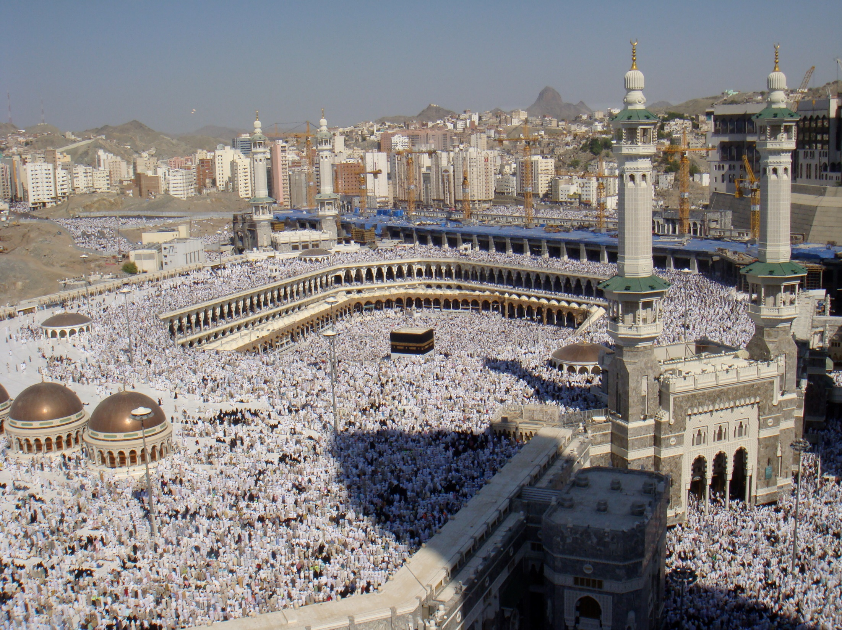
The Kaaba at al-Haram Mosque during the start of Hajj

Slide 41
Holy Book
The Muslim holy book is the Qur’an (Koran).
It states how people should live their lives.
It describes the Five Pillars of Faith (obligations all Muslims must fulfill in their lifetime).

Slide 42
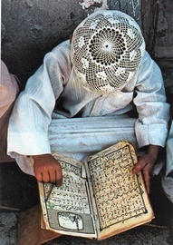
Reading the Qur’an

Slide 43
5 Pillars of Faith
(the main duties of Muslims)
1. Daily prayer,
2. Giving to charity,
3. Belief in and submission to one God (Allah),
4. Fasting during the month of Ramadan,
5. and a pilgrimage (hajj) to Mecca once in a lifetime.

Slide 44
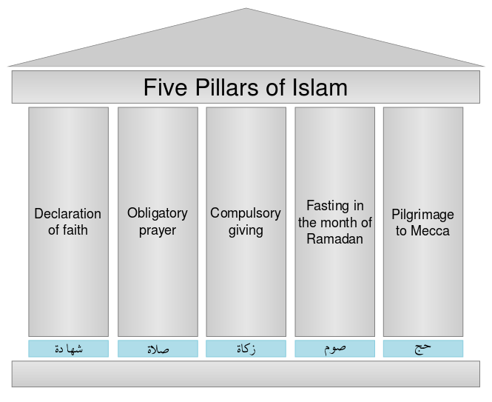

Slide 45
Holidays
Ramadan celebrates the time when the Qur’an was revealed to Muhammad.
It’s the 9th month of the Islamic calendar, and lasts for 29-30 days.
Muslims fast during daylight hours during this month.
Prayer, reading the Qur’an, and charity are important parts of Ramadan.

Slide 46
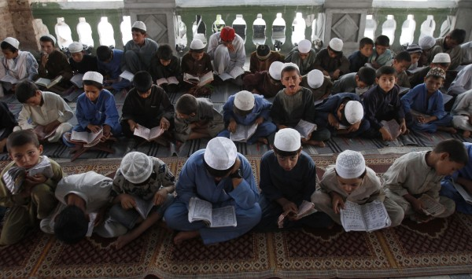
Boys reading the Qur’an at a mosque during Ramadan

Slide 47
Government
Unlike the other religions, in Islam the Qur’an gives instructions on how laws should be enacted.
The governments of Muslim countries follow the Shari'a, or religious law.
This creates a theocracy, a type of government in which religious leaders are in control.

Slide 48
Sunni & Shia

Slide 49
The Split
After Muhammad’s death, followers fought over who would be his successor and become the next leader.
This fight caused Muslims to split into two groups:
Shi’a
Sunni

Slide 50
Shi’a
Shiites believe that the supreme leader (called the Caliph) must be a blood relative of Muhammad.
Roughly 10% of the world’s Muslims are Shi’a.
This branch of Islam is found mostly in Iran and some parts of Iraq.
This is the religion of most Persians (ethnic group in Iran).

Slide 51
Sunni
Sunnis believe that the supreme leader (Caliph) does NOT need to be related to Muhammad.
This is the major branch of the religion, representing about 90% of the world’s Muslim population.

