Slide 1
South Africa under Apartheid

Slide 3
In 1652 the Dutch came to settle in South Africa.
They believed the land was theirs.
They defeated many Africans and forced them to work as servants and slaves.

Slide 4
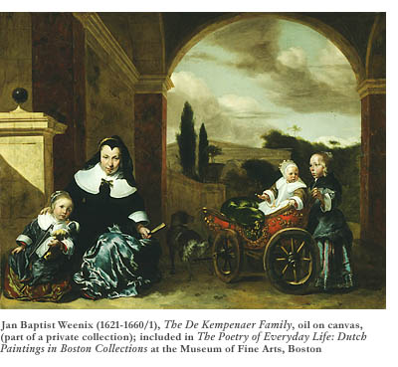

Slide 5
In 1806, Great Britain captured the colony from the Dutch.
When diamonds and gold were discovered, the British forced blacks off the mineral-rich land.
In 1948 the racist Nationalist Party was elected to power.

Slide 6
The government established an official policy called “apartheid.”
The South African government tried to completely separate the small number of whites from the black majority.

Slide 7
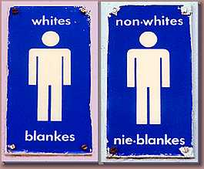

Slide 8
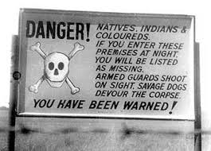

Slide 9
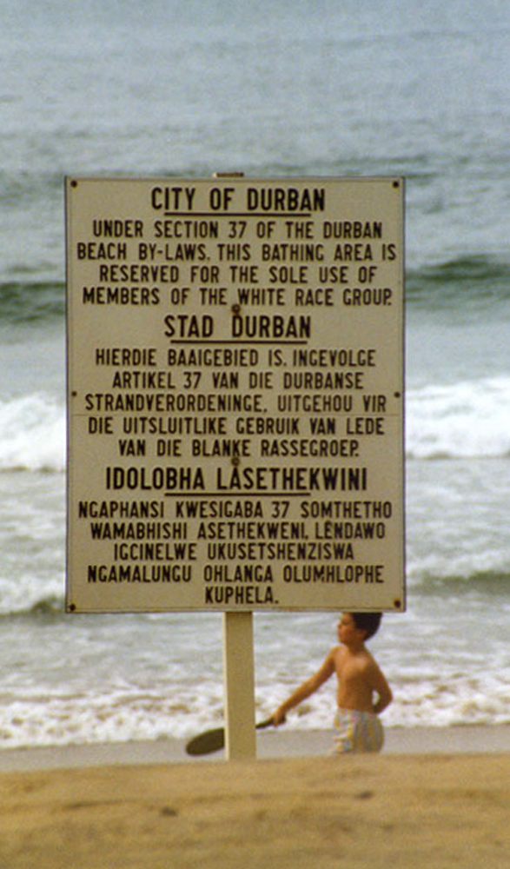

Slide 10
In 1958, the government separated black people from white people by making blacks live on reserves, or homelands.
Several blacks also lived in shanty towns – overcrowded towns full of poorly built shacks on the edges of cities.

Slide 11
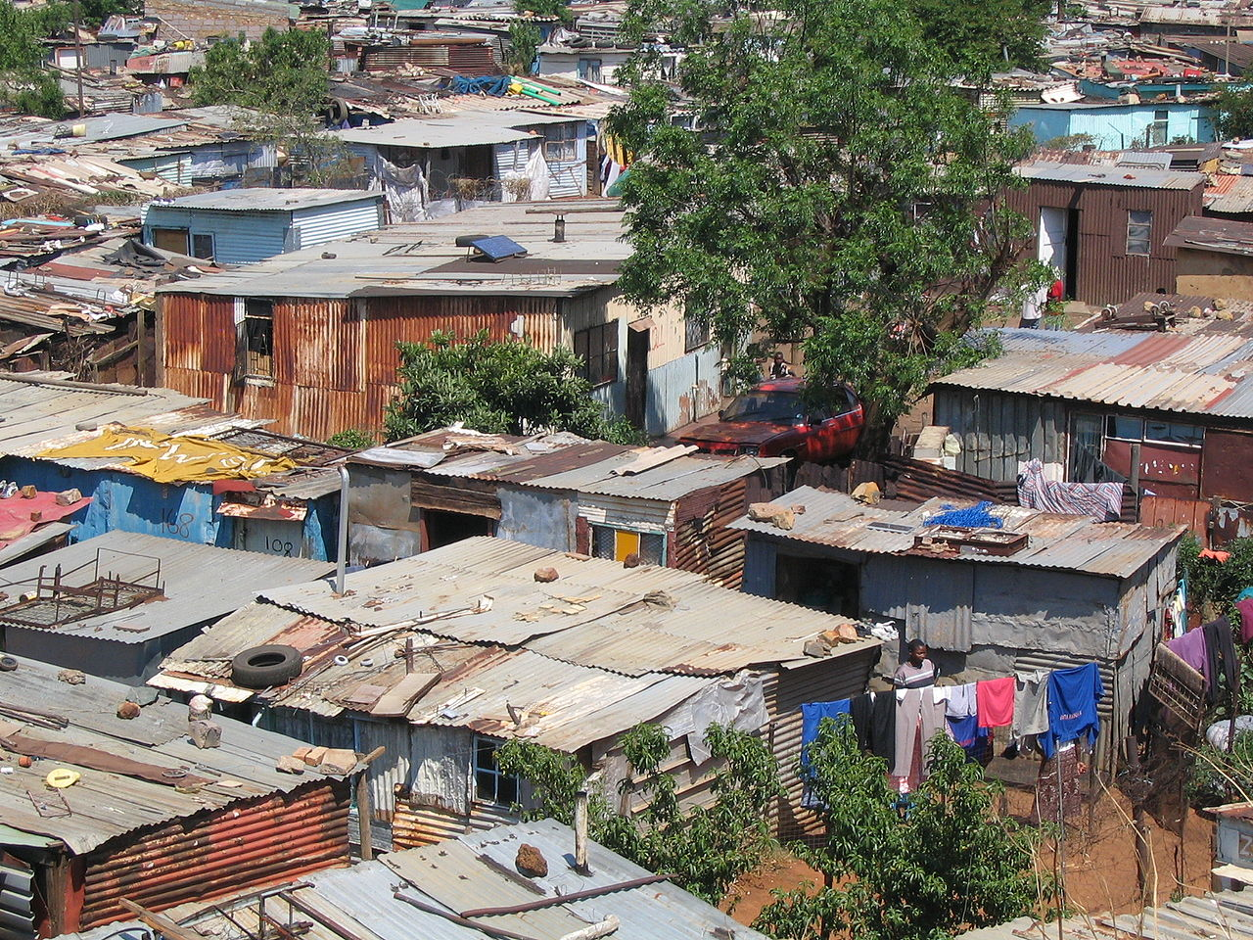

Slide 12
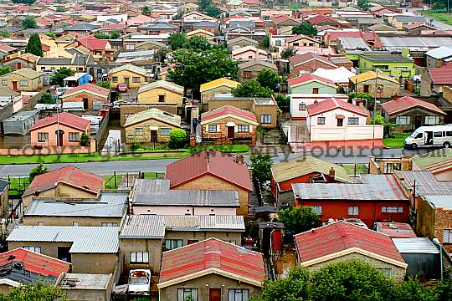

Slide 13
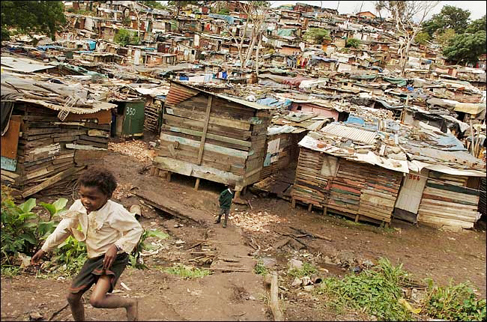

Slide 14
Most black men had to leave their homeland to find work in mines or factories.
Women raised whatever crops they could.

Slide 15
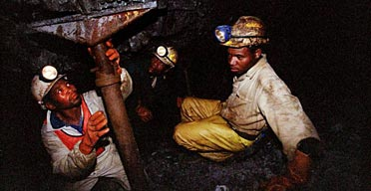
South African Gold Mine

Slide 17
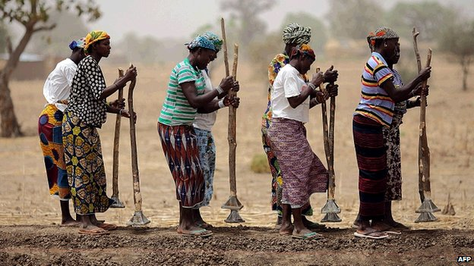

Slide 18
The shanty towns became centers for black groups who resisted the white government.
Thousands resisted apartheid by refusing to work, refusing to buy white products, going into “white only” areas, and marching in nonviolent demonstrations.

Slide 19
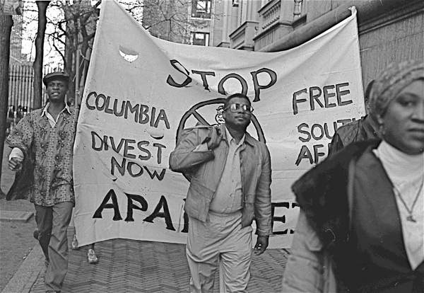

Slide 20
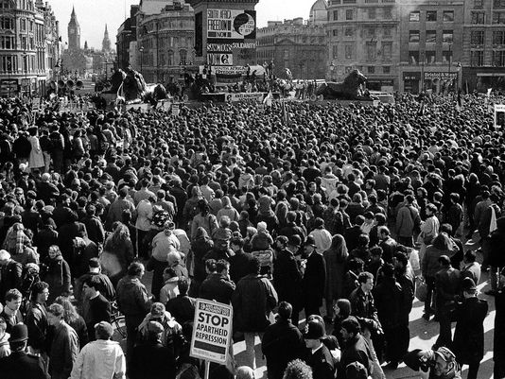

Slide 22
In 1986, the white South African government tried to destroy those who resisted apartheid. Still, blacks increased their actions against the government.
In 1994, the government agreed to an open elections. The African National Congress, the largest anti-apartheid party, won.
Nelson Mandela became the new president of South Africa.

Slide 23
