Slide 1
SS7H3c
Rebuilding
Japan
After World War 11
© 2015 Brain Wrinkles

Slide 2
Background
Information

Slide 3
Pearl Harbor
On December 7, 1941, Japanese airplanes made a surprise attack on the US naval base at Pearl Harbor in Hawaii.
More than 2,400 people were killed, and many US battleships and airplanes were destroyed.
© 2015 Brain Wrinkles

Slide 4
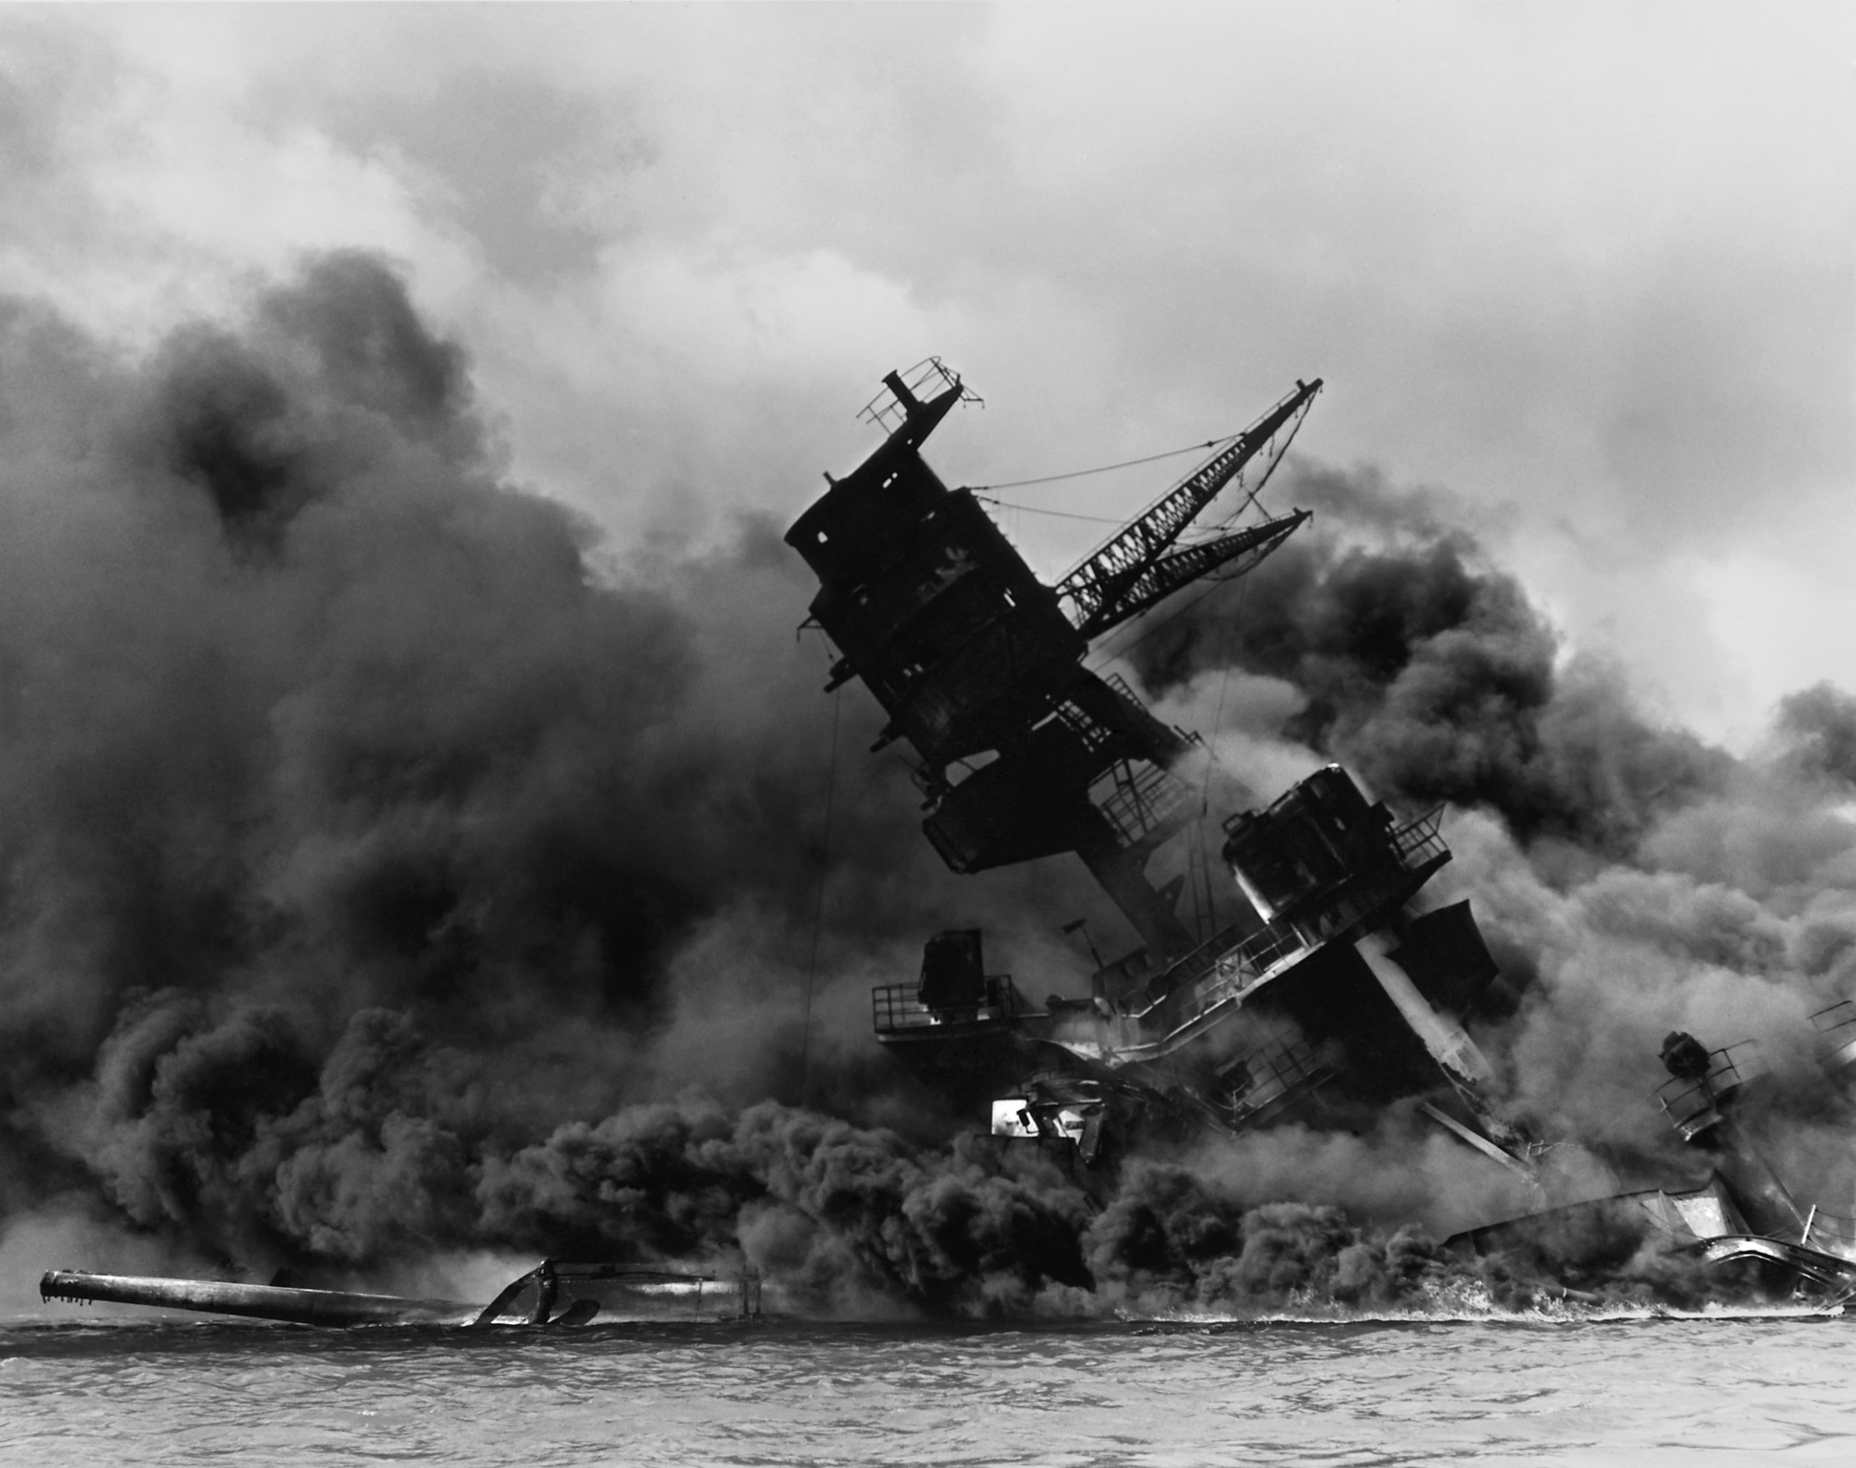
The USS Arizona After the Japanese Surprise Attack on Pearl Harbor.
© 2015 Brain Wrinkles

Slide 5
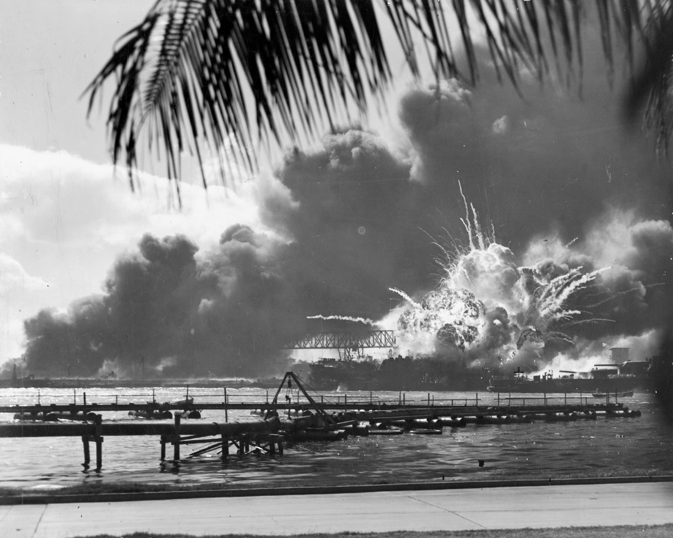
President Roosevelt called December 7, 1941, “a day that will live in infamy.”
© 2015 Brain Wrinkles

Slide 6
US Enters WWII
The next day, President Roosevelt asked Congress to declare war on Japan.
They agreed and the US officially entered WWII on December 8, 1941.
On December 11, Germany and Italy declared war on the US.
The US was now deeply involved in WWII on the side of the Allies.
© 2015 Brain Wrinkles

Slide 7
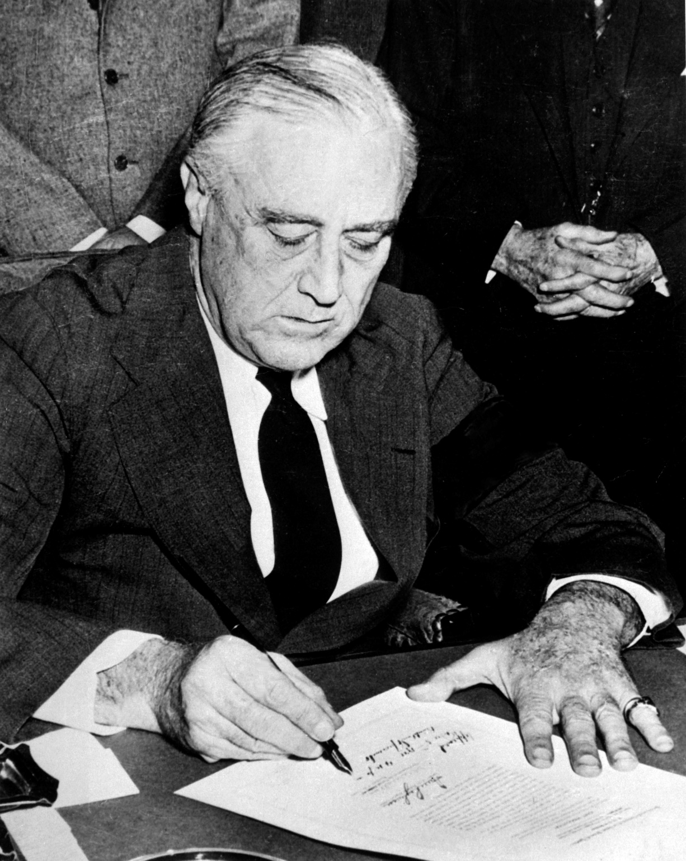
Roosevelt Signing Declaration of War Against Japan.
© 2015 Brain Wrinkles

Slide 8
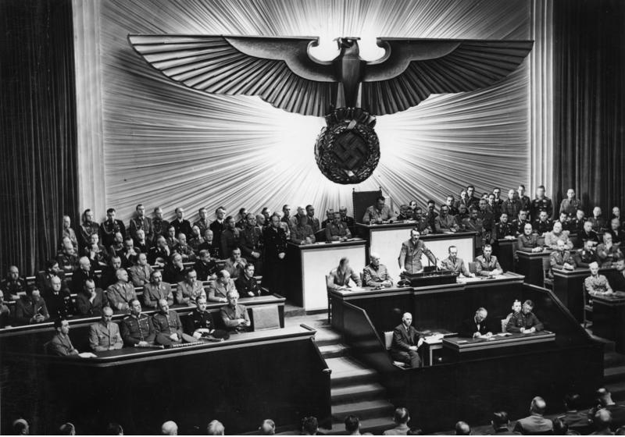
Hitler Declares War on the US – 1941.
© 2015 Brain Wrinkles

Slide 9
Island Hopping
In 1944, the US followed an “island-hopping” campaign in the Pacific.
US forces attacked island after island held by the Japanese.
This campaign brought American troops closer and closer to Japan.
© 2015 Brain Wrinkles

Slide 10
Japan’s Soldiers
Fighting Japan was difficult because the Japanese were fierce warriors.
The Japanese soldiers never gave up and were willing to sacrifice themselves for their country.
Japanese kamikaze pilots crashed their planes into US ships on purpose, fully expecting to die.
© 2015 Brain Wrinkles

Slide 11
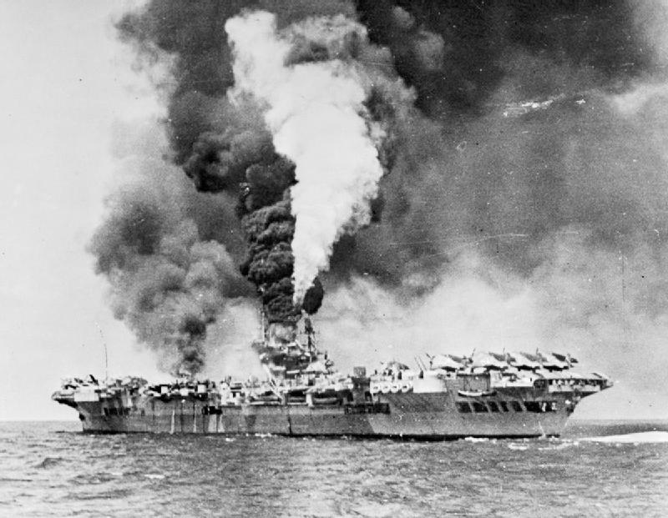
An Aircraft Carrier Hit By Kamikaze Planes – 1945.
© 2015 Brain Wrinkles

Slide 12
Iwo Jima
In February 1945, American forces invaded the island of Iwo Jima.
The island was important because it was close to Japan and it was a good place for US planes to land.
The Japanese protected the island with traps and underground tunnels.
It was a fierce battle, but the US Marines eventually took the island.
© 2015 Brain Wrinkles

Slide 13
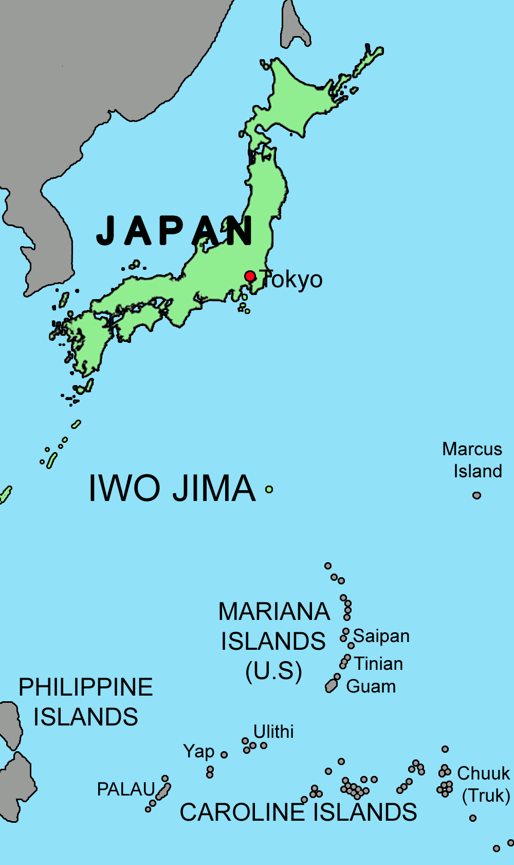
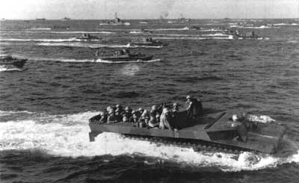
US Marines Approach Iwo Jima.
© 2015 Brain Wrinkles

Slide 14
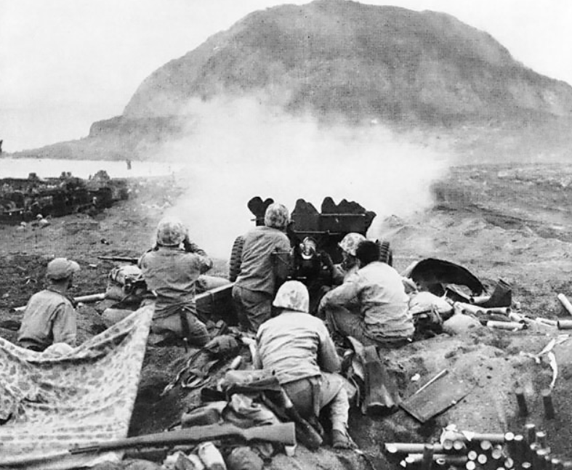
US Marines Fire at Japanese Cave Positions in Iwo Jima.
© 2015 Brain Wrinkles

Slide 15
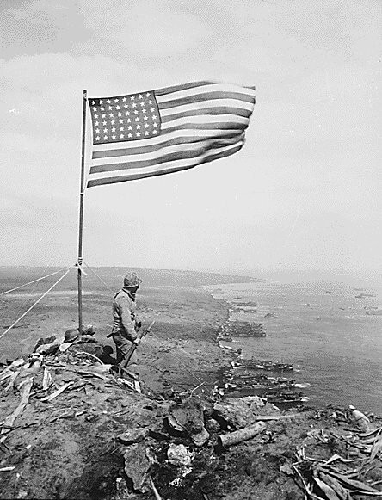
US Marines finally reached the highest point on the island and raised the American flag in victory.
© 2015 Brain Wrinkles

Slide 16
Atomic Bombs
The Allies thought about invading Japan, but were worried that too many soldiers would die.
President Harry Truman made a difficult decision to use nuclear weapons against Japan.
He warned the Japanese government to surrender, but they refused to give up.
© 2015 Brain Wrinkles

Slide 17
Atomic Bombs
On August 6, 1945, an American bomber plane dropped the first atomic bomb ever used in war on the Japanese city of Hiroshima.
A few days later, the US dropped a second bomb on Nagasaki.
Both cities were completely devastated, and the Japanese finally agreed to surrender.
Japan is the only country in the world that has been attacked by nuclear weapons.
© 2015 Brain Wrinkles

Slide 18
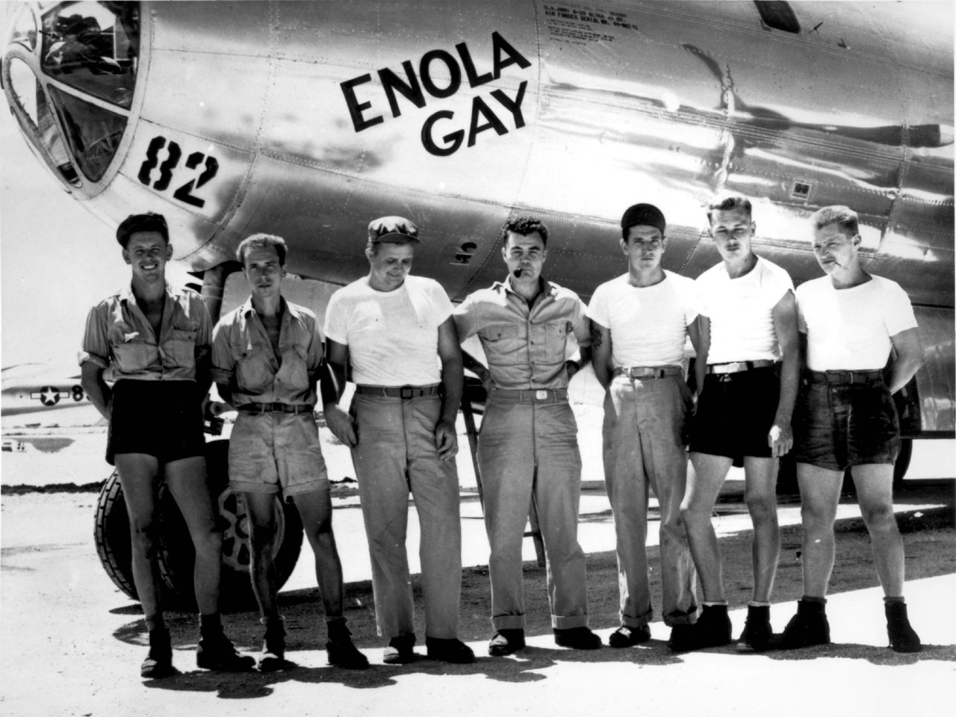
The Enola Gay dropped the “Little Boy” Atomic Bomb on Hiroshima.
© 2015 Brain Wrinkles

Slide 19
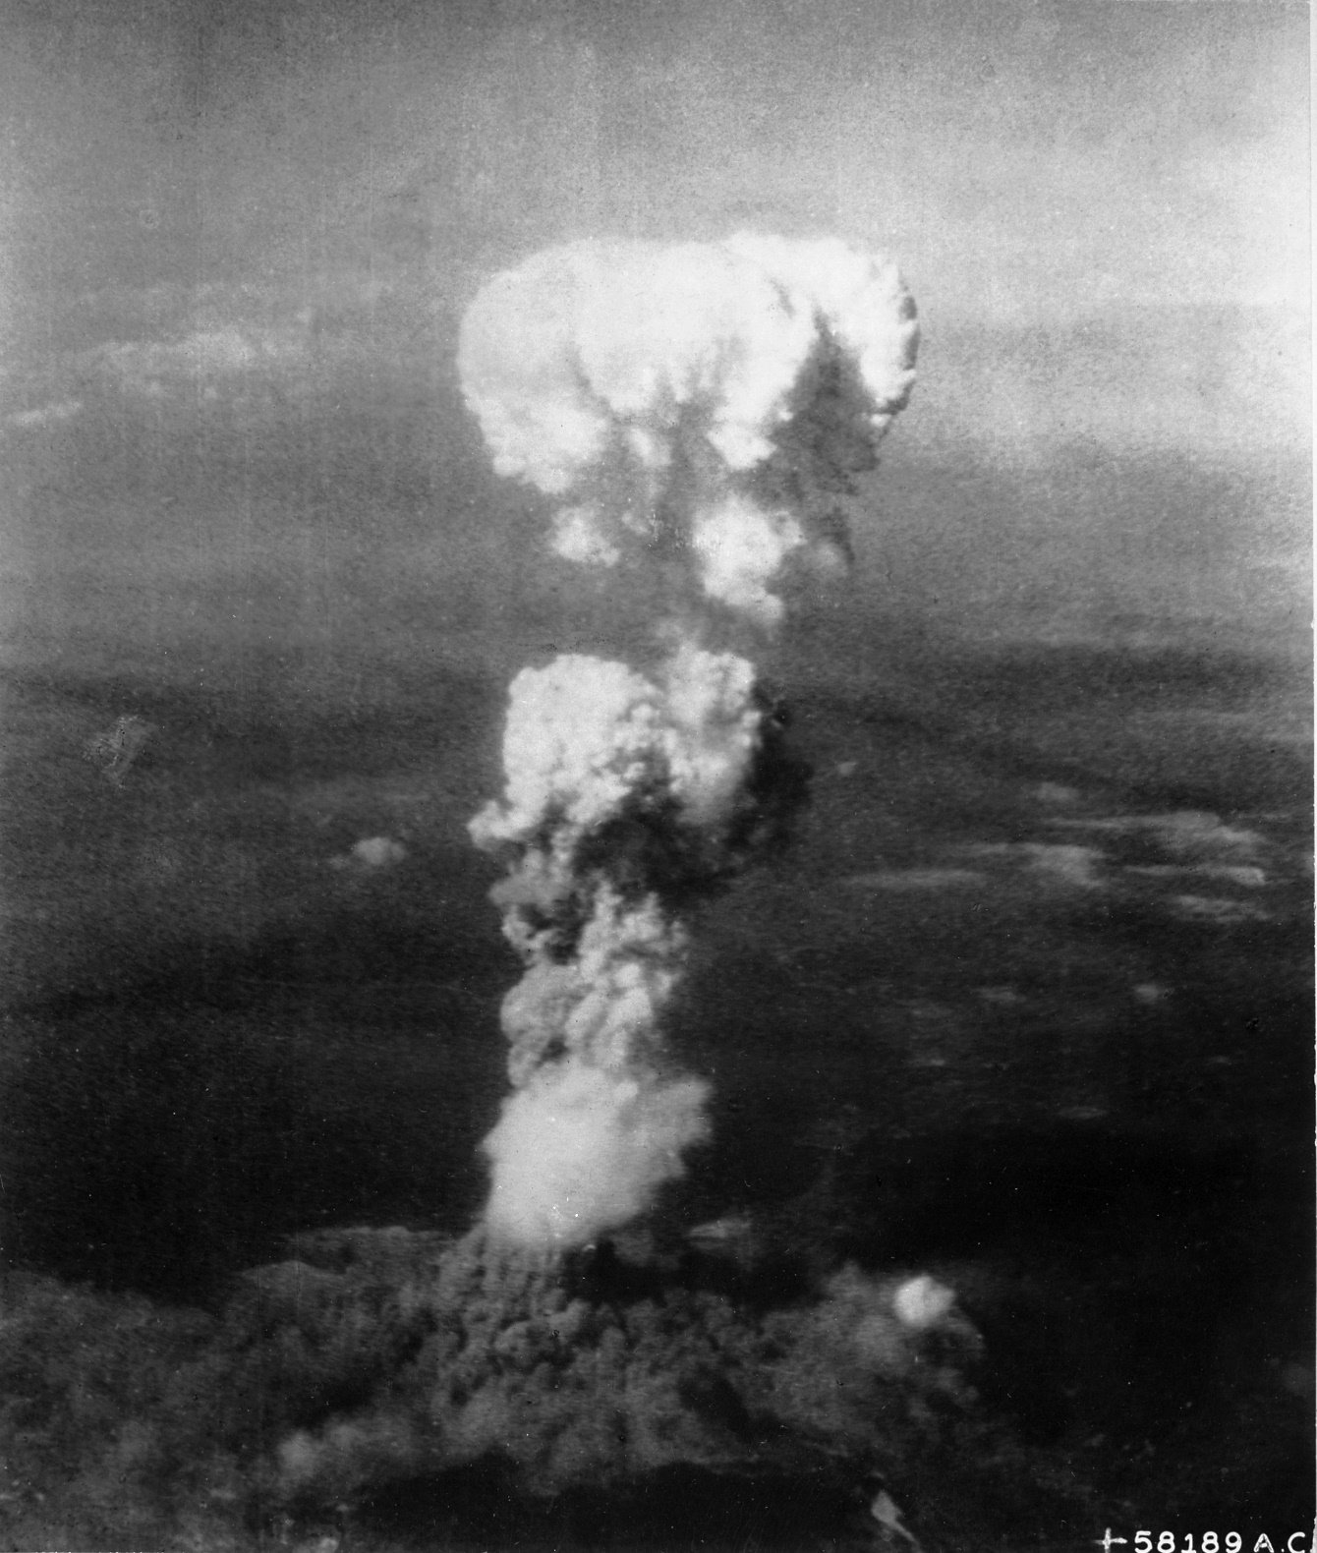
Mushroom Cloud Over Hiroshima.
© 2015 Brain Wrinkles

Slide 20
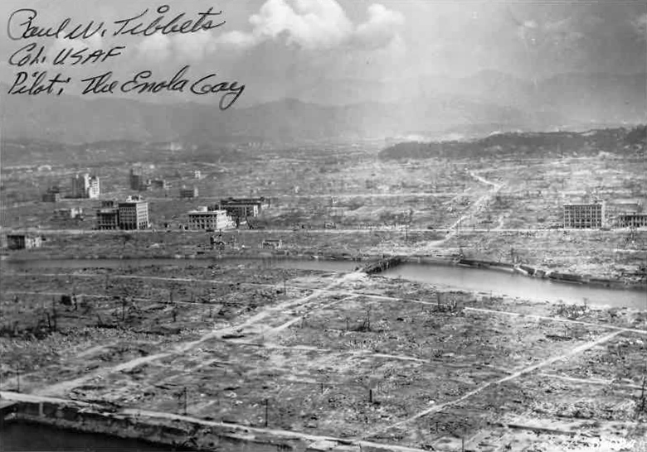
Hiroshima Aftermath
© 2015 Brain Wrinkles

Slide 21
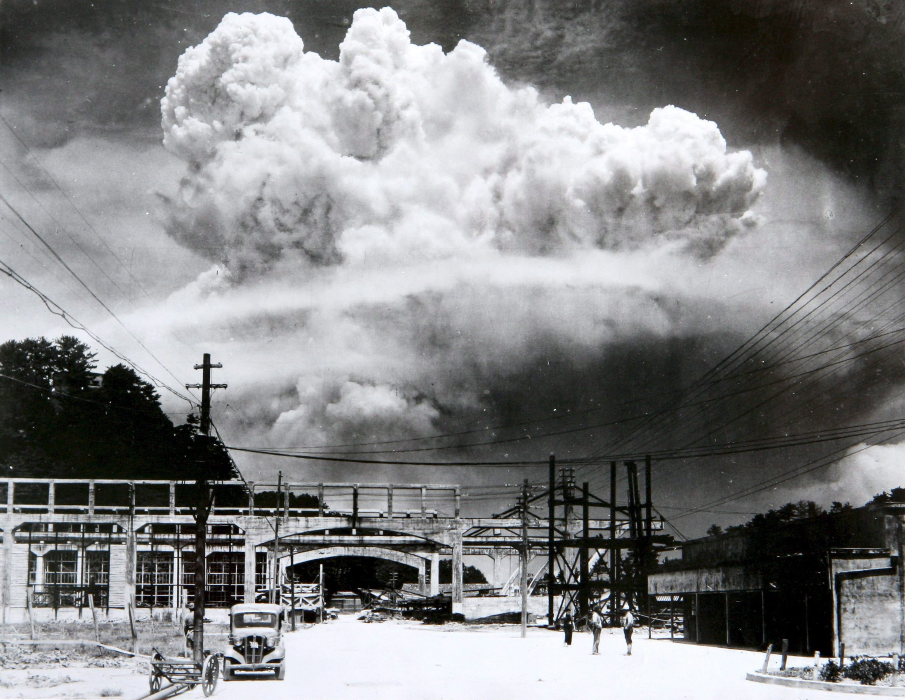
Mushroom Cloud Over Nagasaki.
© 2015 Brain Wrinkles

Slide 22
VJ Day
The two sides signed formal surrender papers on the US battleship Missouri on September 2, 1945.
This day is officially known as VJ Day – Victory in Japan Day.
© 2015 Brain Wrinkles

Slide 23
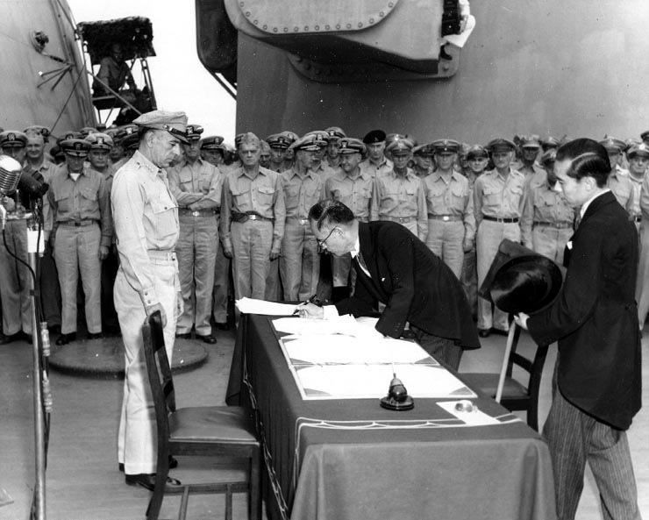
Japan Surrenders Aboard the USS Missouri,
September 2, 1945.
© 2015 Brain Wrinkles

Slide 24
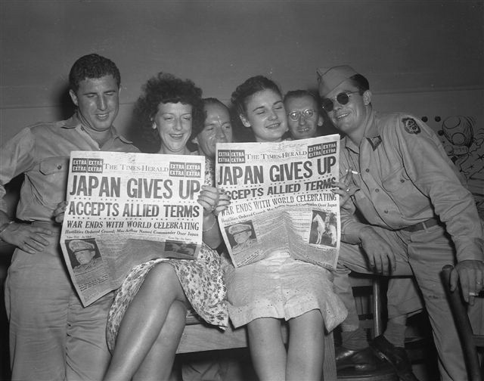
© 2015 Brain Wrinkles

Slide 25
Rebuilding
Japan
© 2015 Brain Wrinkles

Slide 26
Destruction
After Japan’s surrender, Japan’s economy and government were devastated.
Industries and farms were destroyed and the emperor was exposed as a mere mortal and not a god.
The country’s infrastructure (transportation, communication, sewage, water, and electric systems) was demolished.
© 2015 Brain Wrinkles

Slide 27
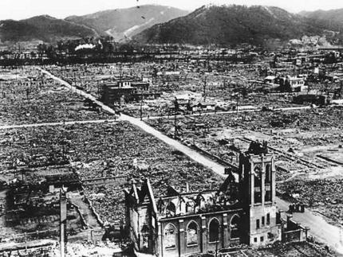
© 2015 Brain Wrinkles

Slide 28
US Occupation
The US had a plan to occupy and rebuild Japan in a way that would guarantee the country would not pose a military threat to others in the future.
General Douglas MacArthur was sent to oversee Japan’s restoration.
The US occupied Japan from 1945 to 1952.
© 2015 Brain Wrinkles

Slide 29
MacArthur’s Help
General MacArthur ordered Japan’s military to be disbanded and closed all weapons factories.
He also directed that government and military leaders involved in World War II were brought to trial and punished.
In addition, MacArthur helped Japan install a new democratic government.
© 2015 Brain Wrinkles

Slide 30
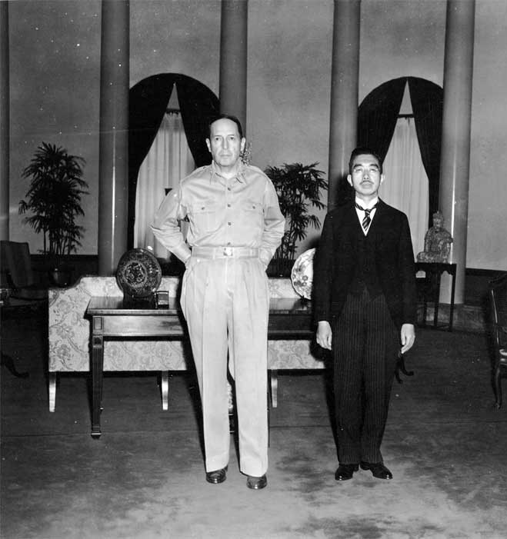
General Douglas MacArthur
and
Emperor Hirohito
© 2015 Brain Wrinkles

Slide 31
Government
MacArthur decided that Japan would be a constitutional monarchy in order to preserve the emperor’s role in the country’s culture.
He wrote Japan’s constitution, still referred to as The MacArthur Constitution, and it is still considered one of the most democratic documents in the world today.
The constitution set up a two-house parliament called a Diet.
Japanese citizens were granted many of the same rights as American citizens.
© 2015 Brain Wrinkles

Slide 32
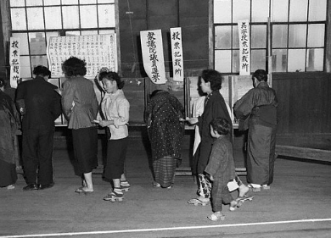
Elections in Tokyo
1952
© 2015 Brain Wrinkles

Slide 33
Reparations
Japan’s constitution also prevents the country from declaring war of fighting with other countries (unless they are attacked first).
After signing the new constitution, the Japanese government pledged to pay reparations to the countries that they harmed during WWII.
The Japanese were also not allowed to rebuild their military in any way.
© 2015 Brain Wrinkles

Slide 34
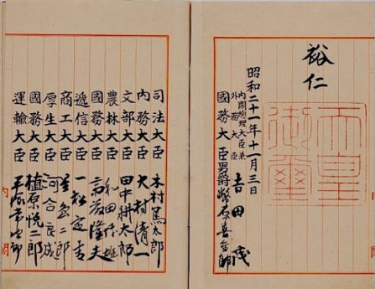
Japan’s Constitution
© 2015 Brain Wrinkles

Slide 35
Economy
The US offered financial support to help kick start Japan’s economy after WWII.
This money coupled with a strong Japanese work ethic led to a boom in Japan’s economic growth.
Much like the US, Japan leans towards a market economy, which motivates its citizens to develop new ideas and expand businesses.
© 2015 Brain Wrinkles

Slide 36
Japan Today
On April 28, 1952, Japan became a fully sovereign nation.
America’s occupation and MacArthur’s rebuilding of Japan has had a positive lasting effect.
Today, the country has one of the most stable democratic governments in the world.
Japan also has one of the most powerful industrialized economies in the world.
© 2015 Brain Wrinkles

Slide 37
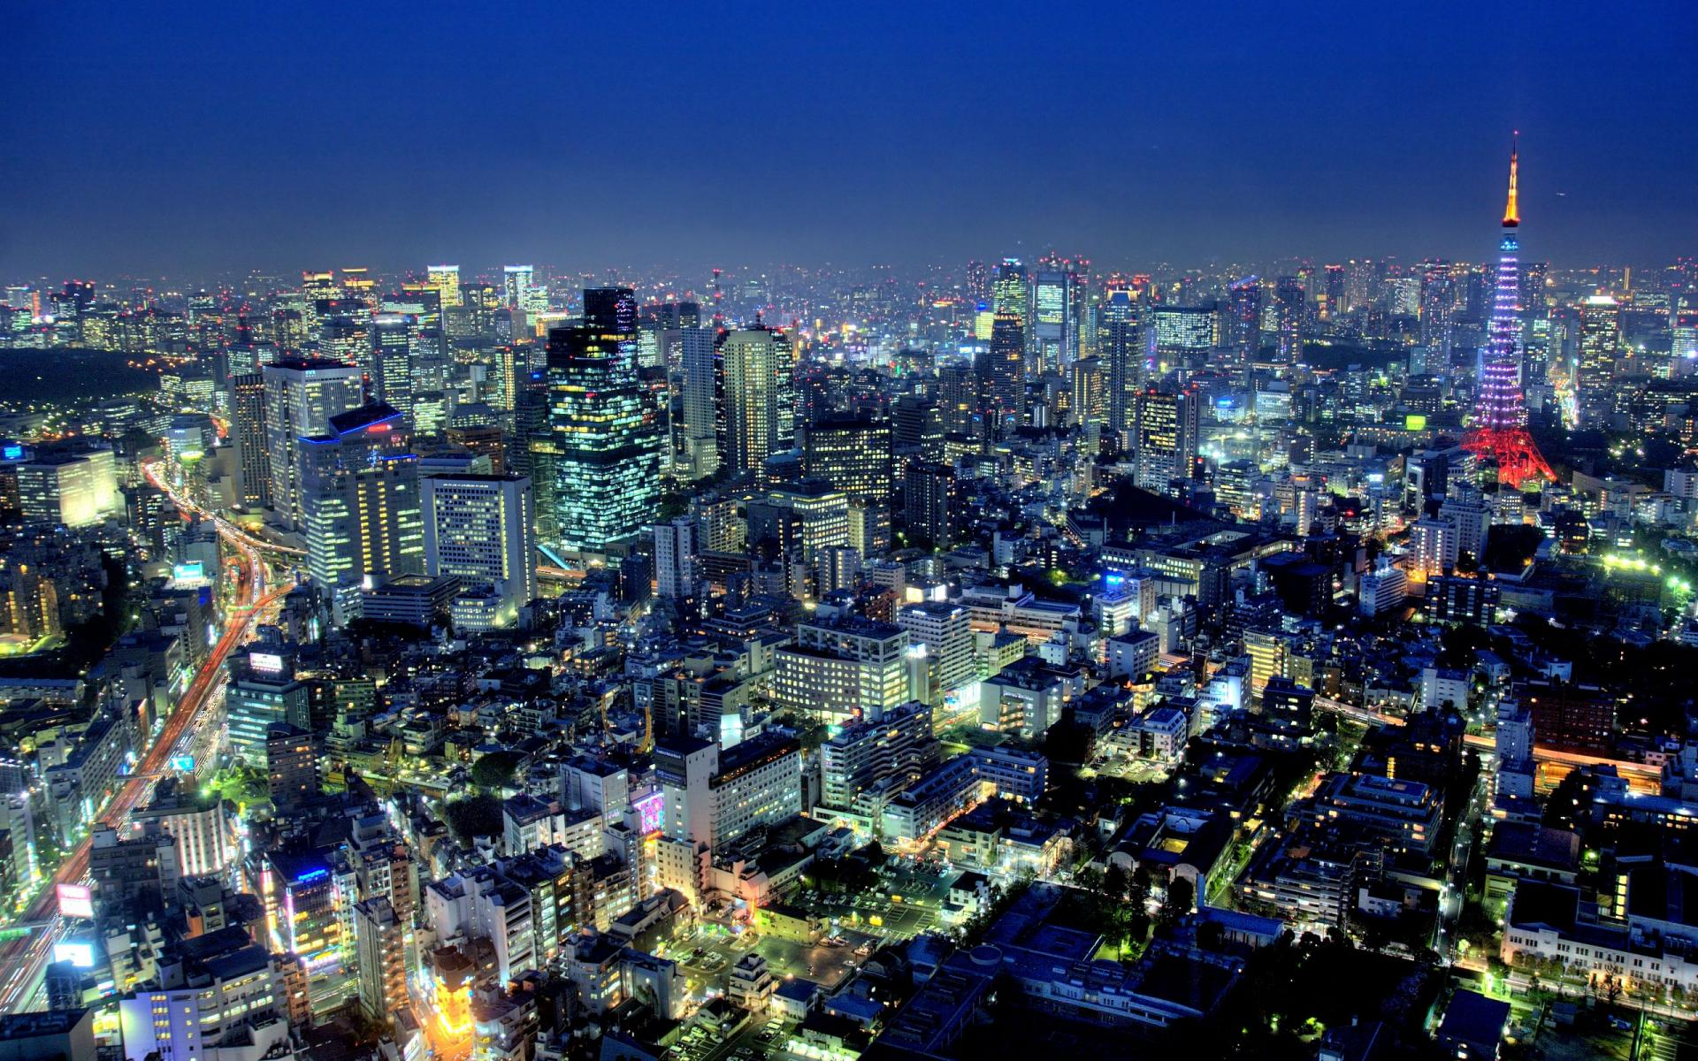
Tokyo, Japan
© 2015 Brain Wrinkles

