Slide 1
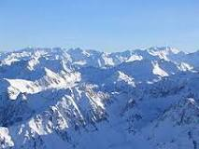
Pyrenees mountains
This beautiful landform is located between France and Spain. This mountain is inorganic, a part of earth’s materials, made uniformitarianism, this mountain is a nonrenewable resource, and this mountain is formed with strata too. I got this information from www.google.com .

Slide 2
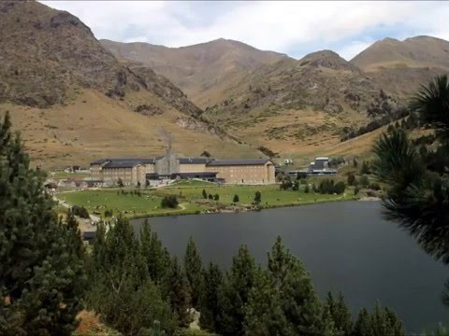
the uses of trade in the Pyrenees
The Pyrenees mountains are used to separate both of the states. It also separates the Iberian peninsula from the rest of the continental Europe. The Pyrenees mountains impacts trading by blocking the people from trading by land. The Pyrenees mountains is a good place to hike, sight see, and etc. you can find this information on www.encyclopedia.com .

Slide 3
Ratios & proportions
The agricultural use for the Pyrenees mountains is that you can grow plants. This information is from www.google.com
Word problems
1. Timothy is doing a diorama on the Pyrenees and he is trying to make it life size and the actual length is 430km. Each day he built 1km his project. how many days did it take for timothy to build his diorama? ________________________
2. Jeffery is trying to write as long as the Pyrenees mountains and he can write 24 words a second. It took him some years to do it. How many words did he write in 1,234 seconds?____________________________________________

Slide 4
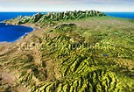
The formation of the Pyrenees
The Pyrenees mountains was formed in 80 million years to 200 million years. The mountains were formed uniformitarianism. This mountain was formed in the tertiary period. It took a long for the mountain to form and it was also formed with strata's. I found this at www.youtube.com .

Slide 5
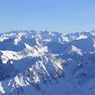
Additional notes & research
The Pyrenees mountains can stretch any where from 430km and rising higher than 3,400m tall
The type of rock the Pyrenees mountains was formed by granite and gneiss
The highest point of the Pyrenees mountains is called the Pico de aneto
On a map the Pyrenees mountains is located between the Atlantic ocean and Mediterranean sea

Slide 6
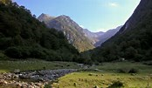
bibliography
www.Encyclopedia.com
www.google.com
www.youtube.com

