Slide 1
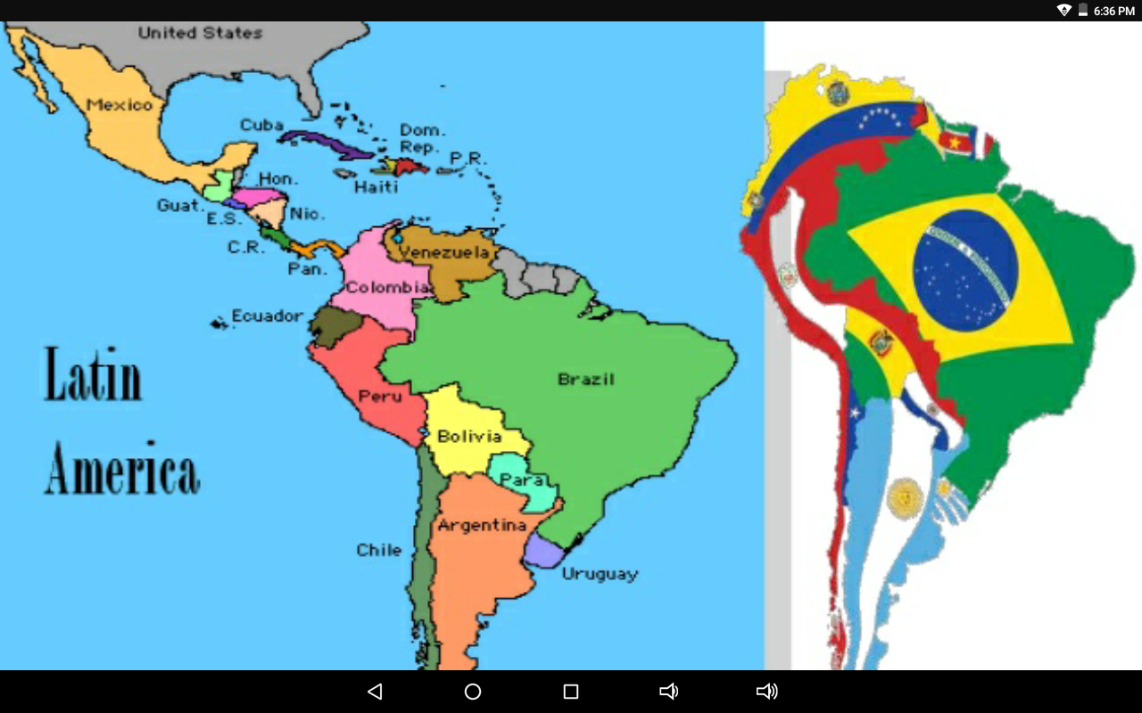
Latian America
By:Robert Lancaster

Slide 2
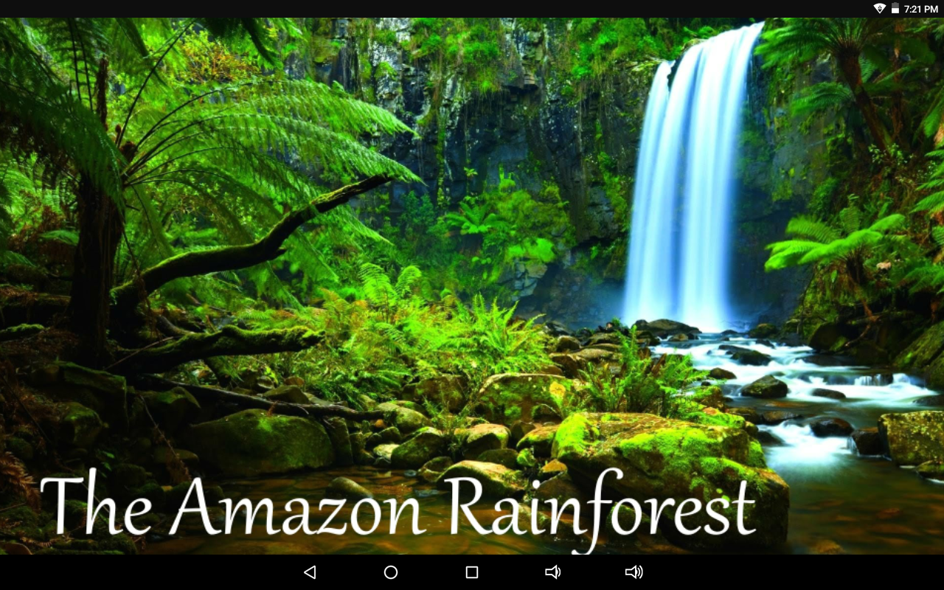
AMAZON RAINFOREST
The amazon rainforst covering much of northwestern Brazil and extending into colombia, Peru and other south america countries, is the world’s largest tropical rainforest, famed for it’s biodiversity. It’s crisscrossed by thousands of rivers, including the powerful amazom. Cattle ranching is the leading cause of deforestation in the amazon rainforest.In Brazil, this has been the case since at least the 1970s. The government figures attributed 38 percent of deforestation from 1966-1975 to brgescale cattle ranching.

Slide 3
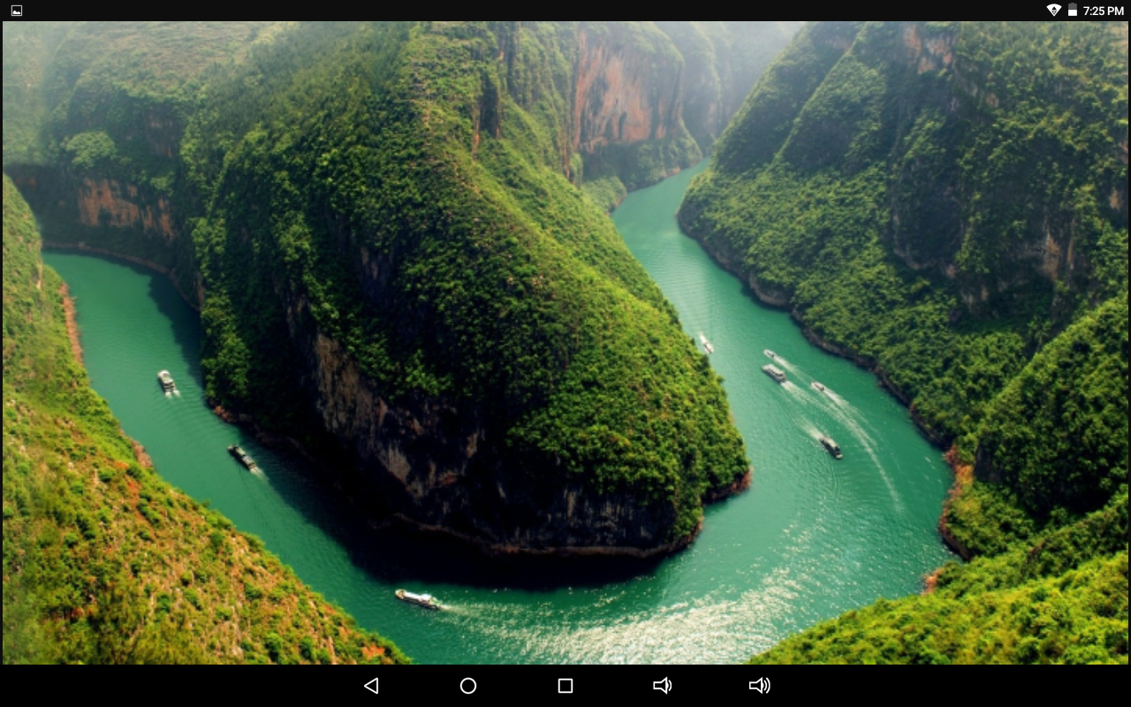
Amazon river
The amazon basin,the largest in the world, covers about 40 percent of south america. It flows from west to east, from lquitos in Peru, acroos brazil to the Atlantic.The amazon river is located in south america. It runs though Guyana, Ecuador, Venezuela, Bolive, brazil colombia and peru. The largest city along the amazon river is manaus.

Slide 4
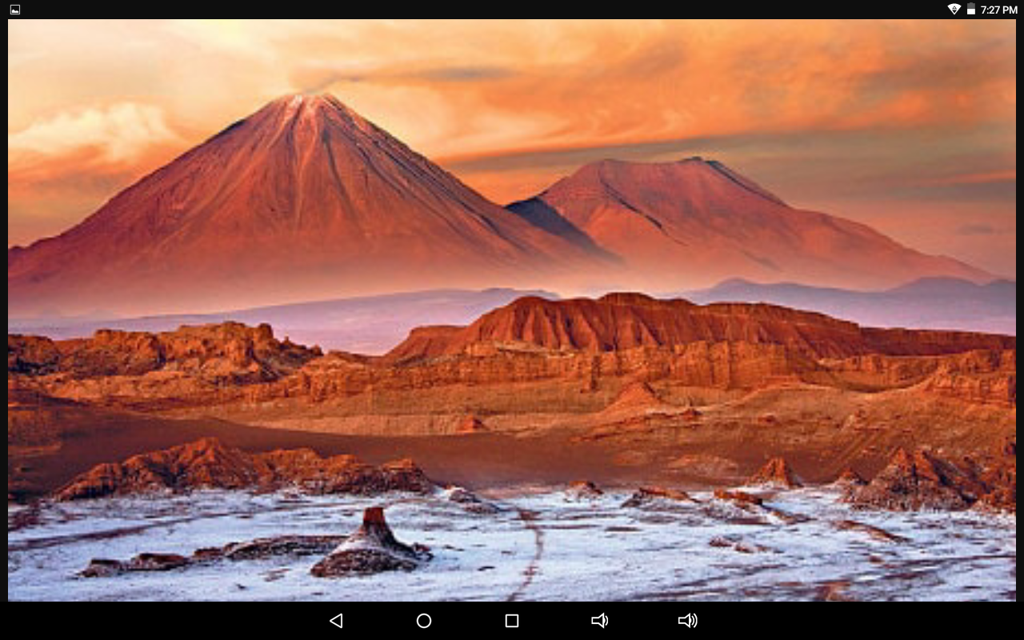
Atacama desert
The atacama desert is a plateau in south america, covering a 1,000 kilo which is 600 mi strip of land on the pacific coast,west of the andas mountains. The atacama is between two mountain chains the chilean coast range of suffcient height to prevent moisture advection from either the pacific or the atlantic oceans, a two-sided rain shadow.

Slide 5
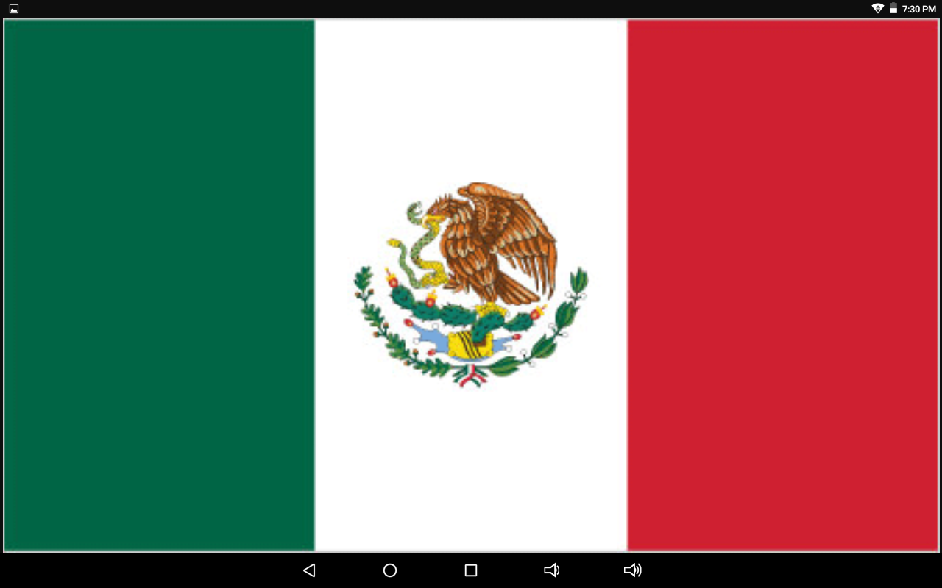
Mexico
Mexico the united mexican states is a federal republic in the southern half of North America. It is bardered to the north to the south and west by the pacific ocean to the southeast by guatemala, belize, and the caribbean sea, and to the Gulf of Mexico. Mexico is the sixth largest country in the Americans by total area and the 13th largest independent nation in the world

Slide 6
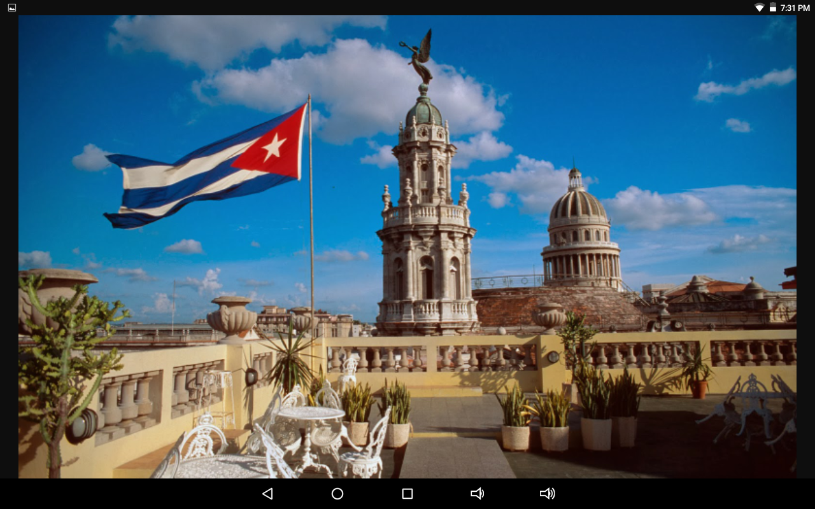
Cuba
Cuba is located in the northern caribbean where the caribbean sea, the Gulf of Mexico, and the Athntic Ocean meet. Cuba is south of both thhe U.s, florida and the Bahamas ,west of Haiti and north of Jamaic. Cuba is the Largest island in the caribbean.Cuba,also called the key to the Gulf, is the largest island of the west indies and one of the largest in the world

Slide 7
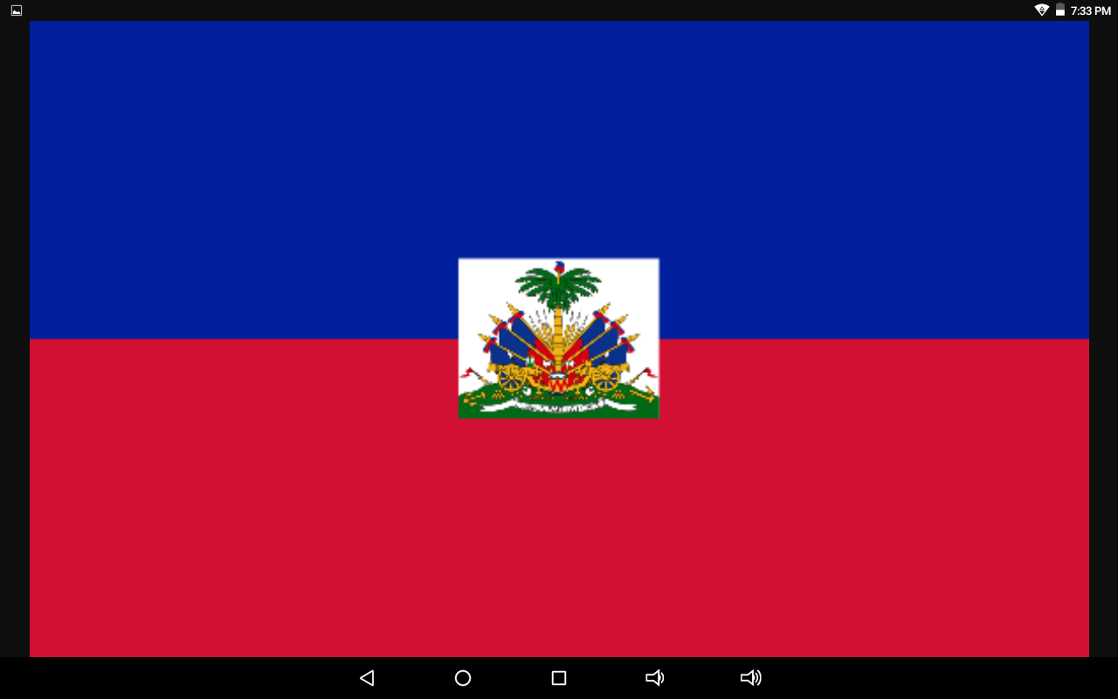
Haiti
Haitii is a caribbean country that shares the island of hispaniola with the dominican republic to its east. As a former french colony, the blue and red colors are modeled after the french tricolore.

Slide 8
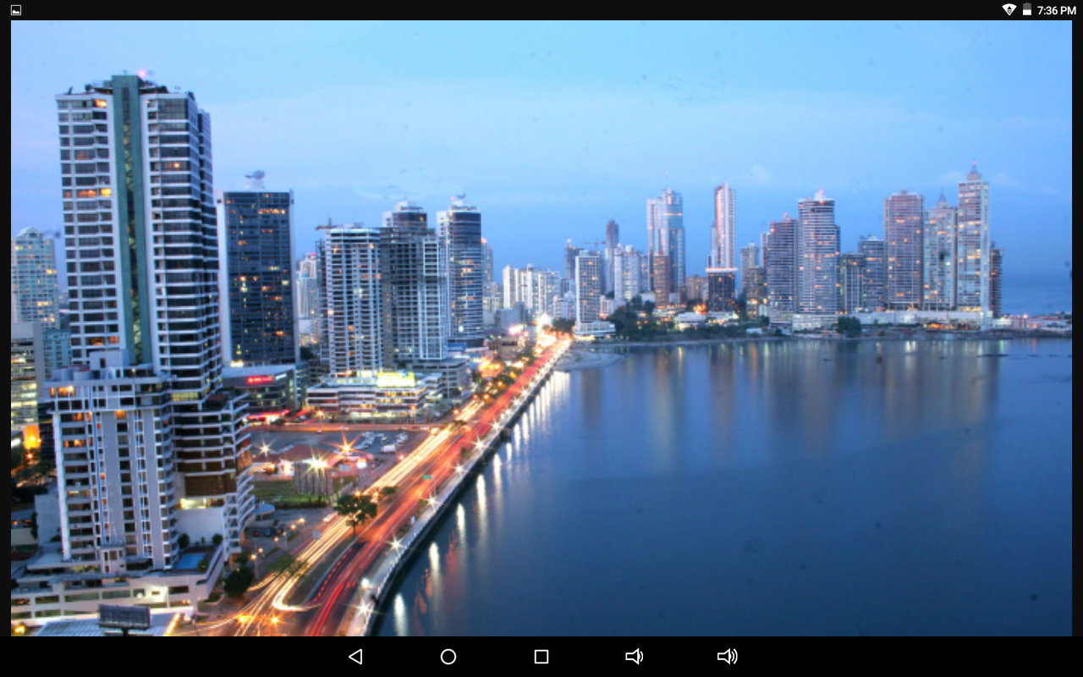
Panama
Panama is a country on the isthmus linking central and south ameruca. The panama canel, a famous feat of human engineering, cuts through its center, linking the atlantic and pacific oceans to create an shipping route. Panama, officially called the republic of Panama, is a country usually considered to be entirely in north america or centrak america. It is bordered by costa Rica to the west and colombia to the southeast

Slide 9
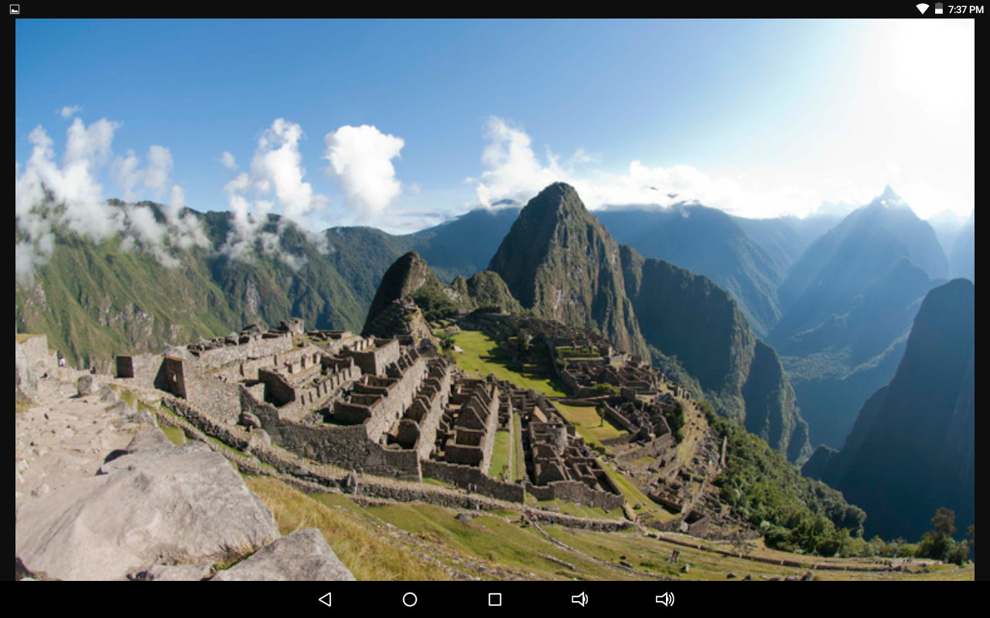
Colombia
Colombia is a country at the northern trip pf south america. It’s land scape is mared by rainforestes, Andes mountains and numerous coffee plantations. Cartagena, on the caribbean coast, has a walled colonial old town a 16th country castle and nearby cural reefs

Slide 10
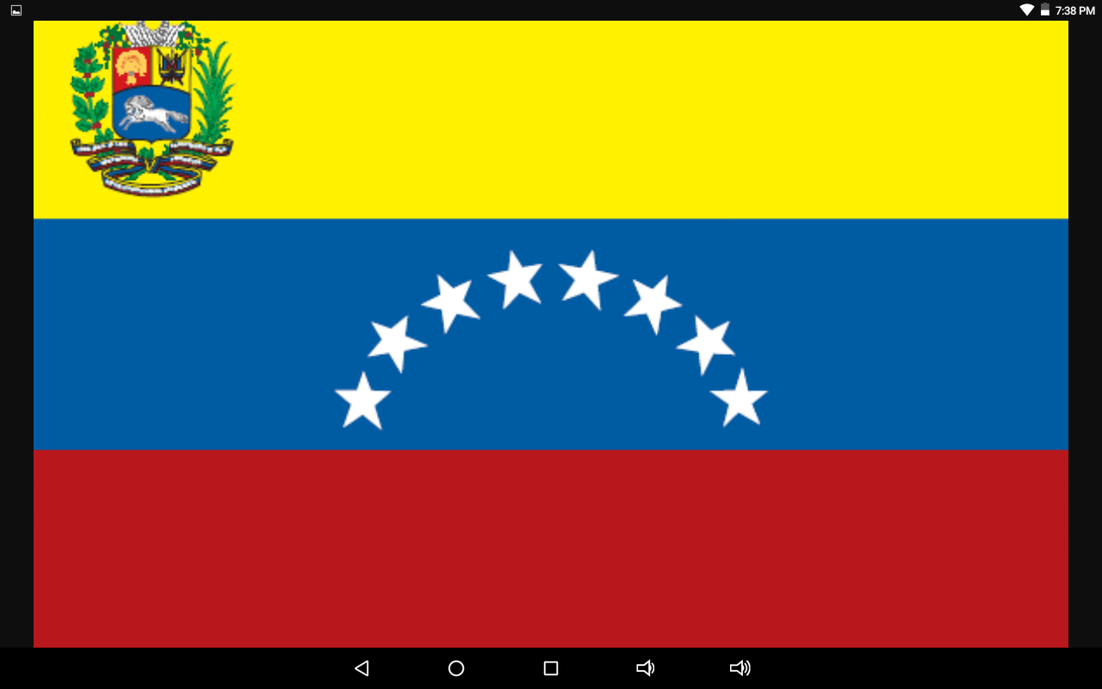
Venezuela
Venezuela is a country in the northern coast of south america with diverse natural attractions. Venezuela officially the bolivarian Republic located on the northern coast of south america. It was bordered by colombia on the west, Brazil on the south and Guyana on the east.Bolivia is a country in central south america, with a varied terrain spanning andes mountains, the atacame desert and amazon basin rainforest.

Slide 11
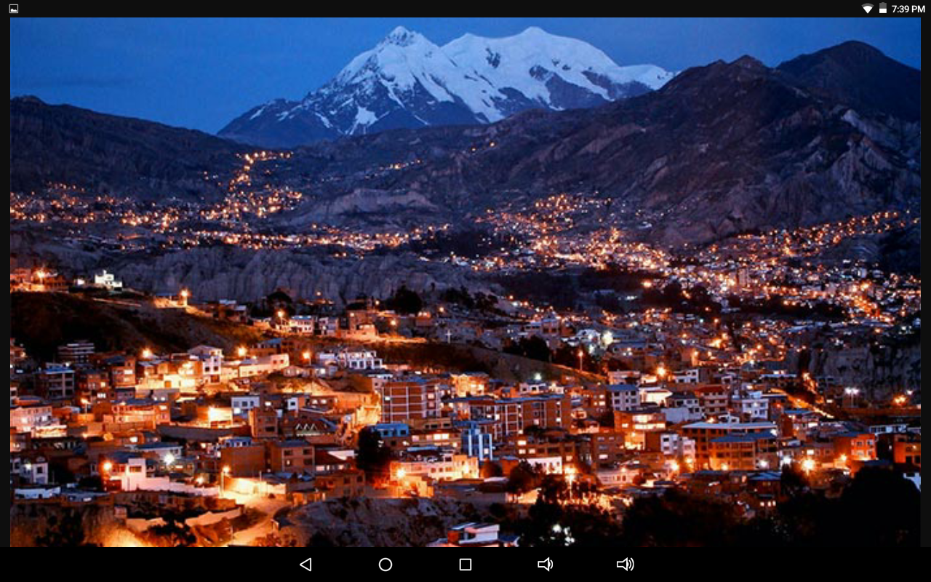
Bolovia
Bolivia offcially known as the plurintional state of boliviaa is a landlocked country located in western-central south america. It is bodered to the north and east by brazil,southwest by chile, and nrthwest by peru. Bolivia is geographically the largest state landloked country in the americas.

Slide 12
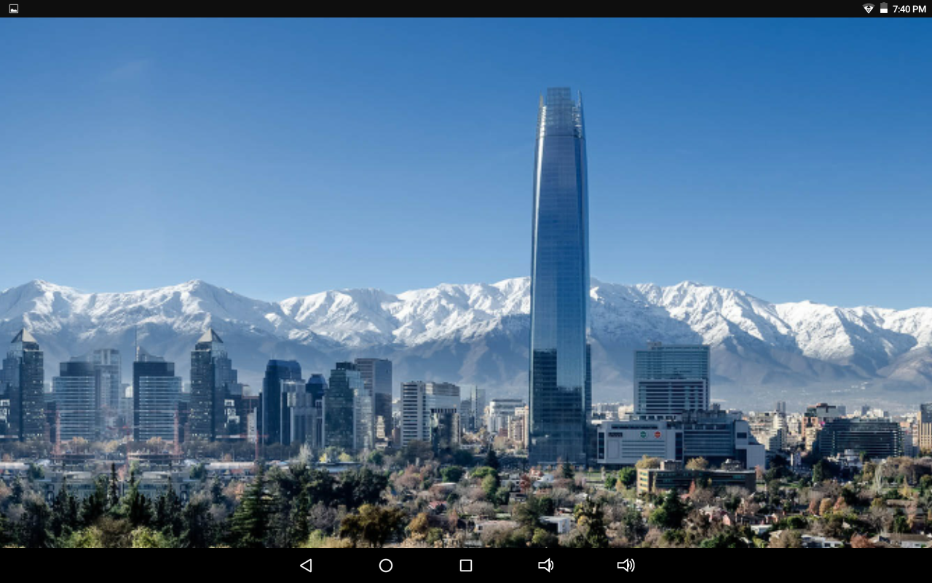
Chile
Chile officially the republic of chile is a south american country occupying a long, narrow strip of land between the ades to the northeast andargentina to the east. The atacama desert in northern chile contains mineral wealth, pincipally copper.

Slide 13
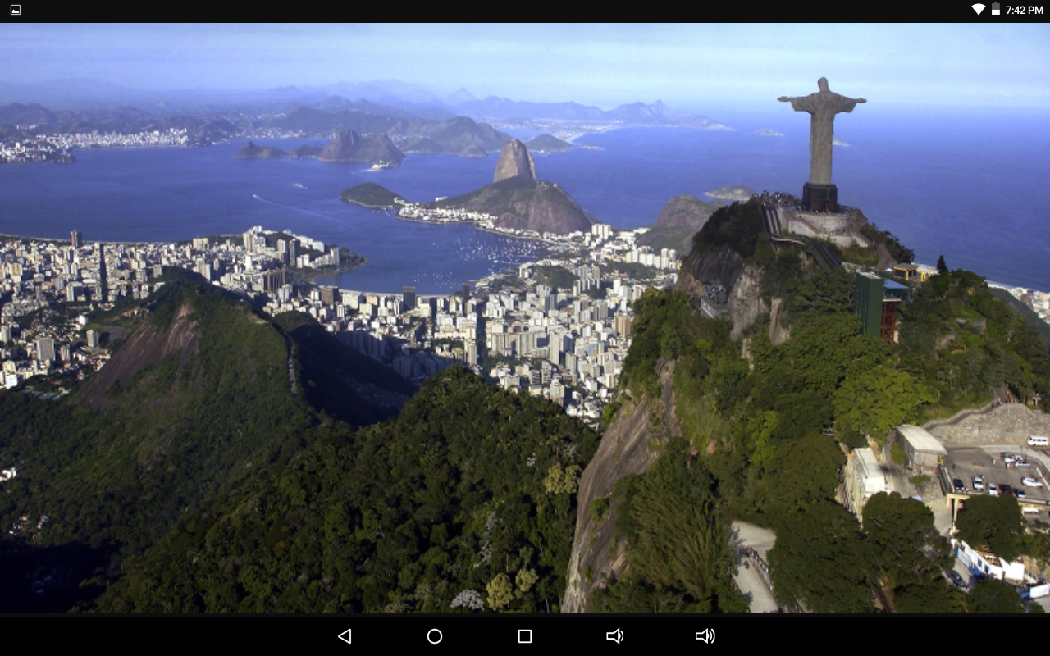
Brazil
Brazil officially the united mexican states is a federal republic in the southern half of north america.The flag is green, symbolic of Brazil’s lush fields and forests. Its primary feature is a large yellow diamond, symbolic of Brazil’s wealth in gold, and in its center floats a blue celestial globe.

Slide 14
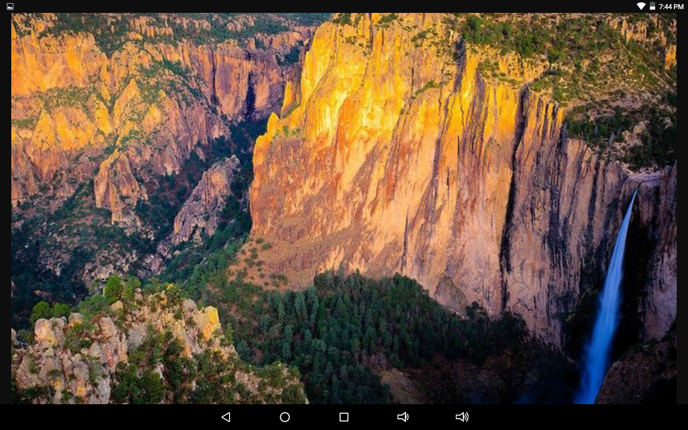
Sierra madre mountains
Sirra madre occidenta is a mountain range in northwest mexico and southern Arizona. Sierra madre oriental, a mountain range in northeastern mexico. The sirra madre ociental is part of ranges that form the western “backbone” north america, south america, central america, and antarctica.

Slide 15
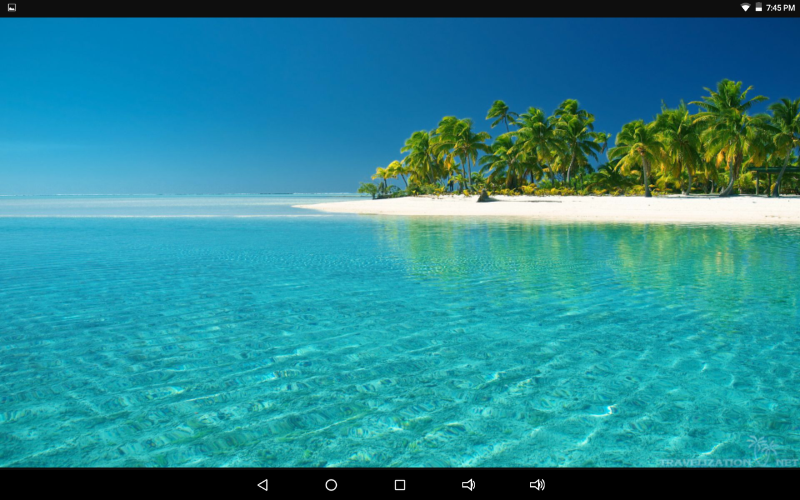
Caribbean sea
The caribbean sea is a sea off the atlantic ocean in the tropics of the western hemisphere. It is bounded by mexico and central america to the west and southwest, to the north by the greater antills stating with cuba, to the east by the lesser antilles, and south by the north coast of south america.

Slide 16
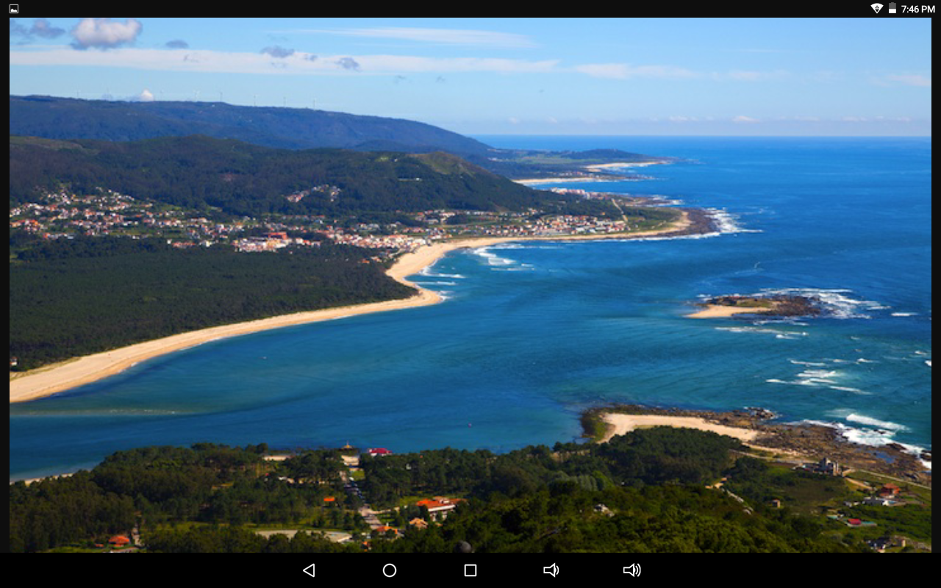
Gulf of mexico
The gulf of mexico is an ocean basin largely surrounded by north american continent. It is bounded on the northeast, north and northwest by the gulf off coast of the united states, on the southwest and south by mexico, and on the southeast by cuba.

Slide 17
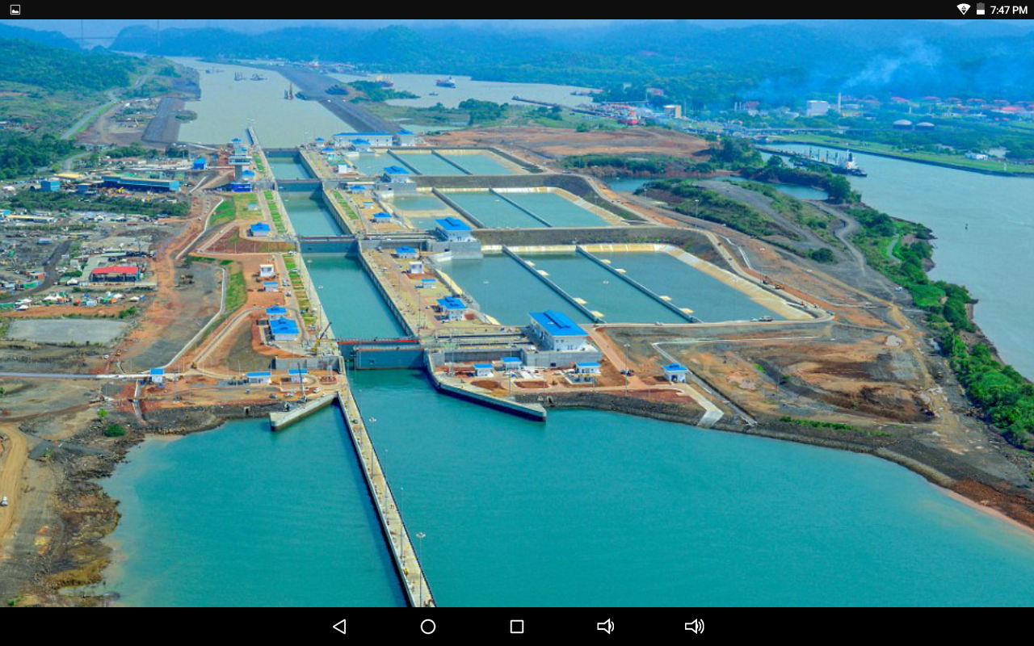
Panama canal
The panama canal is an artifical 48 mile waterway in panama that connects the atlantic oceaan woth the pacific ocean. The canal cuts acroos the isthmus of panama and is a key condult for international maritime trade. The expande canal began commerdal operation on june 26 , 2016. The new locks alloco transit of larger, post panamax ships, copable of handling more cargo.

