Slide 1
The nile river
By Caleb Hepburn 7B

Slide 2
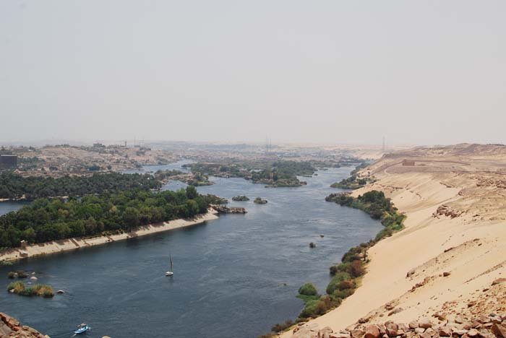
Landforms and uses
The location of the nile river is northern africa.
A very vital use for the nile river is flooding it creates a firtile green valley.
The river runs through Egypt,Tanzania, Uganda and Rwanda
When the nile river floods and creates a firtile valley the crops grown in the valley are used to trade and sell

Slide 3
Ratios and proportions
IF the nile river is 4,258 miles long whats half the length of the nile river
2,129
If the nile river is 2 miles wide how long is it in meters
2.8 kilometers

Slide 4
Formation
The nile river was formed though the joing of the white nile and the blue nile
The nile river emptys in to the medaterin sea
The nile was created ancient times and is to my knowledge still unknown
Like I said in first slide the nile runs through several countries before joining together and becoming the main nile river

Slide 5
Resources and effects
he nile weathers and erodes rocks and other minerals in and close to the river
The nile benefits living thing by providing drinking water and water for plants to grow
When the ne floods it creates a firtile green valley for farming and grasing

