Slide 1
The Nile river

Slide 2
The Nile River is 4132 miles long. It is the longest river in the world. To trade people sailed up and down the river trading goods. The Nile also created good farming land.

Slide 3
People don't have water houses on the Nile because the Nile has over 1,000 diseases. People live on the banks of the Nile so that they can grow crops. The ratio would be 1:1 1/1 or 1to1.
Word problems(you have to answer it)
The teacher told jimmy that 1033 times what number would get you how long the Nile river is.
The teacher also said 2066 times what number would tell you how long the Nile river is.

Slide 4
Erosion is common in the Nile because of all the water.
Weathering happens a lot too because of the water
The sea is rising over sea walls so it is hard for farmers to farm.
Mudslides happen a lot too they slide down hills and can kill people.
Flash floods can happen with little rain it happens when there is a build up and then it all just flows out.

Slide 5
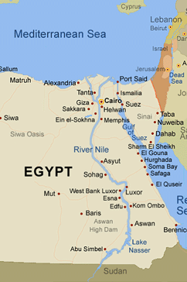
This is a picture of the Nile river.

Slide 6
The white Nile and the blue Nile
The white Nile flows for about 500 miles and joins with the blue Nile.
The blue Nile flows from Sudan and joins the white Nile.

Slide 7
Some resources in and on the Nile are rubber, and coffee shrubs.
Every year the banks get flooded because of rain in the highlands.
Water is the only non living resource because the Nile is very alive.

