Slide 1
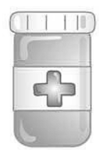
Water Issue Prescription
Directions: You are the doctor! Write a prescription to cure one of the Southwest Asian countries’ water “ailments”.
Name: ______________________
MD Signature:___________________________________
Ailment:
Prescription:

