Slide 1
“PAN”-Africanism
Pan Africanism: is the idea of a global African community working for African independence and prosperity.
This world African community is made up of former slaves and native African emigrants all over the world that come together and work for the common cause of freedom.
The Pan-African movement called for unity among all black people for the betterment of Africa.

Slide 2
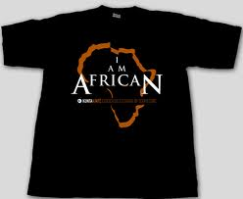
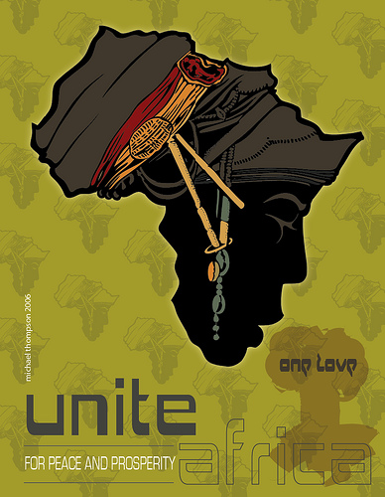
Africans adopted the rallying cry “Africa for Africans”
The Pan African movement began in the early 19th century (1800’s) when black intellectuals called for self rule.

Slide 3
Pan Africanism: How did it start?
The drive for African independence :
Many Africans resented European presence and control over their land
Unequal rights under colonialism fueled African desire for self-rule
Europeans exploited African lands & resources
African societies and cultures were looked down upon by Europeans

Slide 4
Outcome of the Pan African Movement
Brought about the end of colonialism in Africa and to the development of the African Union (AU) – the AU works for African unity, peace, human rights, and cooperation among African countries
Native Africans felt a bond that helped lead to nearly all African nations becoming free of European rule by the late 1980’s, but it has failed to unite Africa as a continent.

