Slide 1
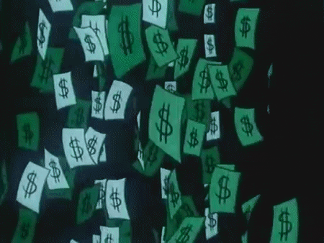
The currency EXCHANGE
SS6E2: Students will discuss money
By: Karsen, Jordan, Joshua

Slide 2
If you need to take notes this will be by it

Slide 3
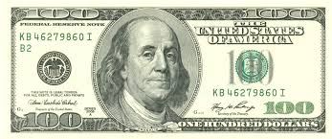
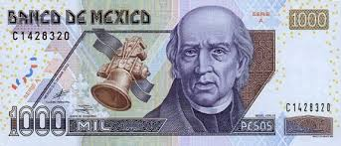
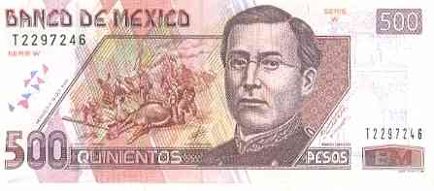
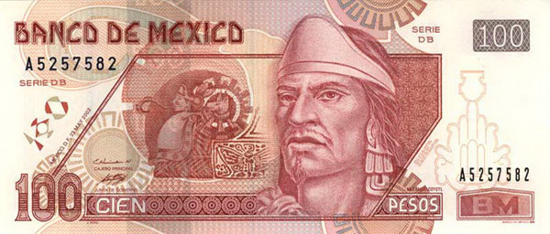
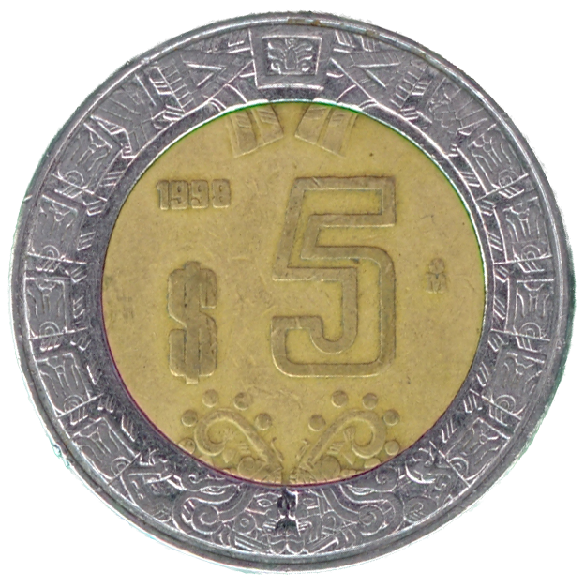
The currency exchange
The currency exchange- when you come from a country and exchange it for that countries currency.

Slide 4
Country | Currency
Japan | Yen
Germany and France | Euro
England | Pounds
America | American dollars
Belize | Belize Dollars
Mexico | Pesos

Slide 5
One dollar in ………
One dollar in Nigeria is worth 199.25 Nigerian Nairas
One dollar in Haiti is worth 61.56 Haitian Gourdes
One dollar in Canada is worth 1.34 Canadian Dollars
One dollar in Belize is 2.00 Belize Dollars
One dollar in Venezuela is 6.35 Venezuelan Bolívarelas
One dollar in Costa Rica is 534.58 Costa Rican Colóns
One dollar in Australia 1.36 Australian Dollars.

Slide 6
Why is this important?
Lets put this into action say if you come from America and you go to Great Britain you would to the currency exchange and exchange your American dollars for English Pounds

