Slide 1
Atlas mountains
By: Iyana dennis

Slide 2
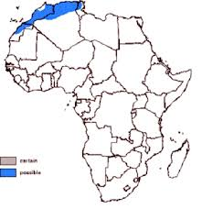
Location and uses
The Atlas mountains are located in north-western Africa.
The mountains run through Algeria, Morocco, Tunisia. The range is about 2,500 km long.
The Atlas mountains are used for their natural resources, fresh waters, and stones. The mountains contains lot’s natural stones that are very popular.

Slide 3
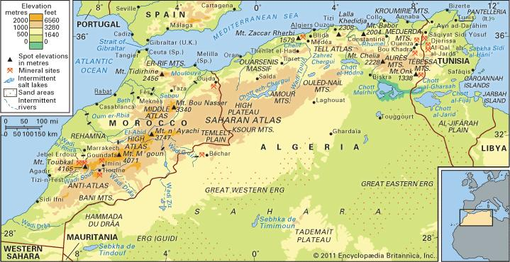
Impact on trade
The Atlas mountains have made a large impact on trade. The mountains natural resources are in high demand in Africa’s surrounding land. The natural resources such as natural gas, coal, marble are well demanded which is making ore money for Africa.
The Atlas mountain creates many natural trade barriers to prevent unwanted people.

Slide 4
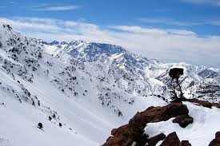
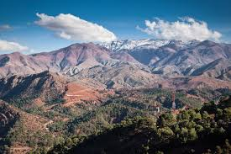
Habitable and unhabitable
Many areas of the Atlas Mountains there are many habitable places. The southern areas of the Mountain range are fairly warm which makes it easier to deal with the climate.
Northern parts of the mountain range are very cold which makes it very unhabitable. Not many plants survive in these harsh conditions of the north. Living in the north would not be a good idea because no plants, no water, and no food.

Slide 5
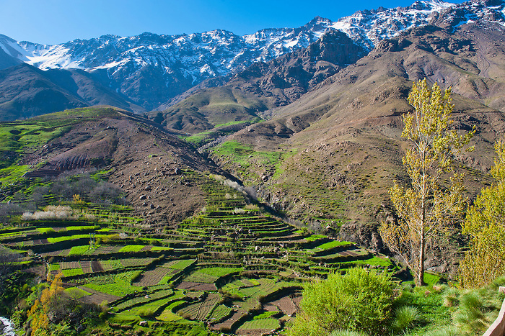
Agriculture use
The Atlas mountains has many agriculture uses. Agriculture in used consistanty in the southern part of The Atlas mountains. The natural landscaping in the Atlas mountains are perfect for farming. The agriculture is used for trade. The plants\vegetables in the Atlas mountains are sold around the world as trade. The agriculture is also used for the mainy native people that live in the mountain ranges.

Slide 6
Solve these problems
Sarah lives in the Eastern area of the Atlas mountains. She is traveling across all of the mountain ranges, she travels 44 miles in 33 hours. How fast is she traveling every hour?
Teala is buying coal from the Atlas mountains’ shop. ‘’Billy’s best coal’’ cost $2 for 4lbs. ‘’Coal best choice’’ cost $3.50 for 7lbs. Which one is the better price?

Slide 7
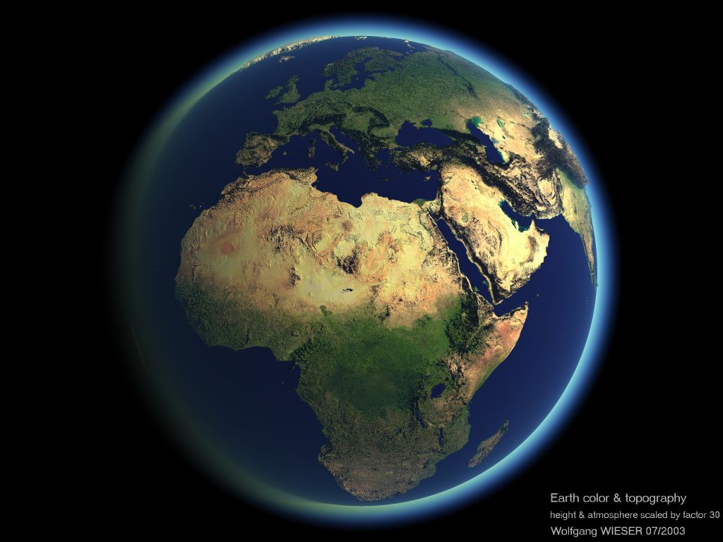
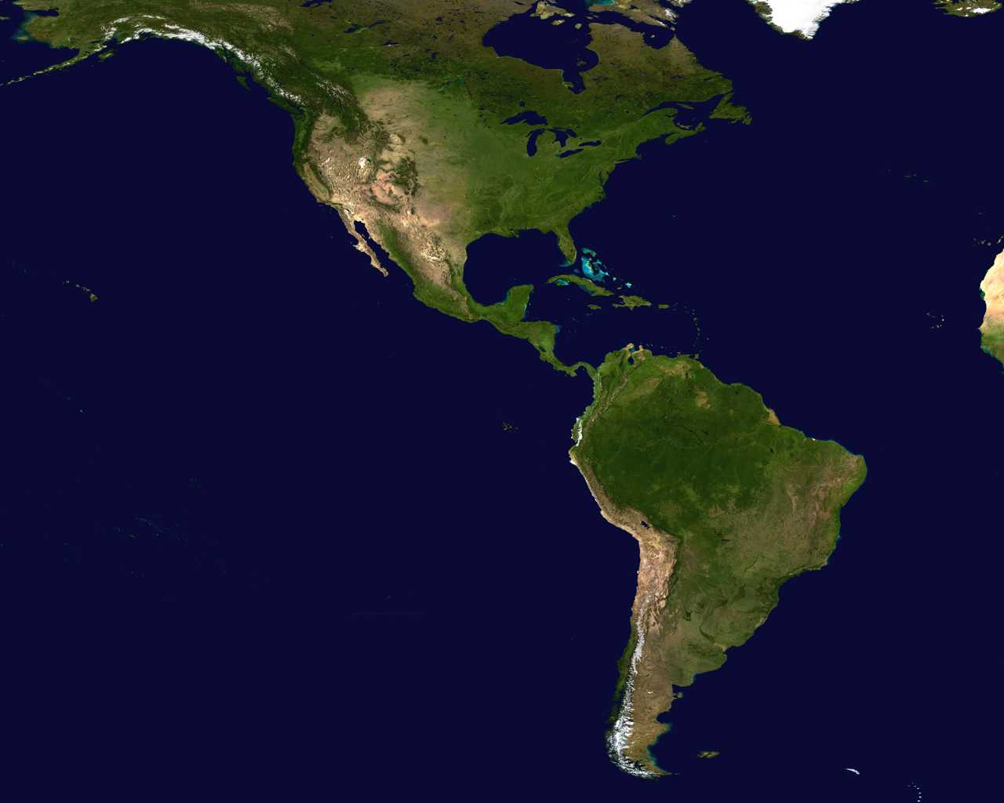
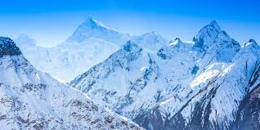
How did the mountains form?
How did they form? There are many different theories of how the Atlas mountains form. What really happened? Millions of years ago Europe, The Americas, and Africa were connected. In the connection process of Africa and America, the Atlas mountains were formed. They later seperated but left behind small pieces of rock, which is now know as the Himalayas.

Slide 8
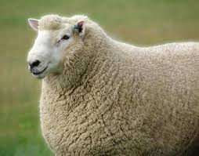
Living resources
The Atlas mountains have many living resources. A few are…..
Soil- the soil is most important part of healthy plants.
Plants- plants are very great trade in the Atlas mountains they are also have very popular demand in trade.
Goats- goats are a great source of protien\milk for people living in the mountains.

Slide 9
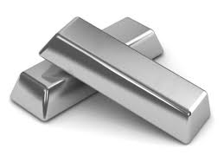
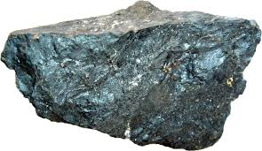
Non-living resources
Coal- coal is very demanded in trade because it is not unlimited.
Natural gas- gas that can’t be made by humans. Good for trade.
Silver- not many places have silver as a natural resource. This makes it very unique.
Iron ore- Very great in trade. Usually rich in iron oxide.

Slide 10
Vocabulary
Resource- source of supply, support, or aid to complete something
Climate- weather conditions
Location- particular place or position
Trade- action of buying and selling goods and services
Natural- caused by nature

Slide 11
notes
The Atlas mountains play a large part in Africa’s history.
The mountain ranges are divided up into 7 sub- regions.
There are very semi-arid mountain ranges.
There is a large human population in the mountain ranges.
The highest mountain in the Atlas is Mount Toubkal. Mount Toubkal measures nearly 14,000 feet, and is located in southwestern Morocco.

