Slide 1
History of
Canada
From European Contact to
Canadian Independence

Slide 2
Standards
SS6H4 The student will describe the impact of European contact on Canada.
a. Describe the influence of the French and the English on the language and religion of Canada.
b. Explain how Canada became an independent nation.

Slide 3
Teachers
Print out the following slide for each student. They should complete the graphic organizer during the presentation.

Slide 4
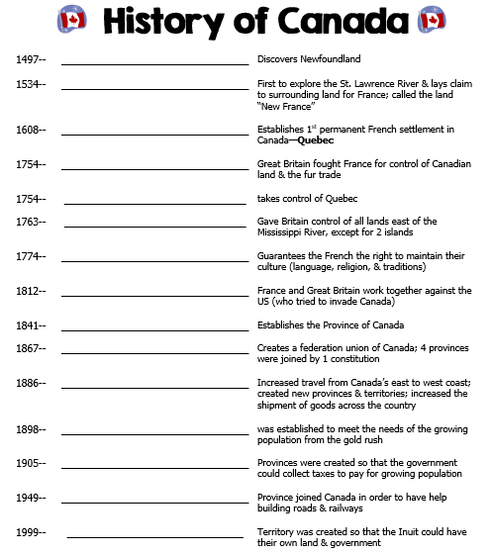

Slide 5
History of
Canada
From European Contact to
Quebec’s Independence Movement

Slide 6
First Nations
The First Nations are the native peoples of Canada.
They came from Asia over 12,000 years ago.
They crossed the Bering Land Bridge that joined Russia to Alaska.
There were 12 tribes that made up the First Nations.

Slide 7
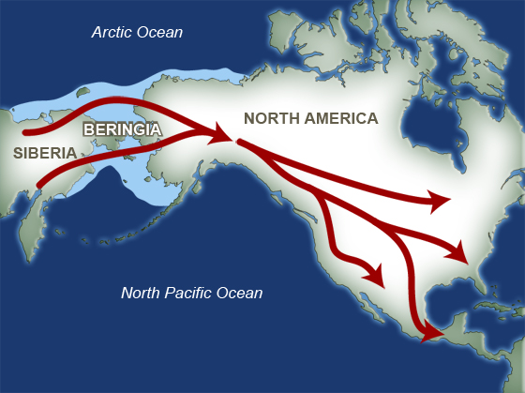

Slide 8
Inuit
The Inuit are one of the First Nation tribes.
They still live in Canada today.
In 1999, Canada’s government gave the Inuit Nunavut Territory in northeast Canada.

Slide 9
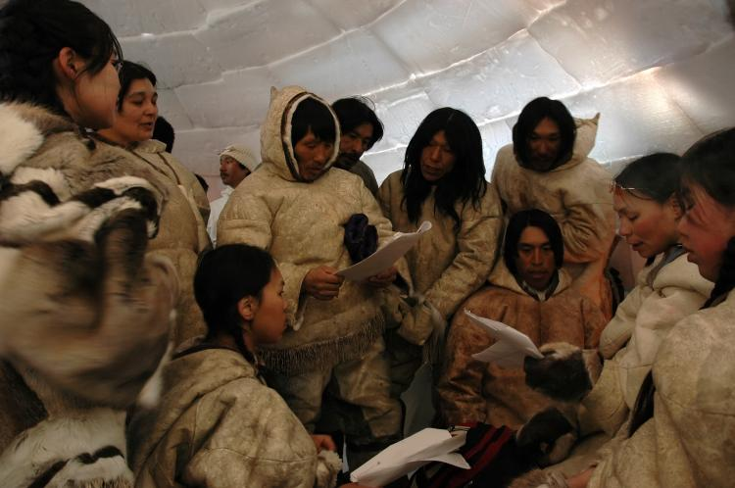
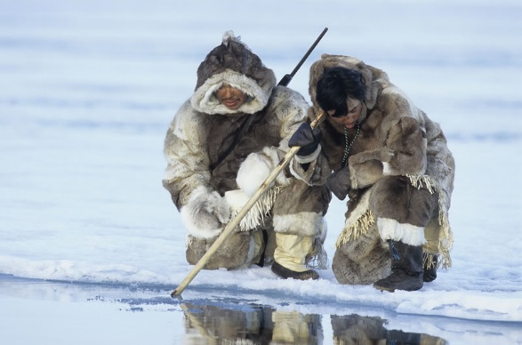

Slide 10
Early Europeans
The first explorers to settle Canada were Norse invaders from the Scandinavian Peninsula.
In 1000 CE, they built a town on the northeast coast of Canada and established a trading relationship with the Inuit.
The Norse deserted the settlement for unknown reasons.
Europeans did not return to Canada until almost 500 years later…

Slide 11
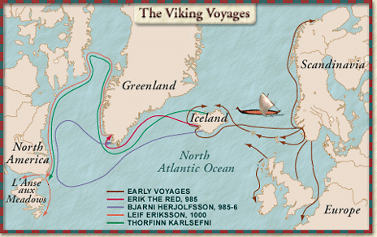
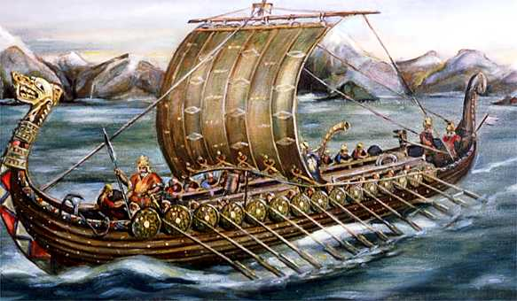

Slide 12
Newfoundland
The Italian explorer, John Cabot, sailed to Canada’s east coast in 1497.
Cabot claimed an area of land for England (his sponsor) and named it “Newfoundland”.

Slide 13
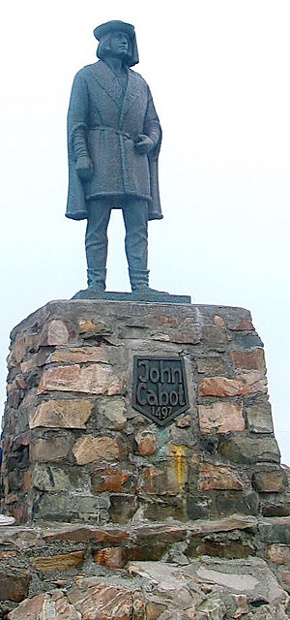
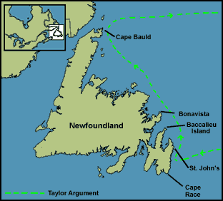

Slide 14
New France
Jacques Cartier sailed up the St. Lawrence River in 1534.
He claimed the land for France.
French colonists named the area “New France”.

Slide 15
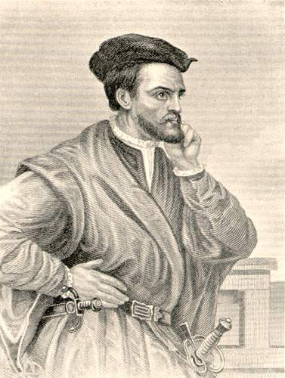
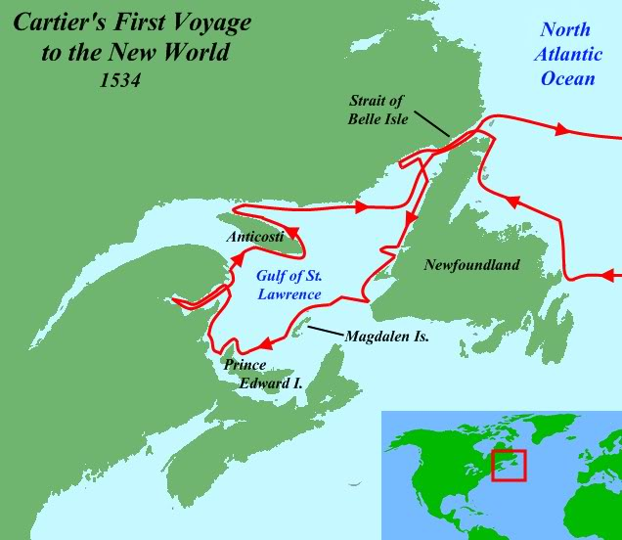

Slide 16
New France (Quebec)
In 1608, Samuel de Champlain built the first permanent French settlement in New France—called Quebec.
The population grew slowly.
Many people moved inland to trap animals.
Hats made of beaver fur were in high demand in Europe.

Slide 17
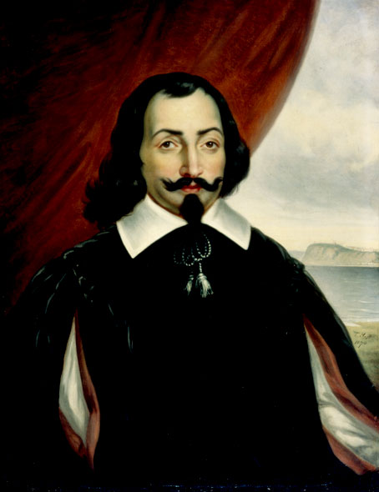

Slide 18
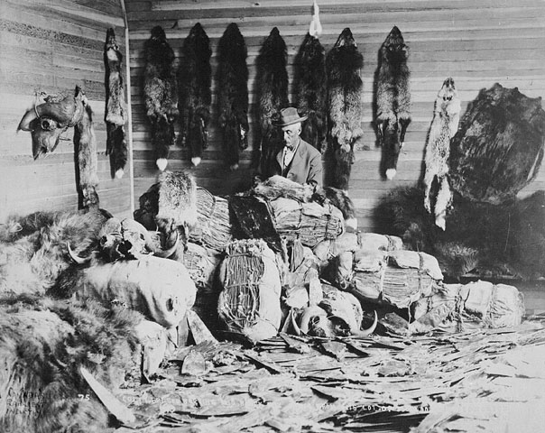
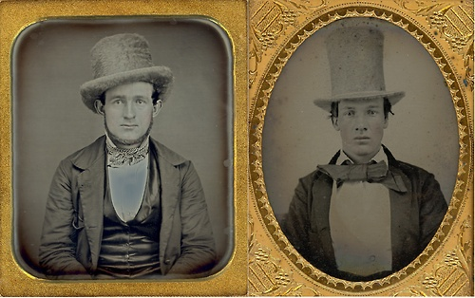

Slide 19
New France (Quebec)
European fur traders were joined by French farmers, merchants, and missionaries from the Catholic Church.
They brought with them French laws, traditions, & religion.
France wouldn’t let anyone move to New France who was not Catholic.

Slide 20
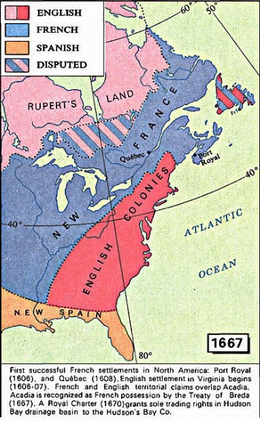

Slide 21
The British in Canada
The British colonized the region south of New France.
They saw New France’s success in fur trapping and wanted to take control of the fur trade.
This led to the French and Indian War in 1754.

Slide 22
French & Indian War
Great Britain fought for control of Canadian territory and the fur trade.
It was Great Britain and the Iroquois Indians versus France and the Huron Indians.
Great Britain conquered Quebec in 1754 and forced France to sign the Treaty of Paris in 1763.

Slide 23
Treaty of Paris
This gave Britain control of all lands east of the Mississippi River, except for 2 islands off the coast of Newfoundland.
The British forced Nova Scotia’s French-speaking people to leave.
Nova Scotia’s French went to another French colony – Louisiana.
Descendants of these people are the Cajuns.

Slide 24
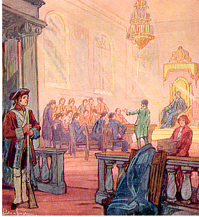

Slide 25
American Revolution
In 1776, Americans gained independence from Great Britain.
This initiated a huge cultural change in Canada.
Americans who did not believe in independence left America and moved to Quebec.
These people were called “Loyalists” because they were loyal to Great Britain.
As a result, Quebec began to have people who spoke English as well as French.

Slide 26
Quebec Act
Many Loyalists did not want to live among French-speaking Canadians.
Cultural difference between the English speakers & French speakers sparked many conflicts.
In 1774, British government passed the Quebec Act.

Slide 27
Quebec Act
The British allowed the French to stay in Quebec, but continued to control the region.
The Quebec Act guaranteed the French the right to maintain their culture (language, religion, traditions).

Slide 28
Results
It gave French Canadians in Quebec the right to continue practicing the Catholic religion and allowed French civil law.
Loyalists were irritated with the new political & cultural power of the French.
They could not own land or have representation in Quebec’s government.
The differences among the two groups eventually led to a re-division of the country.

Slide 29
Division of Canada
Most English speaking citizens lived in Upper Canada (Ontario).
Most French speaking citizens lived in Lower Canada (Quebec).

Slide 30
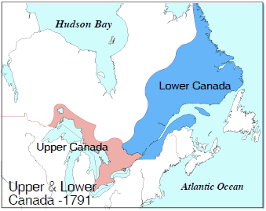

Slide 31
War of 1812
During this war, the French and British worked together against the United States, who tried to invade Canada.
War resulted in a draw, but it defined the US-Canadian border & increased a sense of Canadian nationalism.
Both French Canadians & English Canadians joined to protect their land—they were more united than ever before.

Slide 32
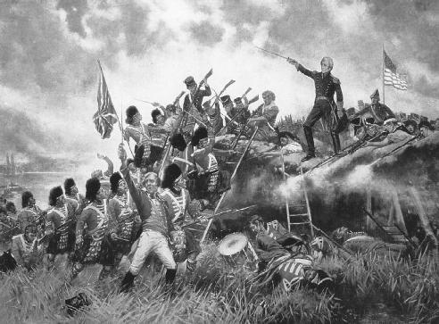

Slide 33
War of 1812 - After
French Canadians and British Canadians realized that they hated being under British rule.
They thought that Great Britain was too far away to understand their economic & political needs.

Slide 34
Province of Canada
In 1837, Canadians began to rebel against British control.
Britain sent a government reformer to examine the Canadian problem.
As a result of the inquiry, Britain discovered an economic need to unify the 2 Canadian provinces.
In 1841, Upper & Lower Canada were united, establishing the “Province of Canada”.

Slide 35
British North America Act
During the 1860s, Canadian leaders discussed the confederation of all British North American Colonies.
In 1867, the British North America Act created a federation union of Canada.
It joined four colonies (Quebec, Ontario, New Brunswick, & Nova Scotia).
The four colonies became provinces joined by a unifying constitution.
Britain accepted the agreement because they were glad to be rid of the responsibility of protecting the colonies (too expensive).

Slide 37
Transcontinental Railroad
The British North America Act allowed each region to sell goods more easily to one another.
This improved trade helped the economy.
Soon there was enough money to build a railroad across the country.
The Transcontinental Railroad was built in 1886.
People could now easily travel from the Atlantic Ocean to Pacific Ocean.

Slide 38
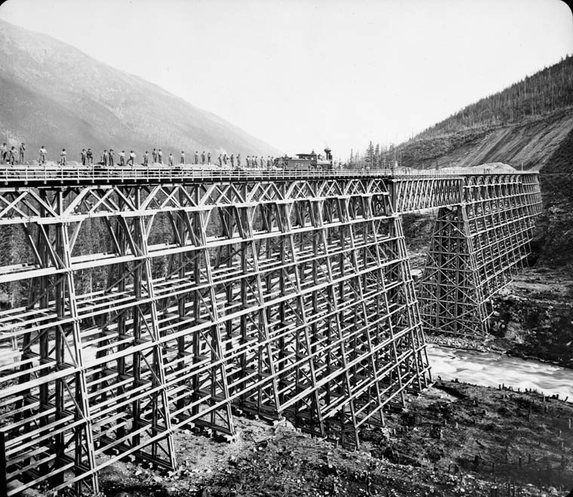
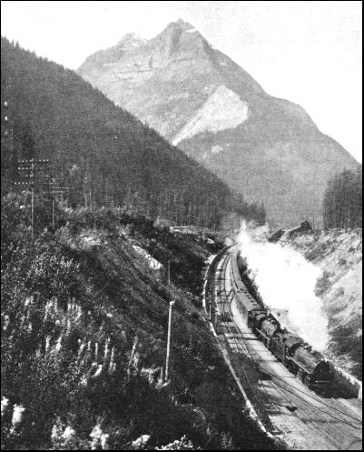

Slide 39
Expanding Canada
When Canada became a confederation in 1867, there were only 4 provinces.
Leaders desired to expand the new country from the Atlantic to the Pacific.
They bought land from the Hudson’s Bay Company.
They thought the purchase would be a simple process, but problems occurred with the native peoples.

Slide 40
Expanding Canada
Eventually the First Nations (Inuit) agreed to relocate to reservations (now Nunavut).
Transcontinental Railroad was built on this land.
Soon, 3 new provinces and 1 territory were created: Manitoba, British Columbia, Prince Edward Island, and the Northwest Territories.

Slide 42
Railroad’s Results
The railroad increased the shipment of goods across Canada.
It increased travel from coast to coast.
It caused the creation of new provinces and territories.
The railroad was also the birth of Canadian nationalism.
Before the railroad, most people only thought of themselves as belonging to their province; after, they felt as if they were part of one country.

Slide 43
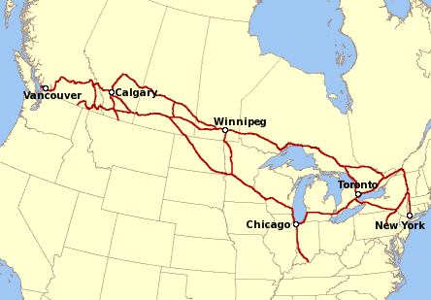

Slide 44
Yukon Gold
Gold was discovered along the western coast of Canada in 1896.
Canada’s government created Yukon territory in 1898 to meet the needs of the area’s growing population.

Slide 45
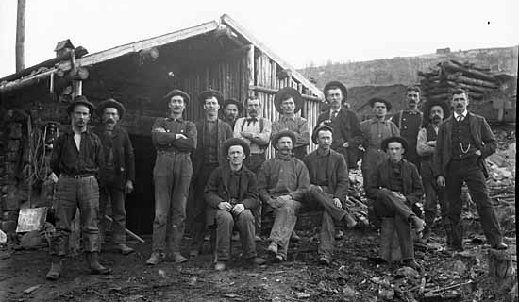
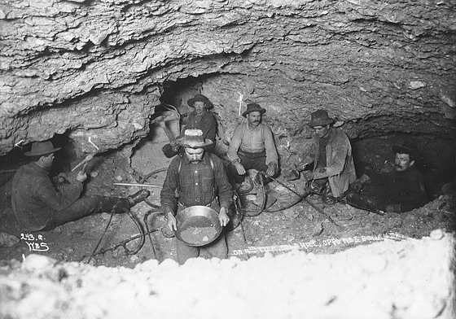

Slide 46
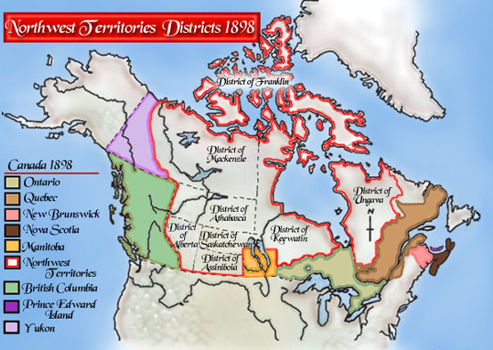

Slide 47
Saskatchewan & Alberta
1905
This land was originally part of Northwest Territories, but by early 1900s, many people wanted this to change.
Reason 1: The economy had shifted from fur trade to farming, mining, logging & railway.
Reason 2: The population grew quickly because of the new industries.
Reason 3: The area could not afford everything people needed (like schools).
By forming new provinces, they could collect taxes to pay for these things.

Slide 48
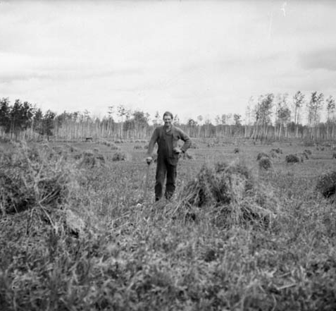
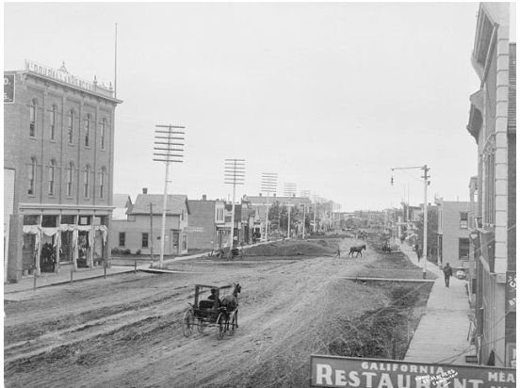

Slide 49
Canada in WWI
Canada still had close ties with Britain and felt they should contribute in the fight against Germany.
They sent military forces, raw materials, & food to Europe.
Canada’s contribution changed the way the world viewed the country.
Canada was now a union that was able to compete with world powers.
WWI also increased Canadian nationalism.

Slide 50
Newfoundland - 1949
Newfoundland joined the country of Canada because:
Canada promised to help them by building many things such as railroads and roads.
Britain didn’t want the cost of supporting Newfoundland anymore.

Slide 51
Nunavut - 1999
In the 1970s, the Inuit wanted to create a territory called Nunavut.
They wanted their own territory so that they could start making decisions for themselves.
They needed their own government.
They wanted control of their land.
For many years Canada had used the resources of the Arctic without asking the Inuit.
Inuit still live the same way that their ancestors did—they use traditional methods for survival.

Slide 52
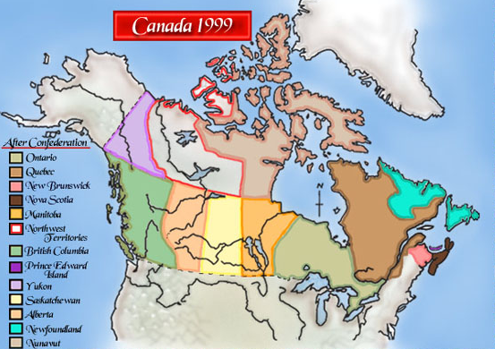

Slide 53
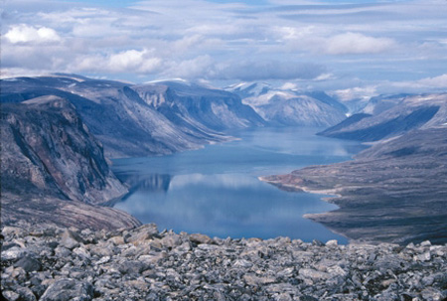
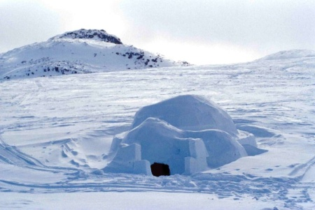

Slide 54
Teachers
Have the students use their notes to create a colorful timeline of Canada. I let the students use a sentence strip (or construction paper cut in half and taped end-to-end) to make long timelines. (Sentence strips are nice because they have lines.)
These make great hallway displays!

Slide 55
Create a Timeline
Be sure all 14 dates are written on your timeline.
Label each event—make it short and sweet (you don’t have to use complete sentences).
Draw a simple illustration to accompany at least seven of the events.
Use thin markers or colored pencils to make your timeline colorful and creative.

Slide 57
Historical Marker
Have you ever seen a sign that marks a significant event in history? We have them all over our country, and now you get to create a marker that could be used in Canada!
Review your “History of Canada” notes. Which event do you think is the most important event in Canada’s history? You are going to be creating a marker that will tell tourists about the significance of that event.

Slide 58
Historical Marker
Directions:
1. Choose your event and write what it is in the CIRCLE on the top of the historical marker.
2. Next, write a short description of the event.
3. Then, write a brief opinion statement on why you think that this event is important to Canada’s history.
4. At the bottom, write the place where your marker will be located (province, territory, city, physical feature, etc.).
5. Draw an illustration that symbolizes your event.

Slide 60
Teacher – Insta-Snaps Ticket Out the Door
Have the students draw a picture of an important part of the day’s lesson.
They should also write a #summary of the event. (Usually just a couple of words…)
*There are two per page.

Slide 61
Insta-Snaps
Insta-Snaps
What would you capture from the events in today’s lesson? (Illustrate & Summarize)
What would you capture from the events in today’s lesson? (Illustrate & Summarize)

Slide 62
Teachers
Thank you for downloading this file. I hope you enjoy using it with your students, and I can’t wait to read your feedback in my TPT store! ☺
For more social studies materials, please visit my store: http://www.teacherspayteachers.com/Store/Brain-Wrinkles
I teach Language Arts and Social Studies in Georgia, so my products are aligned with Common Core (LA) and Georgia Performance Standards (SS).
© Copyright 2013. Brain Wrinkles. All rights reserved. Permission is granted to copy pages specifically designed for student or teacher use by the original purchaser or licensee. The reproduction of any other part of this product is strictly prohibited. Copying any part of this product and placing it on the Internet in any form (even a personal/classroom website) is strictly forbidden. Doing so makes it possible for an Internet search to make the document available on the Internet, free of charge, and is a violation of the Digital Millennium Copyright Act (DMCA).

Slide 63
Credits:
All photos were found via Creative Commons and labeled for reuse.
Fonts:
Backgrounds & Graphics:

