Slide 1



Combating
Aids & Famine
Across Africa
© 2014 Brain Wrinkles

Slide 2
Standards
SS7CG3 The student will analyze how politics in Africa impacts standard of living.
b. Describe the impact of government stability on the distribution of resources to combat AIDS and famine across Africa.
© 2014 Brain Wrinkles

Slide 3
Teacher Directions – CLOZE Notes
The next 2 pages are handouts for the students to use for note-taking during the presentation. (You might want to print front-to-back so that it’s only 1 page.)
Check the answers as a class after the presentation.
© 2014 Brain Wrinkles

Slide 4
AIDS
Acquired Immunodeficiency Syndrome (AIDS) is a ________________that is spread through blood and other bodily fluids.
It attacks and destroys the _____________________________, leaving the victim unable to fight off ________________.
AIDS in Africa
About _________________________ across the continent have AIDS, and 1.5 million have died.
These deaths have created over __________________________________.
No Cure
Scientists haven’t been able to find a vaccine or _______________________________.
There are drugs that can _____________________ the progress of the disease called antiretroviral drugs (AVTs), but they are expensive and many patients can’t afford them.
Epidemic
Poor healthcare systems, poverty, and lack of __________________________, as well as ignorance about the disease and its causes and prevention, contribute to the number of AIDS cases.
The situation has gotten even worse as a result of ________________ and weak educational and _______________________________.
The epidemic now places a ________________ on the healthcare systems on countries that barely have enough resources to _______________________________.
Few African countries have the resources to _____________________________.
Government Stability
AIDS has become an epidemic in Africa because the ________________ _______________________________ by the lack of stability in African governments.
A country’s government stability has a ____________________ on the distribution of resources to combat AIDS.
South Africa
AIDS took hold in South Africa just as ______________________________ and the country’s focus was on ______________________________ during the early stages of the AIDS epidemic.
Zimbabwe
Zimbabwe has one of the ______________________________ of HIV/AIDS in the world.
The country also has __________________________________________________________ ______________________________ —which has made the situation worse.
© 2014 Brain Wrinkles
AIDS & Famine CLOZE Notes

Slide 5
Nigeria
In the 1990s, Nigeria’s government began to make AIDS a priority and began to focus on __________________________________________________________ .
The nation still struggles, but the government is trying to ______________________________ about prevention.
Botswana
Botswana has maintained a ___________________________________ since the country gained independence in 1966.
As a result, Botswana has the ______________________________ treat AIDS patients.
Botswana’s government has provided _____________________________________ for its citizens.
It was also the first country to offer the necessary drug therapy for _________________________________________ .
Famine
Along with AIDS, __________________is one of Africa’s biggest problems.
Famine occurs when a region does not have ____________________________for a long period of time.
People who are starving can die from __________________.
Climate
Many African countries face __________________ because of climate changes.
Repeated drought has plagued Africa since the __________________.
Soil infertility and erosion have decreased the ________________________________________.
Government Stability
The stability of a country’s government directly impacts the country’s ability to ____________________________to prevent famine.
Civil wars interrupt daily life for most people, including farmers, which causes ____________________________.
Some governments have ____________________________instead of ____________________________for their people.
Other governments have used ____________________________by denying food shipments to political enemies.
© 2014 Brain Wrinkles
AIDS & Famine CLOZE Notes

Slide 6
AIDS
Acquired Immunodeficiency Syndrome (AIDS) is a disease that is spread through blood and other bodily fluids.
It attacks and destroys the immune system, leaving the victim unable to fight off infections.
AIDS in Africa
About 23 million people across the continent have AIDS, and 1.5 million have died.
These deaths have created over 11 million orphans.
No Cure
Scientists haven’t been able to find a vaccine or prevent the HIV infection.
There are drugs that can slow down the progress of the disease called antiretroviral drugs (AVTs), but they are expensive and many patients can’t afford them.
Epidemic
Poor healthcare systems, poverty, and lack of government organization, as well as ignorance about the disease and its causes and prevention, contribute to the number of AIDS cases.
The situation has gotten even worse as a result of poverty and weak educational and public health services.
The epidemic now places a huge burden on the healthcare systems on countries that barely have enough resources to handle basic care.
Few African countries have the resources to treat AIDS patients.
Government Stability
AIDS has become an epidemic in Africa because the spread of the disease was overshadowed by the lack of stability in African governments.
A country’s government stability has a huge impact on the distribution of resources to combat AIDS.
South Africa
AIDS took hold in South Africa just as Apartheid was ending and the country’s focus was on stabilizing the country during the early stages of the AIDS epidemic.
Zimbabwe
Zimbabwe has one of the highest rates of HIV/AIDS in the world.
The country also has government corruption, civil unrest, and a suspicion of outside help —which has made the situation worse.
© 2014 Brain Wrinkles
AIDS & Famine CLOZE Notes
KEY

Slide 7
Nigeria
In the 1990s, Nigeria’s government began to make AIDS a priority and began to focus on prevention, treatment and care.
The nation still struggles, but the government is trying to educate its citizens about prevention.
Botswana
Botswana has maintained a stable democratic government since the country gained independence in 1966.
As a result, Botswana has the resources to help treat AIDS patients.
Botswana’s government has provided education and prevention training for its citizens.
It was also the first country to offer the necessary drug therapy for free to infected people.
Famine
Along with AIDS, famine is one of Africa’s biggest problems.
Famine occurs when a region does not have enough food for a long period of time.
People who are starving can die from malnutrition.
Climate
Many African countries face drought because of climate changes.
Repeated drought has plagued Africa since the 1970s.
Soil infertility and erosion have decreased the amount of crops grown.
Government Stability
The stability of a country’s government directly impacts the country’s ability to provide enough food to prevent famine.
Civil wars interrupt daily life for most people, including farmers, which causes food shortages.
Some governments have built armies instead of investing in food for their people.
Other governments have used food as a weapon by denying food shipments to political enemies.
© 2014 Brain Wrinkles
AIDS & Famine CLOZE Notes
KEY

Slide 8
Combating
Aids & Famine
Across Africa
© 2014 Brain Wrinkles

Slide 9
AIDS
Acquired Immunodeficiency Syndrome (AIDS) is a disease that is spread through blood and other bodily fluids.
It attacks and destroys the immune system, leaving the victim unable to fight off infections.
Today, 34 million people worldwide are living with HIV/AIDS, and two-thirds of those people are in sub-Saharan Africa.
© 2014 Brain Wrinkles

Slide 10
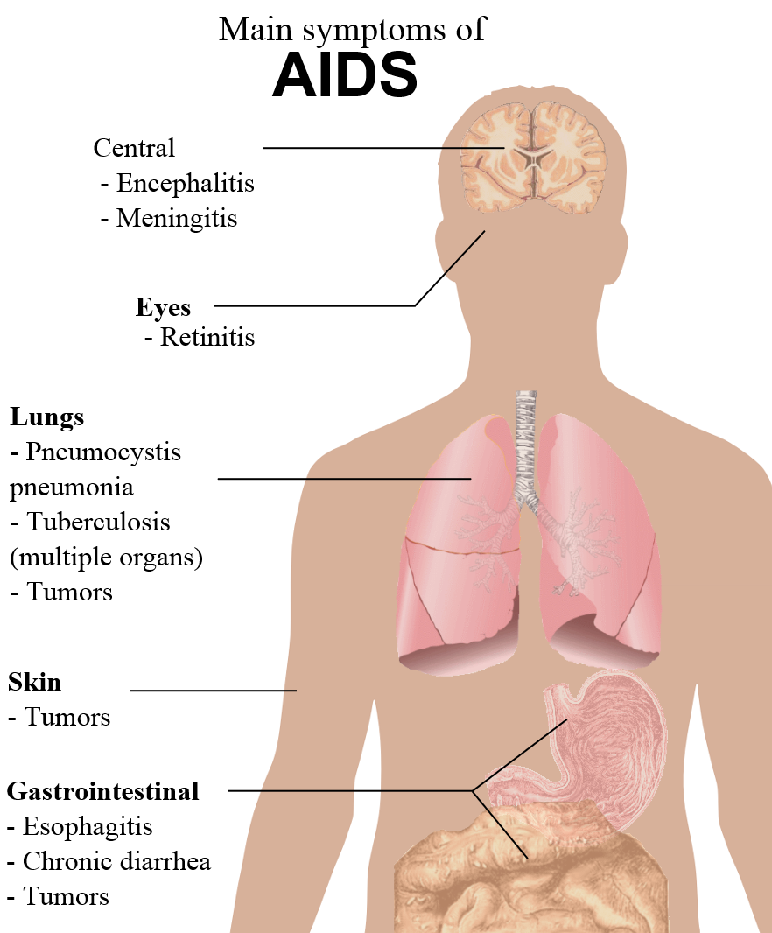
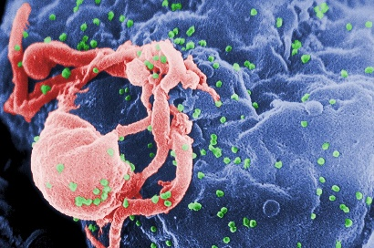
© 2014 Brain Wrinkles

Slide 11
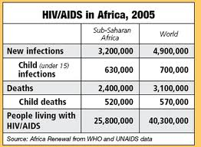
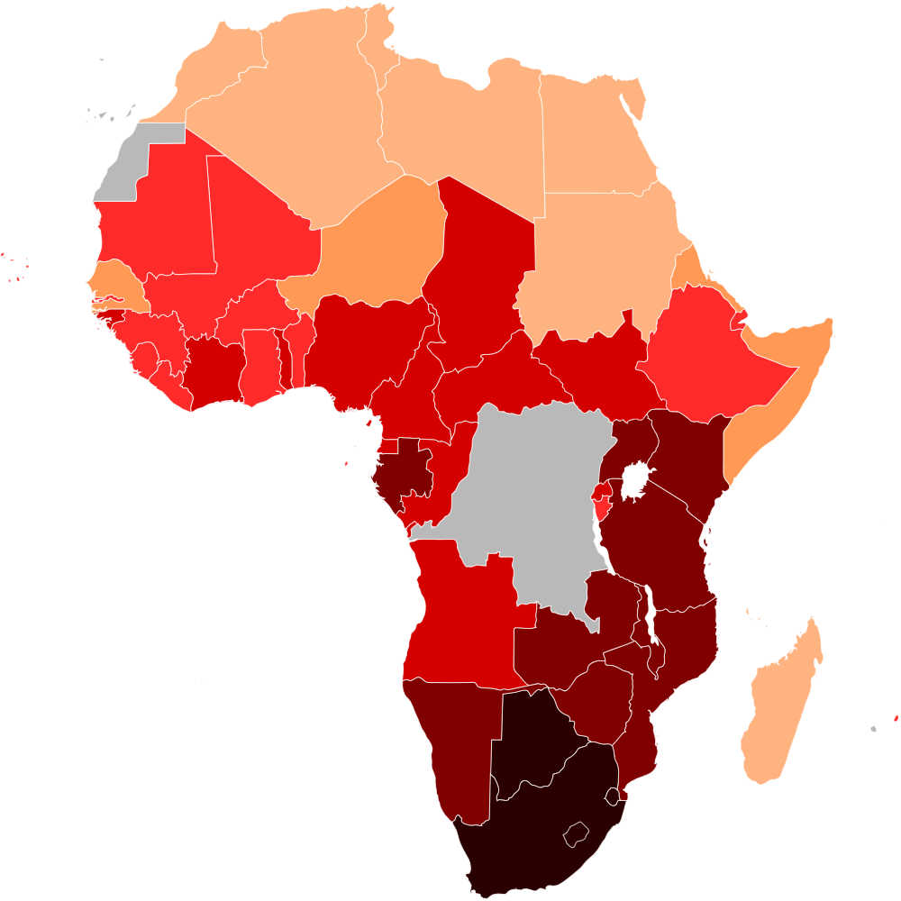
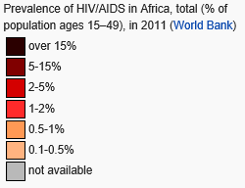
© 2014 Brain Wrinkles

Slide 12
AIDS in Africa
Sub-Saharan Africa has one of the highest HIV/AIDS infections in the world.
About 23 million people across the continent have AIDS, and 1.5 million have died.
  These deaths have created over 11 million orphans.
© 2014 Brain Wrinkles

Slide 13
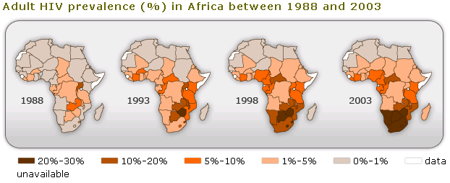
© 2014 Brain Wrinkles

Slide 14
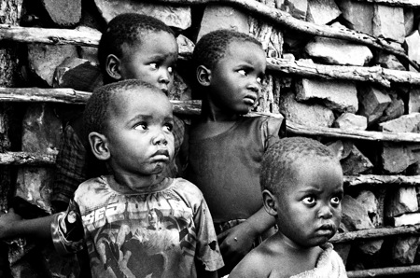
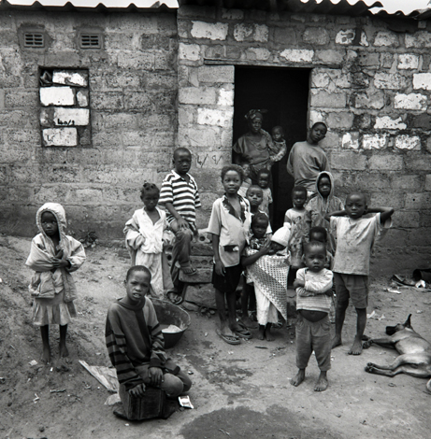
AIDS Orphans,
Swaziland
© 2014 Brain Wrinkles

Slide 15
No Cure
Unfortunately AIDS cannot be cured.
Scientists haven’t been able to find a vaccine or prevent the HIV infection.
There are drugs that can slow down the progress of the disease called antiretroviral drugs (AVTs), but they are expensive and many patients can’t afford them.
© 2014 Brain Wrinkles

Slide 16
Epidemic
The first case of an HIV infection was detected in the continent of Africa and governments were slow to respond.
Poor healthcare systems, poverty, and lack of government organization, as well as ignorance about the disease and its causes and prevention, contribute to the number of AIDS cases.
© 2014 Brain Wrinkles

Slide 17
Epidemic
The situation has gotten even worse as a result of poverty and weak educational and public health services.
The epidemic now places a huge burden on the healthcare systems on countries that barely have enough resources to handle basic care.
Few African countries have the resources to treat AIDS patients.
© 2014 Brain Wrinkles

Slide 18
Government Stability
AIDS has become an epidemic in Africa because the spread of the disease was overshadowed by the lack of stability in African governments.
A country’s government stability has a huge impact on the distribution of resources to combat AIDS.
© 2014 Brain Wrinkles

Slide 19
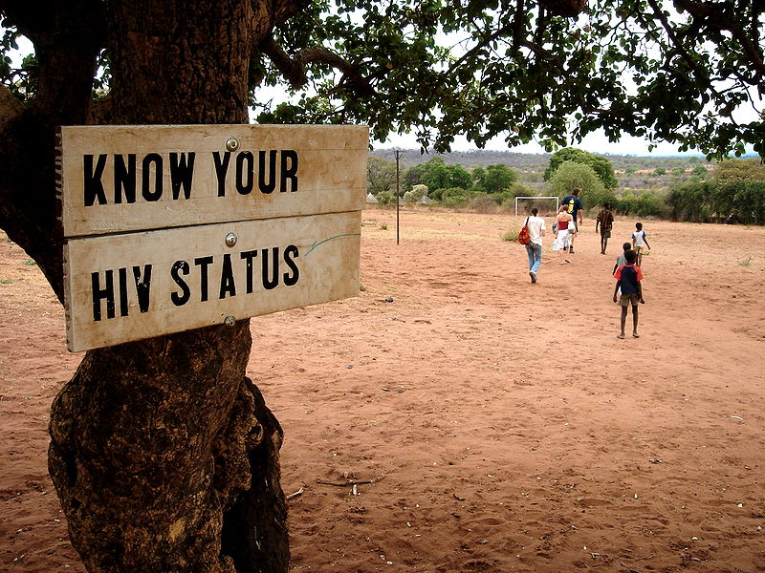
Sign in Zambia
2005
© 2014 Brain Wrinkles

Slide 20
South Africa
In South Africa, it is estimated that 1 in 5 people may be infected with AIDS, yet few have access to the AVTs.
AIDS took hold in South Africa just as Apartheid was ending and the country’s focus was on stabilizing the country during the early stages of the AIDS epidemic.
© 2014 Brain Wrinkles

Slide 21
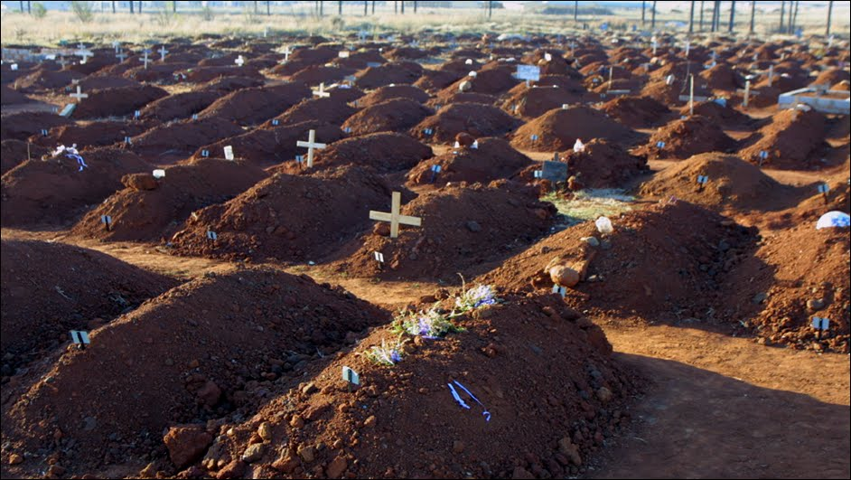
South Africa is running out of space in its cemeteries.
2013
© 2014 Brain Wrinkles

Slide 22
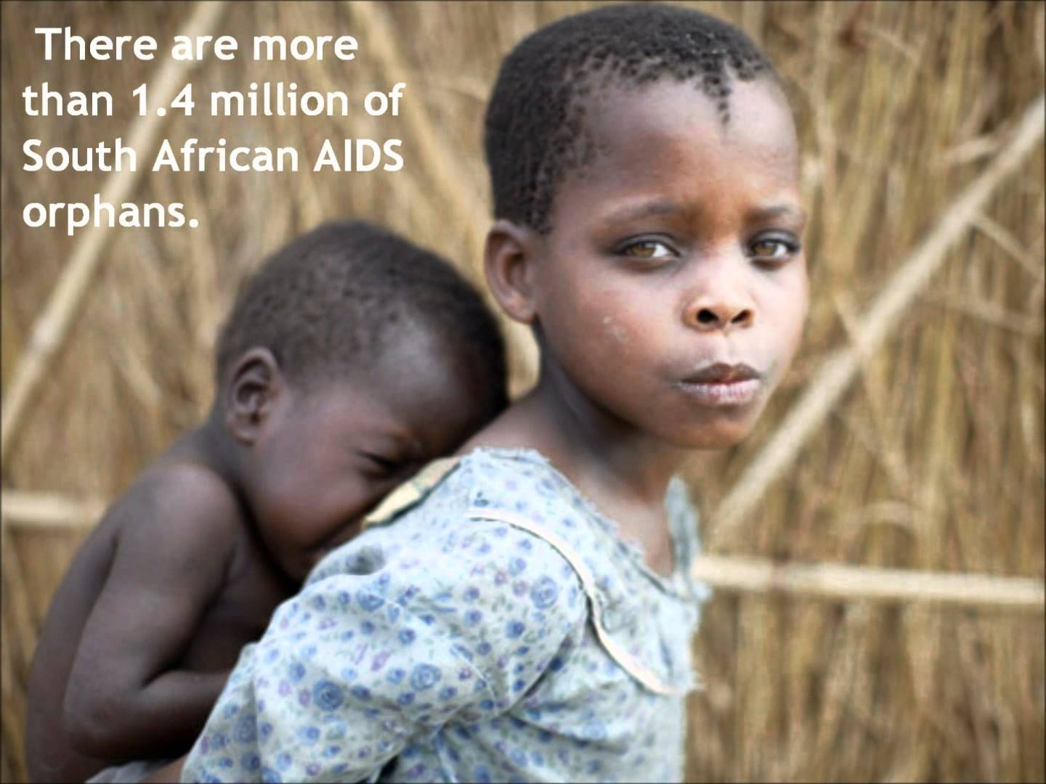
© 2014 Brain Wrinkles

Slide 23
Zimbabwe
Zimbabwe has one of the highest rates of HIV/AIDS in the world.
The country also has government corruption, civil unrest, and a suspicion of outside help—which has made the situation worse.
Zimbabwe also has a very poor economy, meaning that the expensive AVTs are impossible for most people to afford.
© 2014 Brain Wrinkles

Slide 24
Nigeria
Almost 3 million people in Nigeria are currently infected with AIDS.
Even though Nigeria has oil, most Nigerians are relatively poor and cannot afford treatment.
In the 1990s, Nigeria’s government began to make AIDS a priority and began to focus on prevention, treatment and care.
  The nation still struggles, but the government is trying to educate its citizens about prevention.
© 2014 Brain Wrinkles

Slide 25
Botswana
Botswana has maintained a stable democratic government since the country gained independence in 1966.
  As a result, Botswana has the resources to help treat AIDS patients.
Botswana’s government has provided education and prevention training for its citizens.
It was also the first country to offer the necessary drug therapy for free to infected people.
© 2014 Brain Wrinkles

Slide 26
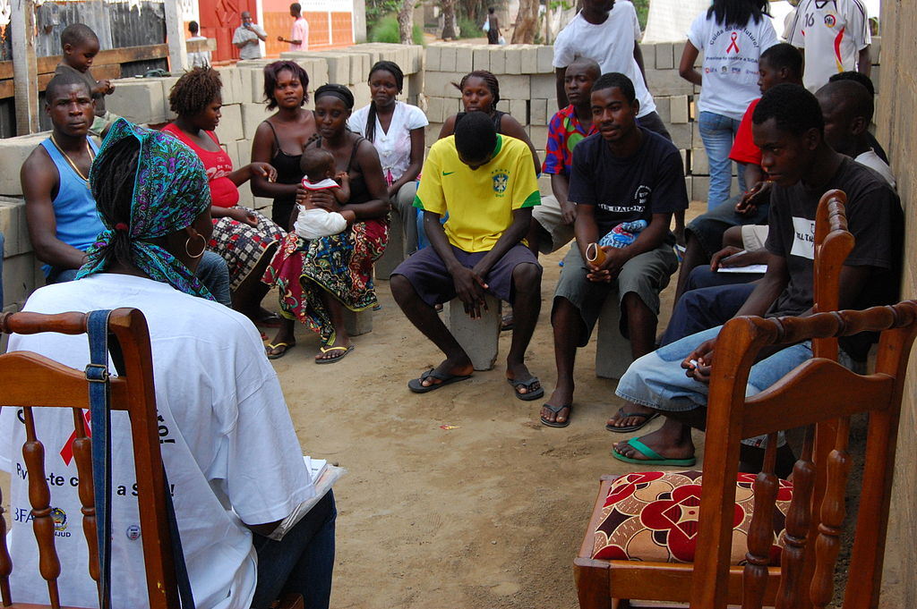
AIDS Education Outreach Event
© 2014 Brain Wrinkles

Slide 27
Famine
Along with AIDS, famine is one of Africa’s biggest problems.
Famine occurs when a region does not have enough food for a long period of time.
People who are starving can die from malnutrition.
Famines are both human-made and natural.
© 2014 Brain Wrinkles

Slide 28
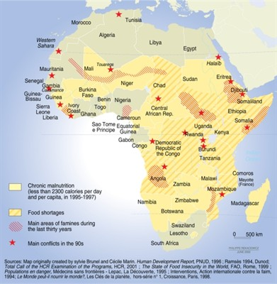
© 2014 Brain Wrinkles

Slide 29
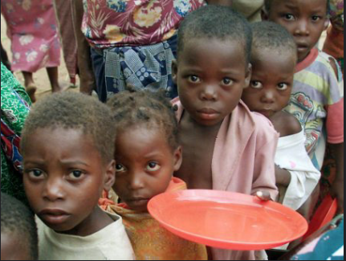
© 2014 Brain Wrinkles

Slide 30
Climate
Many African countries face drought because of climate changes.
Repeated drought has plagued Africa since the 1970s.
Soil infertility and erosion have decreased the amount of crops grown.
© 2014 Brain Wrinkles

Slide 31
Government Stability
The stability of a country’s government directly impacts the country’s ability to provide enough food to prevent famine.
Civil wars interrupt daily life for most people, including farmers, which causes food shortages.
Some governments have built armies instead of investing in food for their people.
Other governments have used food as a weapon by denying food shipments to political enemies.
© 2014 Brain Wrinkles

Slide 32
Teacher Info –
Combating AIDS App
Print off the Combating AIDS App pages for each student. (There is a brainstorm sheet and a final copy page.)
Students should create a new app that will slow down (or stop) the spread of the AIDS virus in Africa (Have the students think about what the African governments can start doing...)
On the final copy, they will turn the information from their brainstorm sheet into a paragraph about the app.
© 2014 Brain Wrinkles

Slide 33
Combating AIDS App
Directions: Imagine that Apple has hired you to create a new application that will slow down (or stop) the spread of the AIDS virus. (Think about what African governments can do…) Complete the graphic organizer below to help you organize your thoughts before you create your app.
App Title: ___________________________
Describe the AIDS Epidemic: | What does the app do?
How does the app work? How will it slow down the spread of AIDS? | What are the app’s special features/functions?
App Creator: ________________________
App $: _______________________________
© 2014 Brain Wrinkles

Slide 34
Description:
App Title: ___________________________
Creator: ____________________________
$
Rating
© 2014 Brain Wrinkles

Slide 35
Teacher Directions – Famine “Prescription”
Have the students write a prescription that will “cure” the famine “disease”.
They should use information that they’ve learned about government stability to write the prescription for a cure.
© 2014 Brain Wrinkles

Slide 36


Famine in Africa Prescription
Directions: You are the doctor! Write a prescription to cure the “ailments” of famine in Africa. How can you make this horrible situation better? What would work to stop the spread of the famine “disease”?
Name: ______________________
MD Signature:___________________________________
Ailment:
Prescription:
© 2014 Brain Wrinkles

Slide 37
Teacher Info – Aids & Famine Graffiti Wall
Print off the Graffiti Wall handout for each student.
The students will write down all the facts that they’ve learned about Aids & Famine in Africa ALL over the wall.
Next, they will switch papers with a partner.
They will read their partner’s wall and respond with their thoughts and feelings about the information.
*Have the students use different colors so it looks like real graffiti!
© 2014 Brain Wrinkles

Slide 38

Graffiti Wall
Directions: Write down everything that you’ve learned about Aids & Famine in Africa ALL over the wall. Afterwards, switch papers with a partner. Read your partner’s wall and respond with your thoughts and feelings about the information. Use different colors so it looks like real graffiti!
Aids & Famine
© 2014 Brain Wrinkles

Slide 39




Thank You!
Thank you so much for downloading this file. I sincerely hope you find it helpful and that your students learn a lot from it! I look forward to reading your feedback in my store.
If you like this file, you might want to check out some of my other products that teach social studies topics in creative, engaging, and hands-on ways.
Best of luck to you this school year,
Ansley at Brain Wrinkles
© 2014 Brain Wrinkles

Slide 40





Terms of Use
© 2014 Brain Wrinkles. Your download includes a limited use license from Brain Wrinkles. The purchaser may use the resource for personal classroom use only. The license is not transferable to another person. Other teachers should purchase their own license through my store.
This resource is not to be used:
By an entire grade level, school, or district without purchasing the proper number of licenses. For school/district licenses at a discount, please contact me.
As part of a product listed for sale or for free by another individual.
On shared databases.
Online in any way other than on password-protected website for student use only.
© Copyright 2014. Brain Wrinkles. All rights reserved. Permission is granted to copy pages specifically designed for student or teacher use by the original purchaser or licensee. The reproduction of any other part of this product is strictly prohibited. Copying any part of this product and placing it on the Internet in any form (even a personal/classroom website) is strictly forbidden. Doing so makes it possible for an Internet search to make the document available on the Internet, free of charge, and is a violation of the Digital Millennium Copyright Act (DMCA).
Thank you,
Ansley at Brain Wrinkles
Clipart, fonts, & digital papers for this product were purchased from:
© 2014 Brain Wrinkles

