Slide 1
Trail hazards
By chase
Cj Jacquez

Slide 2
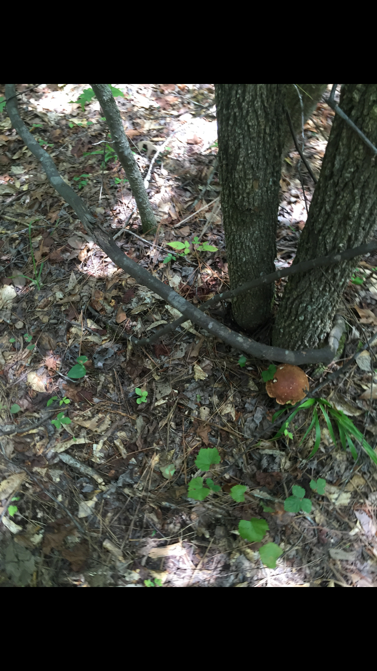
This trail had a lot of hazards including mushrooms
This is a hazards, because the mushroom could be poisonous

Slide 3
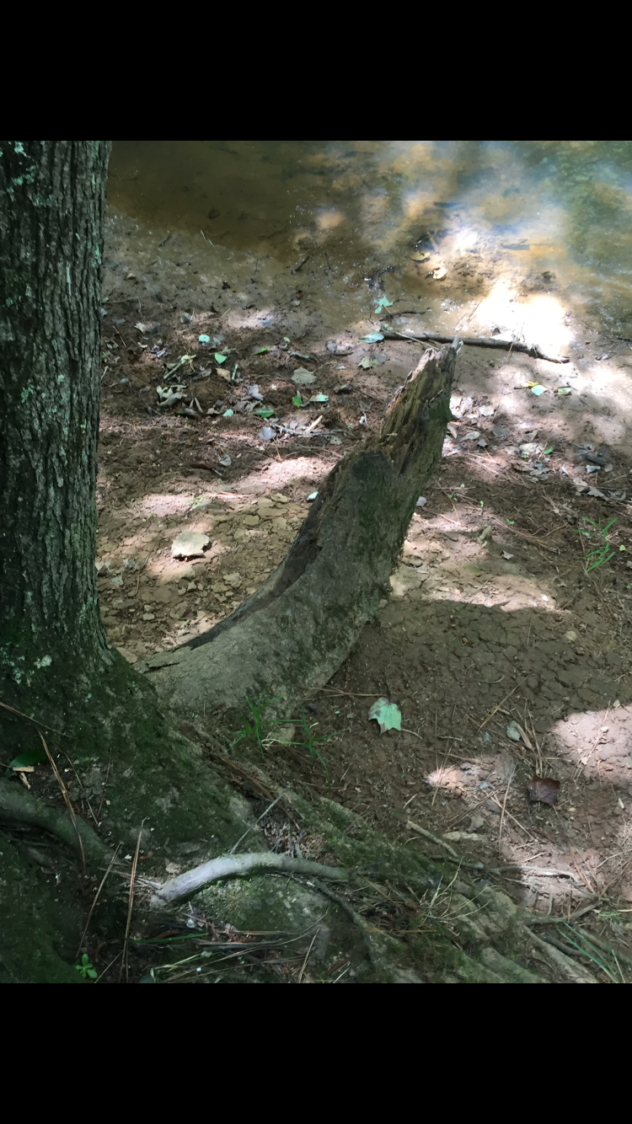
Their were a lot of broken trees on this hike/trail
This is a hazard, because someone can trip over it and hurt themselves

Slide 4
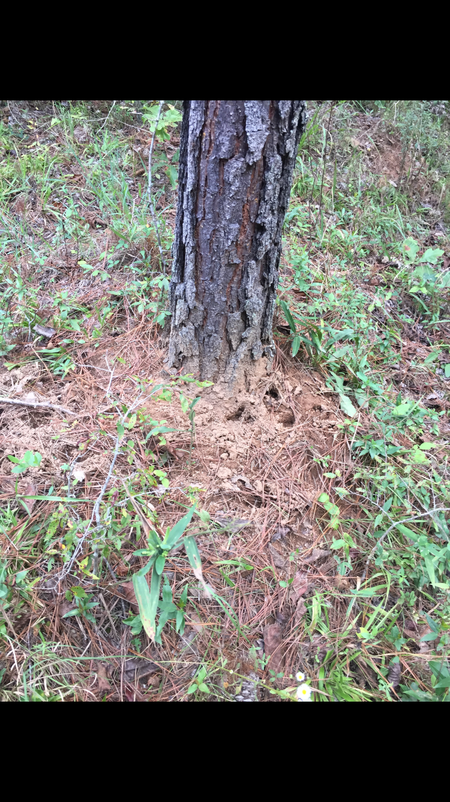
Also, this trail had a lot of rabbit holes
This is a hazard, because someone can fall into the hole and harm the animal and themselves

Slide 5
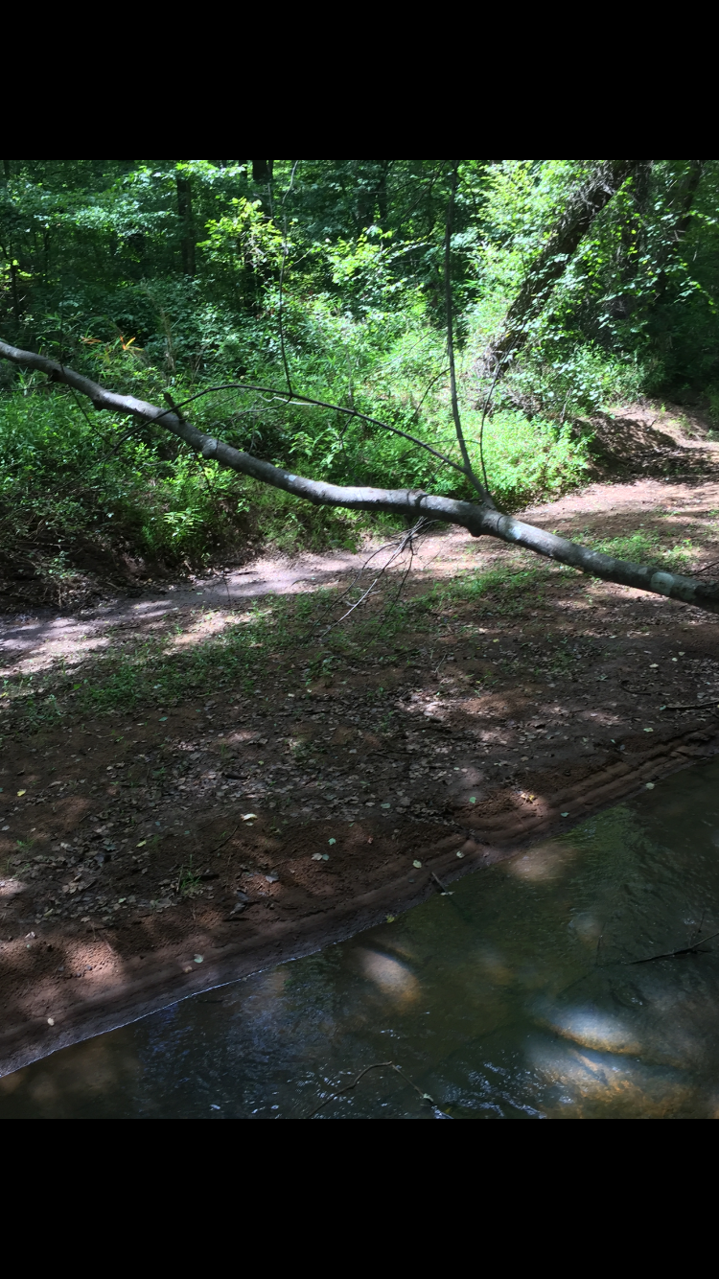
We saw a lot of broken branches
This is a hazard, because the branch can fall on someone and harming them

Slide 6
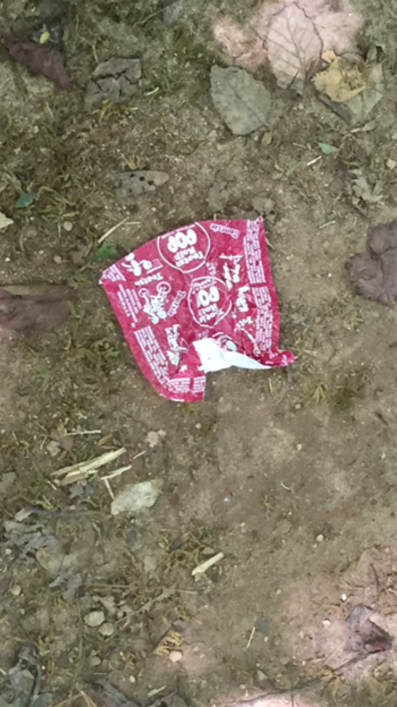
Their were trash on trail that could harm the environment
This a hazard, because a animal can eat it and get sick

Slide 7
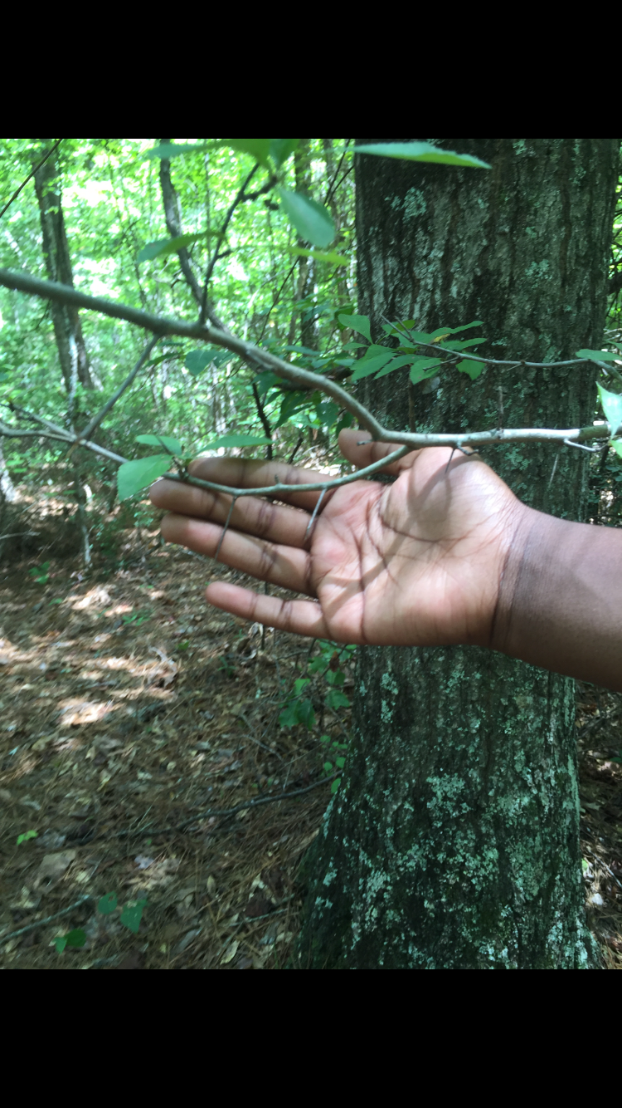
Their were thorns on the trees the can harm people and animals

Slide 8
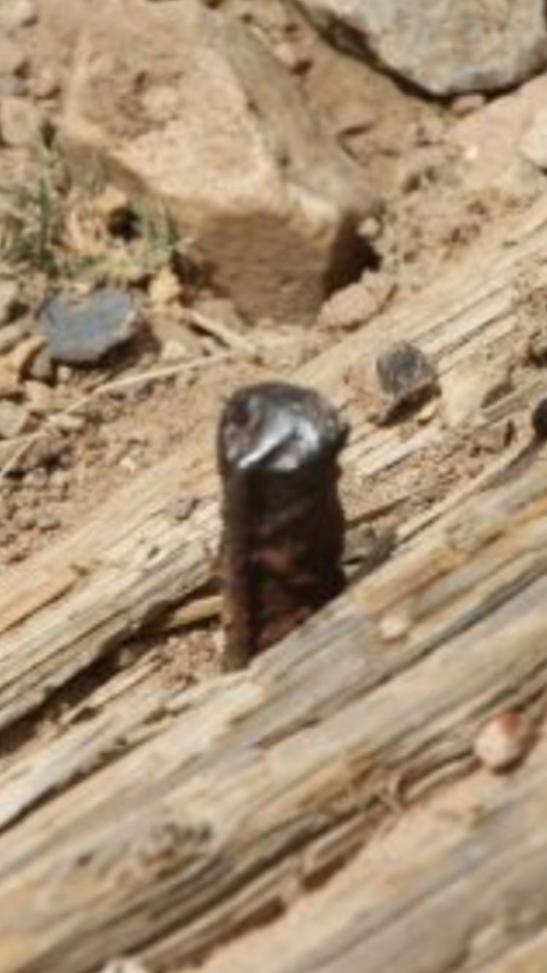
There were nails in the bridge
This is a hazard, because someone could trip or step on it a get hurt
themselves

Slide 9
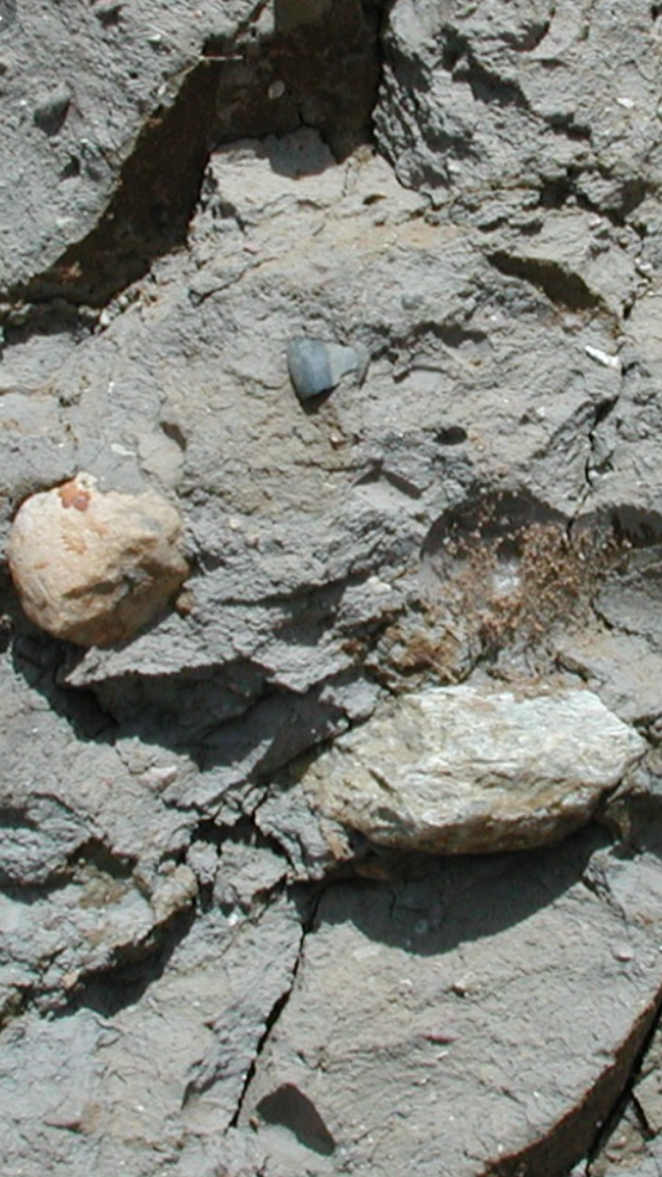
There were rocks everywhere on the trail
This is a hazard, because someone can fall and cut themselves on these rocks

Slide 10
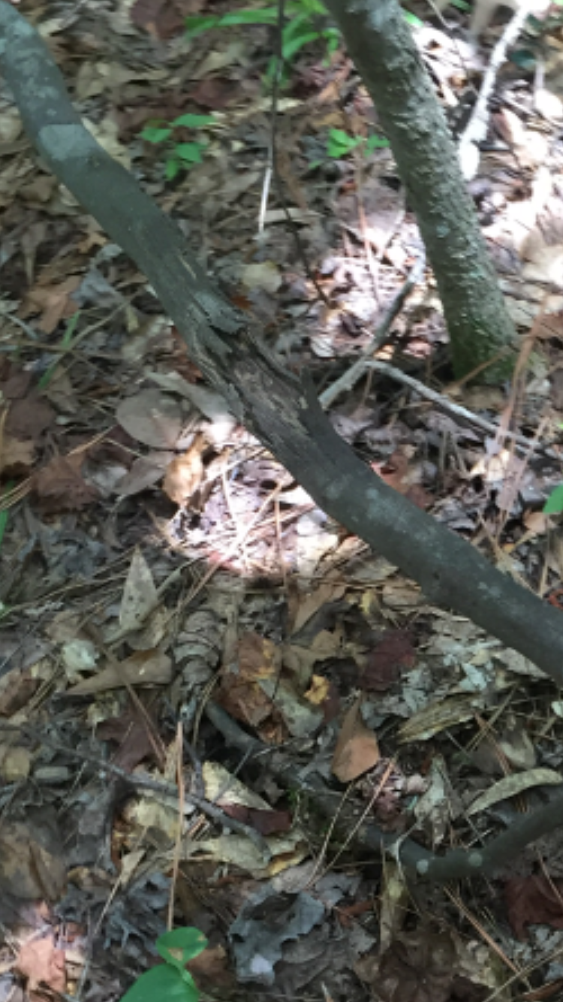
There were sharp trees on trail
This is a hazard, because a piece of the tree can poke someone and cause them to bleed

