Slide 1

Environmental Concerns of Canada

Slide 2

Environmental Issues in Canada
1. Acid Rain
2. Pollution of the Great Lakes
3. Extraction and Use of Natural Resources on the Canadian Shield
4. Timber Industry in Canada

Slide 3
Acid Rain
Coal-burning factories, cars, & trucks release chemicals that pollute the air
  The pollutants mix with water molecules in clouds and turn the water acidic
High levels of acid in rain can damage or kill trees and pollute lakes enough to kill fish
Houses, buildings, statues can also be damaged

Slide 4
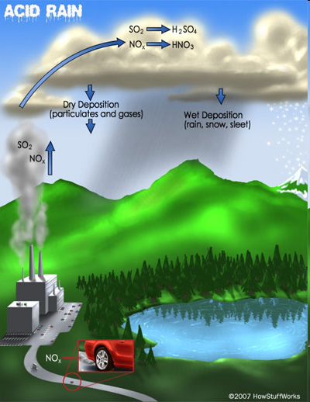

Slide 5
Acid Rain
Southern Canada (near the Great Lakes region) experiences the highest levels of acid rain
50-75% of the pollution that causes acid rain actually comes from the US
  Wind patterns tend to move the pollution from the US north into Canada

Slide 6
Acid Rain – The Solution
Canada’s government has done several things to reduce pollution:
  They are building factories that don’t pollute the air
  Laws have been passed that require cars to produce less pollution
  They are encouraging people to walk or ride bikes/buses, rather than driving

Slide 7

Pollution of the Great Lakes
1970s: Great Lakes had high levels of water pollution
  Fishing was unsafe; tons of animals and plants were harmed or killed
  Factories around the region used the lakes as a place to dump wastes
  Factories also used the chemical phosphorus when producing things like toothpaste, fertilizer, pesticides, detergents, etc.
    Really bad for lakes because it caused a rapid increase in algae

Slide 8
Pollution of the Great Lakes – The Solution
1971: Great Lakes Water Quality Agreement was signed by US and Canada (renewed in 2002)
Goal was to restore the lakes’ environment and prevent further damage
  Working together to reduce amount of human wastes dumped in lakes
  Working to make sure that chemicals (like phosphorus) are not put into lakes

Slide 9

Natural Resources on the Canadian Shield
Canadian Shield is a large area of thin, rocky soil that surrounds the Hudson Bay
  Beneath the soil is one of Canada’s most valuable resources: minerals (gold, silver, copper, zinc, lead, iron ore, uranium, & nickel)
Very important to Canada’s economy (mineral deposits and jobs)
  1.5 million people make their living in the mining industry in this area

Slide 10
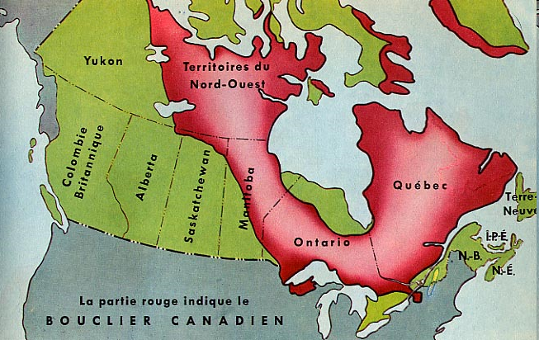
The Canadian Shield

Slide 11
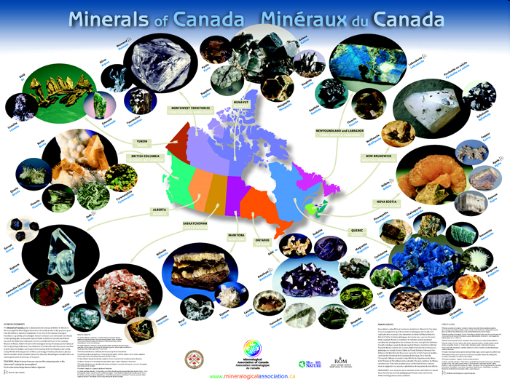

Slide 12
Extraction and Use of Resources on the Canadian Shield
Blasting & digging with heavy machinery causes the land around mines to be damaged and the environment is often ruined
Slag, or leftover rock from the smelting process, is often dumped in any convenient place
Mining processes release harmful chemicals into the air, which causes acid rain

Slide 13
Extraction of Resources -- The Solution
Canada’s government has made new rules about mining
  Some rules reduce the amount of pollution allowed in waterways
  Government hopes to keep its fish alive and safe to eat

Slide 14

Timber Industry
With almost half its land covered in forests, Canada is a leading producer of timber products
  products include lumber, paper, plywood, and wood pulp
The major timber-producing provinces include British Columbia, Quebec, and Ontario.

Slide 15

Timber Industry
Citizens are concerned that logging is destroying the forests
Most timber companies cut all the trees in a given area, leaving large treeless gaps in the forest (called clear-cutting)
  Reduces water quality, causes erosion, & kills animals’ habitats
Heavy machinery leaves the forest floor compacted
  Makes it hard for new growth to start

Slide 16
Timber Industry – The Solution
Government and industry are working together to manage use of the forests:
  Hundreds of millions of seedlings are planted each year
  Billions of dollars are spent on managing and protecting the forests
  Over $100 million is spent each year by the logging industry to protect wildlife & their habitats

