Slide 1
Before Europeans Came

Slide 2
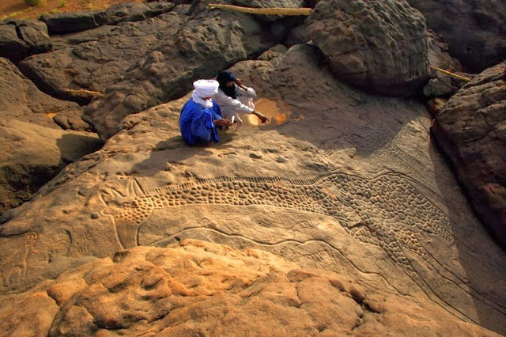
Warm-Up: Topic : “Before they Came”
When you hear of Ancient Africa what do you think of?
Look at the picture…what do you see? Where do you think it is? >>
Notes:
Picture is from the Air Mountains in Niger. They found 828 engraved images (petroglyphs) that included: 704 animals, in majority bovids, giraffes, ostriches and antelopes, rare lions and rhinos and camels, 61 human figures, and 159 indeterminate figures. Thought to have been created 10k to 8k years ago.
The were carved using various methods – scraping and smoothing in areas, deep engraving for the outline, and low-relief carving (like a stamp) for the spots/dots.
The Giraffe is 6.35 meters tall from ears to leg.
Much like Stonehenge (England), the Hall of Bulls (France), and Cave Creek (Arizona)

Slide 3
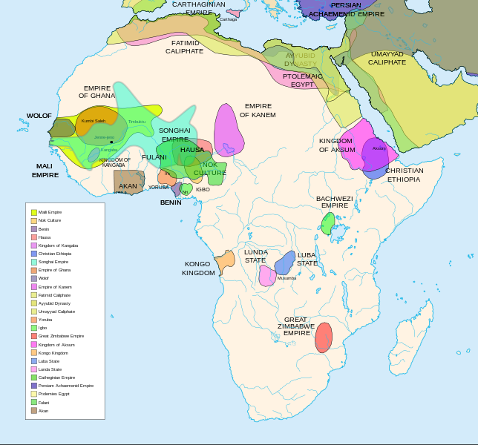
Notes:
http://www.timemaps.com/history/africa-3500bc
Starts 3500 bc. and goes to 2005
This map shows that various empires in Africa throughout time.

Slide 4
Before Civilization
Africa was covered in groups of
hunters/gatherers
And small farming groups
Temporary encampments
Sahara is cooler/more wet than it is now but is starting to get dry.
Chiefdoms start to emerge along the Nile.
Notes:
The area now covered by the Sahara desert is cooler and wetter than it is now, although at this date it is getting dryer.
Farming peoples are slowly spreading along the north African coast, and down the fertile strip of land along the river Nile is already home to a dense population of farmers.
In this area, some powerful chiefdoms are now emerging which will, over the next few centuries, come under one ruler to form the kingdom of Egypt. Throughout the rest of sub-Saharan Africa, small groups of hunter-gatherers, mostly related to modern day San bushmen and Pygmy peoples, live in small, temporary encampments as they follow their prey and forage for nuts, berries and other nutritious plants.
Beside rivers and lakes, settlements of fishermen are situated.

Slide 5
North Africa
Notes:
Other Websites to use for information:
http://www.slideshare.net/KMcClain/ancient-african-civilization

Slide 6
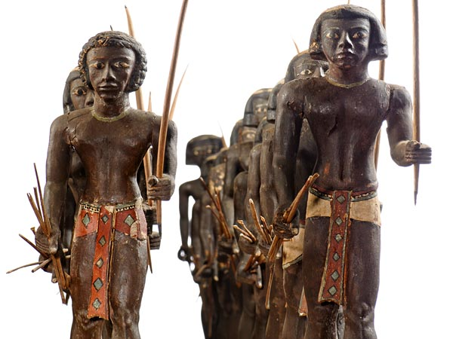
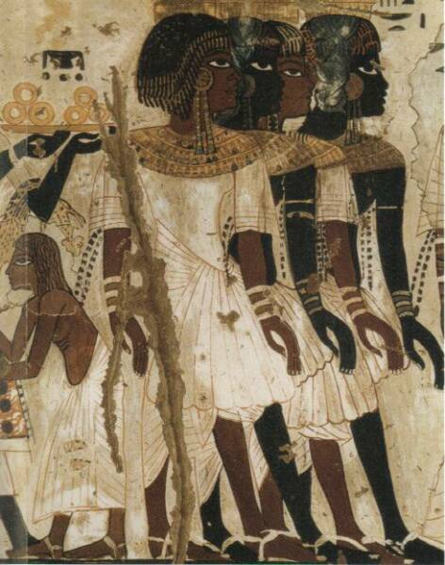
Nubia
Also known as Kush = Land of Gold
Thrived in Central Sudan
Was covered in seasonal lakes, and savannas
Lived a “settled” lifestyle
Known for Iron Forging
Known for having Great Natural Wealth
Prized by neighbors
Bowmen warriors were fierce and feared
Notes:
http://www.anth.ucsb.edu/faculty/stsmith/research/nubia_history.html
http://wysinger.homestead.com/nubians.html

Slide 7
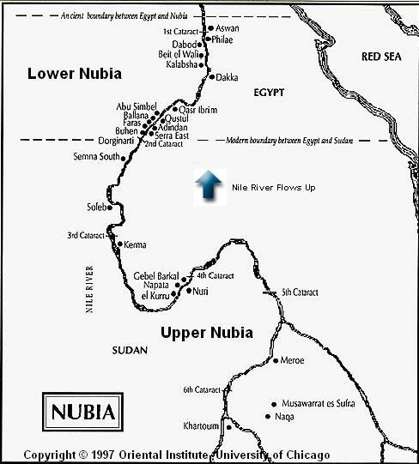
Map of Nubia (Kush)

Slide 8
East Africa

Slide 9
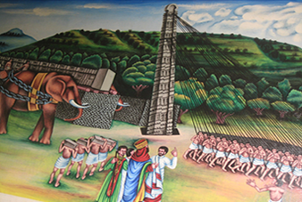
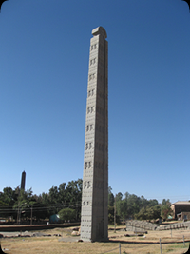
Aksum (Axum)
Arises in 200 AD
Largely Christian state
Converted by those in the Byzantine Empire
This will play an enormous part in the cultural and political life
Controlled (briefly) the SW part of the Arabian Peninsula
Major influence on Maritime Practices
Notes:
http://www.findethiopiatours.com/historic_attractions.php

Slide 10
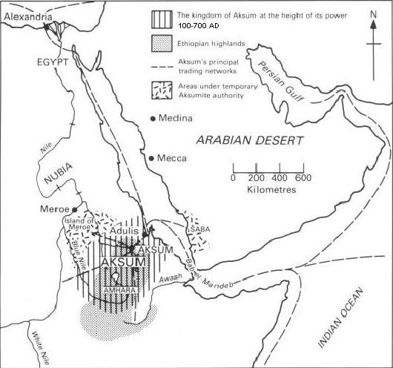
Map of Aksum Empire

Slide 11
West Africa

Slide 12
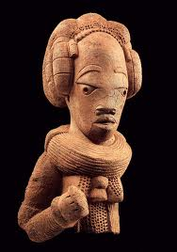
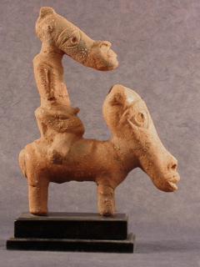
Nok
Mysteriously vanished around 300 AD
Thrived for centuries before
Experts in Terracotta creations
These varied from figurines to everyday items
Believed to be a highly civilized society
Were miners, used tools made from iron

Slide 13
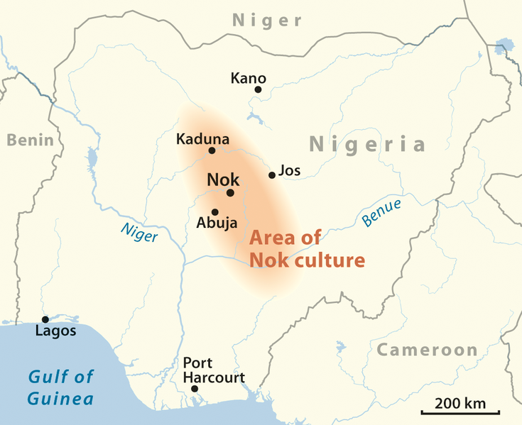

Slide 14
South Africa

Slide 15
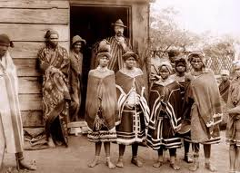
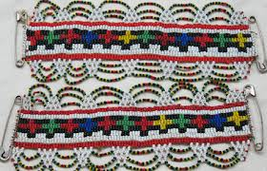
Xhosa
Known for their beadwork
King does not have absolute power
Oral tradition
Stories that have animal protagonist and human characters
Poems, and songs are also important
Cattle were important among them
They were a symbol of wealth
Notes:
http://www.sahistory.org.za/people-south-africa/xhosa

Slide 16
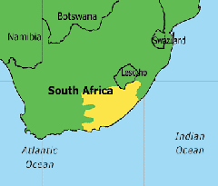
Xhosa are still around today.
Nelson Mandela was apart of the Xhosa tribe and was buried amongst his ancestors to become a protector

Slide 17
Madagascar

Slide 18
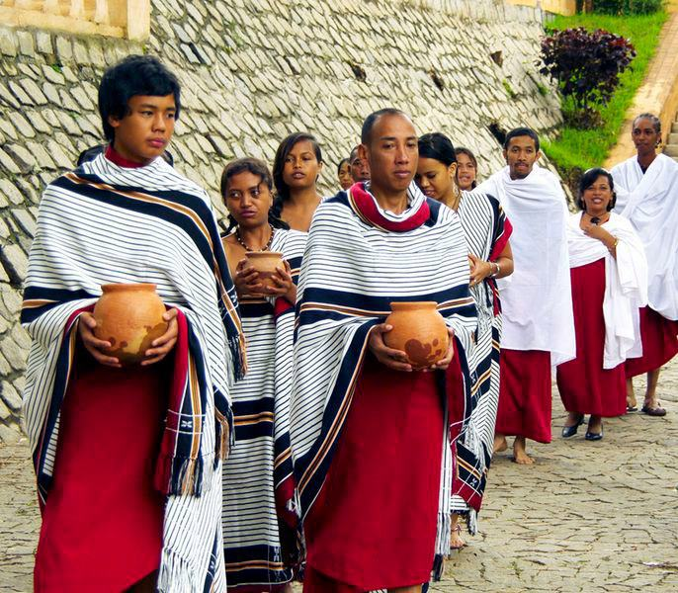
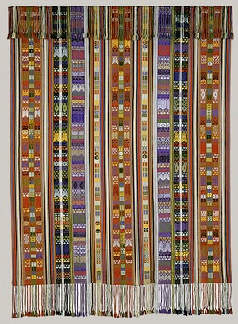
Merina
Known for their SE Asia similarities they were originally founded in the 16th century
There was no European contact until the French arrived 2 centuries later
Belief in a type of mythology were spirits of ancestors, and a divine creator
Known as Malagasy Mythology
Cultivated rice and other farming methods.

Slide 19
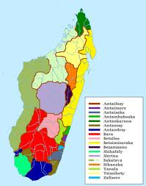

Slide 20
Work Session

Slide 21
Where is it From?
With a partner (or Solo) complete the worksheet
Use the sheet of artifacts given to you (and your partner)
When you are finished write a short story or newspaper article about the artifacts you ‘found’
Short story can take place anytime, and have any Point of View
Newspaper article can take place of time of discovery, or at a later date.

Slide 22
