Slide 1
TURKMENISTAN
BY:ASHLYN DAVIS

Slide 2
THE FLAG
The national flag of Turkmenistan features white crescent and the five stars represent the five regions of the country.
The flag was officially adopted February 19,1997

Slide 3
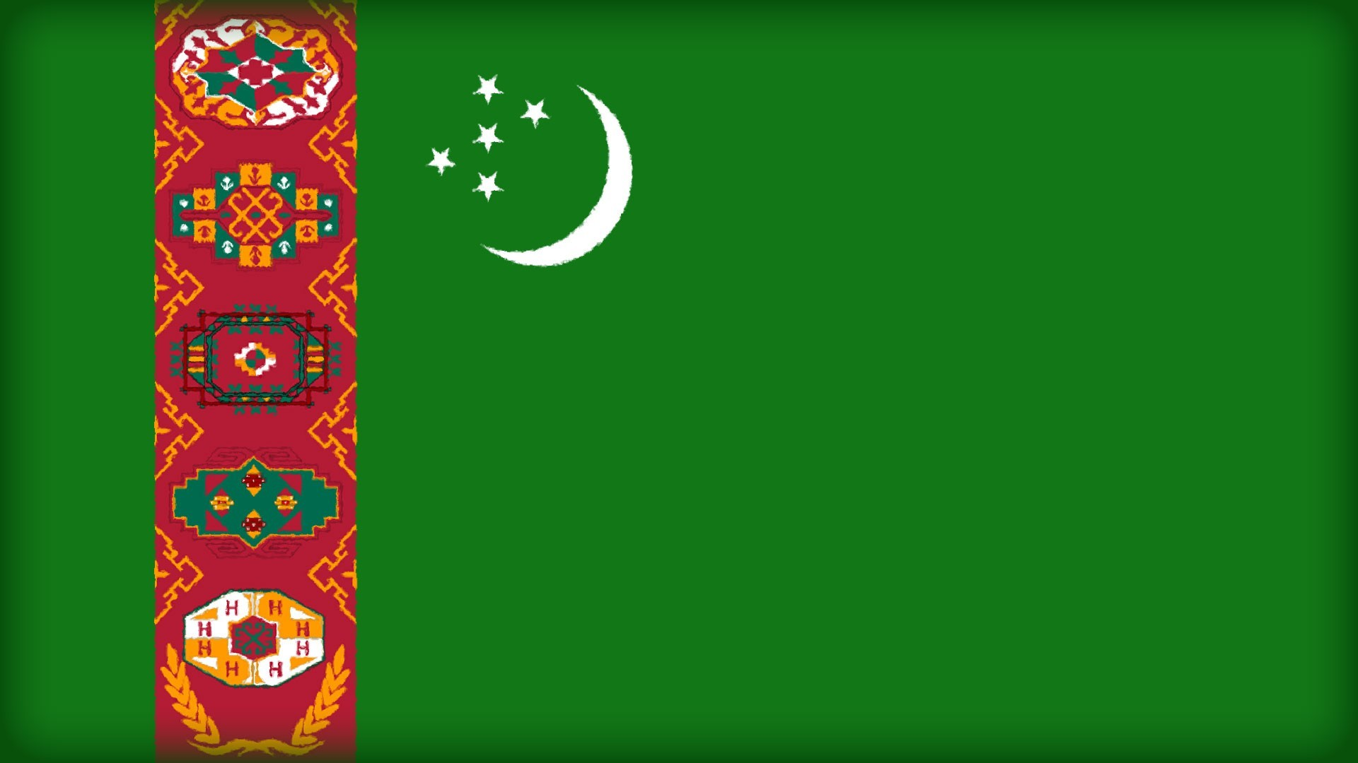
TURKMENISTAN FLAG

Slide 4
THE CULTURE
Turkmenistan culture is slightly different from the cultural tradition of the neighboring Muslims. The reason is the ancestors of the Turkmen were nomadic tribes, where the lands of modern Tajikistan and Uzbekistan were populated by the settled tribes of farmers.
The horse is one of the most important Turkmen symbols especially the Akhal-Teke breed. In 1935 a group of Turkmen rode 300 miles to Moscow to demonstrate their desire to protect the breed. In 1973 a result of the slaughter horses for meat and attempts cross-breeding. Eighteen pure Akhal-Teke were left in the Soviet Union. In 1988 the trek to Moscow was reenacted to demonstrate that Turkmen considered the horse as a defining symbols of their culture.

Slide 5
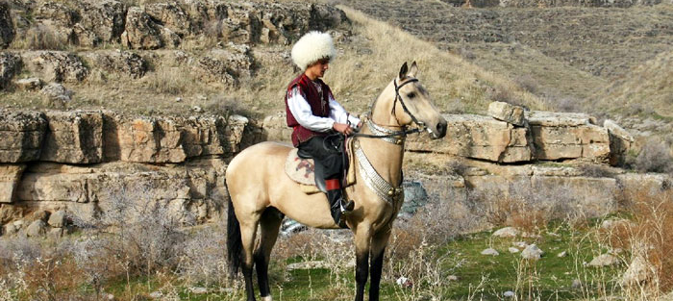
TURKMEN
This is a Turkmen riding one of his favorite horses

Slide 6
THE FOOD
Turkmenistan cuisine is very similar to that of other Central Asian countries(especially Iranian). They have rice and vegetables, and of course various meats(mutton, lamb, beef, and poultry). Most of the meals often begin with soup.
A popular soup is Chorba a meat and vegetables soup. Plov is also a national dish. It is basically a rice dish served with mutton, onions, carrots, spices, raisins, peas or quince mixed all together. Turkmen like to drink “gok chai” it is green tea with dried fruit and herbs are optional to give the tea flavor such as a mint flavor.

Slide 7
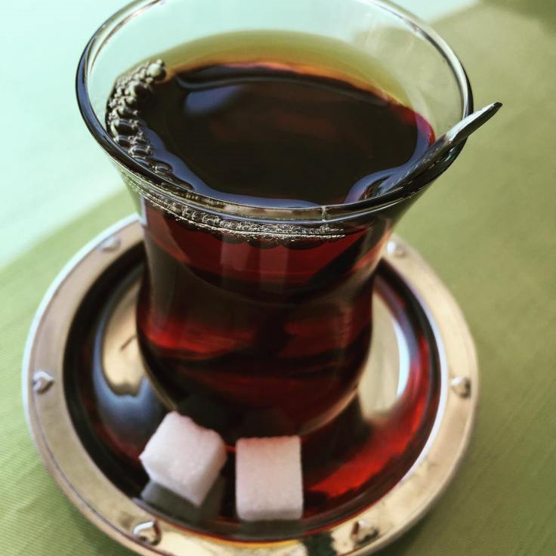
“Gok Chai”
This is “gok chai” this is the favorite kind of tea that Turkmen like to drink.

Slide 8
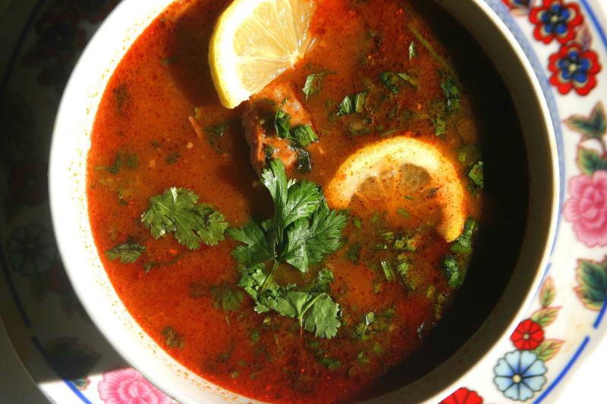
Chorba
This is what chorba looks like. This is a popular soup in Turkmenistan.

Slide 9
Football
Football is the most popular sport in Turkmenistan a country that gained independent in 1991. Turkmenistan ranks 5th in the world for GDP(gross domestic product) growth rate. The national association regularly takes part in competitions organized by FIFA and the AFC. Valeri Nepomniachi is probably the most famous name in Turkmen football. He was the coach who led Cameroon to the 1990 FIFA world cup in Italy.

Slide 10
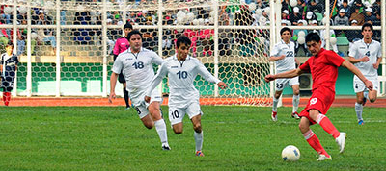
FOOTBALL
This is them in Turkmenistan playing football(soccer).

Slide 11
THE RELIGION
In Turkmenistan they have all sorts of people of different religion. On all parts of Turkmenistan. Not all the people there are Turkmen.
89% are Muslims, 9% are Eastern Orthodox, and 2% are uknown they do not know what their religion is.

Slide 12
THE REVIEW
In the end Turkmenistan seems like a good place to be. They have good food, good drinks, and their favorite sport football known as soccer. The religion is different in most part of Turkmenistan, so you have choices.

