Slide 1
Apartheid
in South Africa
Nelson Mandela & F.W. de Klerk
© 2014 Brain Wrinkles

Slide 2
Standards
SS7H1 The student will analyze continuity and change in Africa leading to the 21st century.
c. Explain the creation and end of apartheid in South Africa and the roles of Nelson Mandela and F.W. de Klerk.
© 2014 Brain Wrinkles

Slide 3
Teacher Info.
Print off the Apartheid Questions handout for each student.
They should answer the questions while discussing the presentation. Afterwards, check and share answers as a class.
© 2014 Brain Wrinkles

Slide 4
Which European powers colonized South Africa?
Which political party came to power in South Africa in 1948?
What were the apartheid laws?
How did the apartheid laws impact lives?
What did the Bantu Authorities Act do in 1952?
What was the African National Congress?
Who was Nelson Mandela?
What was the Sharpeville Massacre?
How did South Africa’s government react to the ANC and Mandela?
Describe Mandela’s prison experience:
Who was F.W. de Klerk?
How did he change South African policy?
Why did de Klerk and Mandela win the Nobel Peace Prize?
What is significant about the year 1994?
What is South Africa like today?
© 2014 Brain Wrinkles
Apartheid Questions

Slide 5
Which European powers colonized South Africa? Dutch and British
Which political party came to power in South Africa in 1948? National Party
What were the apartheid laws? A series of segregationist laws set up by whites in government
How did the apartheid laws impact lives? They restricted where blacks could live, work, go to the bathroom, sit, travel, eat, etc. Blacks could not participate in government.
What did the Bantu Authorities Act do in 1952? Set up poor quality homelands for blacks; couldn’t leave homeland without a passport
What was the African National Congress? One of the main groups that fought against apartheid
Who was Nelson Mandela? An educated lawyer who was a member of the ANC and protested apartheid
What was the Sharpeville Massacre? A peaceful protest that turned violent when policemen opened fire—killing 69 and wounding 120
How did South Africa’s government react to the ANC and Mandela? The government declared the ANC illegal and Mandela was captured and sentenced to life in prison.
Describe Mandela’s prison experience: had to do hard labor, one visitor every 6 months, 27 years in prison
Who was F.W. de Klerk? The president of South Africa in 1989, worked to dismantle apartheid laws
How did he change South African policy? Renounced the ban on the ANC, pardoned Mandela and other ANC leaders
Why did de Klerk and Mandela win the Nobel Peace Prize? They peacefully moved the country to a nonracial democracy.
What is significant about the year 1994? South Africa had its first election open to all races; Mandela was elected first black president of South Africa
What is South Africa like today? Democratic, strongest economy in Africa, still has economic inequality and poverty
© 2014 Brain Wrinkles
Apartheid Questions
KEY

Slide 6
Colonization
In the 1600s, the British and the Dutch colonized South Africa.
More European settlers came to South Africa than to anywhere else on the continent.
South Africa was eventually seized by the British from the Dutch settlers (after the Boer War).
In 1910, Great Britain established the Union of South Africa and it became part of the British commonwealth.
Power was only given to whites.
© 2014 Brain Wrinkles

Slide 7
Apartheid
In 1948, a new political party, the National Party, came to power and voted to implement a series of restrictive segregationist laws, known collectively as apartheid.
The National Party enforced the policy of apartheid through legislation across South Africa.
Apartheid was a social and political policy of racial segregation and discrimination.
In Afrikaans (the language of white South Africans), apartheid means “apartness”.
© 2014 Brain Wrinkles

Slide 8
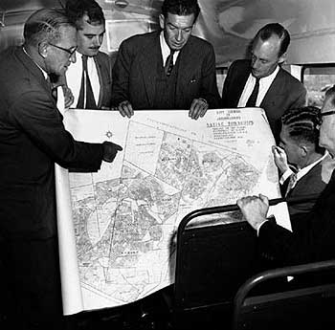
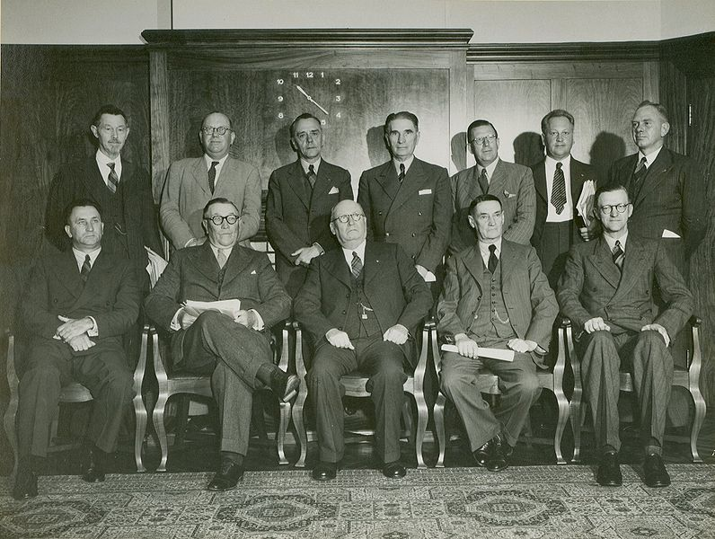
National Party, 1948
© 2014 Brain Wrinkles

Slide 9
Segregation
The policy of apartheid took a strong hold in the country.
It separated South Africa into whites and non-whites, restricting where blacks could live, work, travel, sit, go to the bathroom, eat, etc.
Under apartheid, blacks could not vote or participate in government.
What does this remind you of??
© 2014 Brain Wrinkles

Slide 10
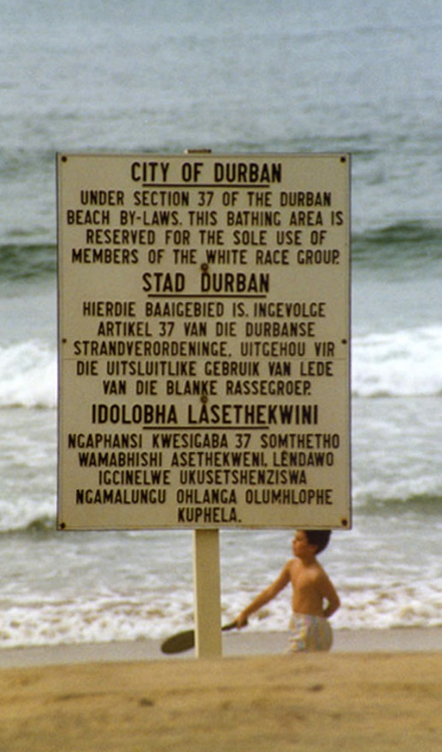
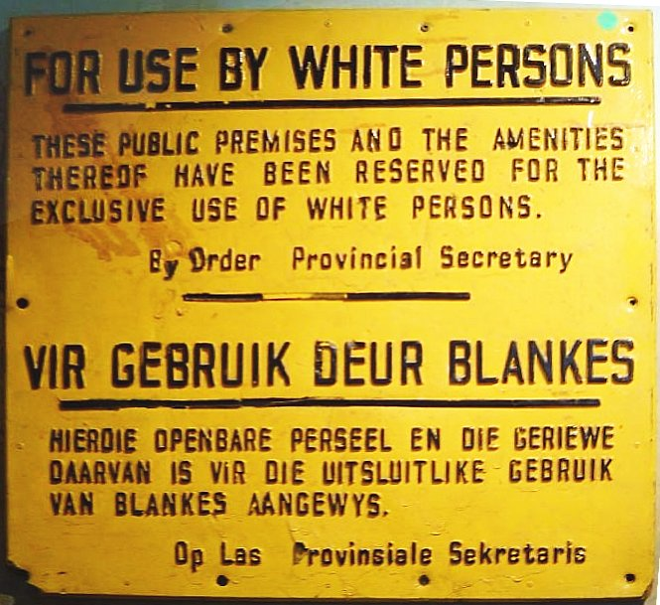
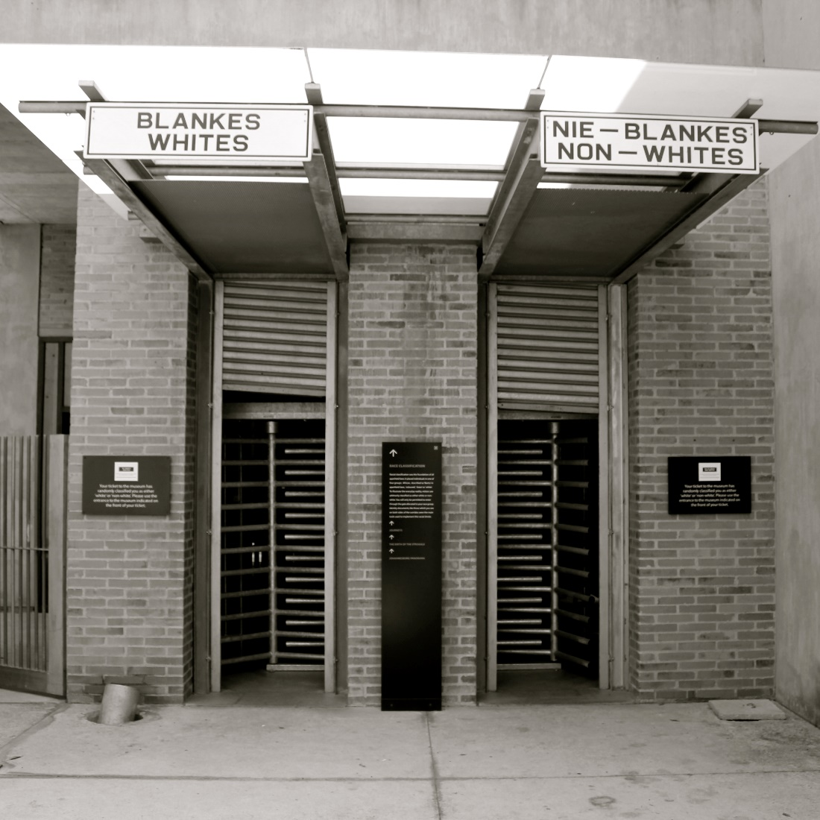
© 2014 Brain Wrinkles

Slide 11
Bantu Authorities Act
In 1951, government officials created the Bantu Authorities Act, which created “homelands” for black South Africans.
At this time, whites owned 80% of the land, although they only represented 10% of the population.
As a result of this law, 9 million South Africans were excluded from participating in the government.
© 2014 Brain Wrinkles

Slide 12
Life Under Apartheid
Apartheid allowed many whites to grow wealthy and powerful, while millions of blacks suffered.
Afrikaners lived in up-scale neighborhoods while native South Africans lived in slums or in Bantustans.
Bantustans were artificially created reservations (“homelands”) for native Africans to live on.
Bantustans offered a poor quality of land and were unfit for the large populations forced to live there.
South Africans were unable to leave their Bantustan without a passport.
© 2014 Brain Wrinkles

Slide 13
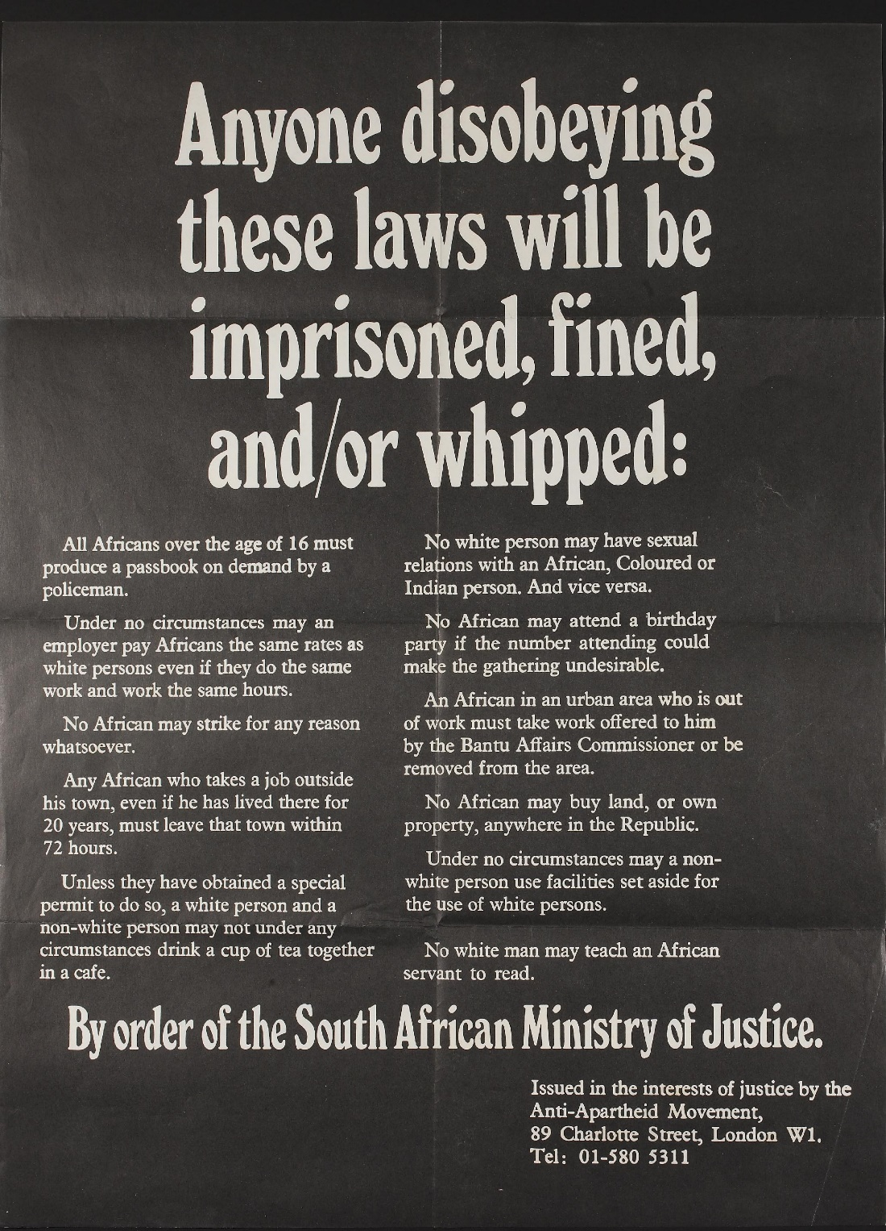
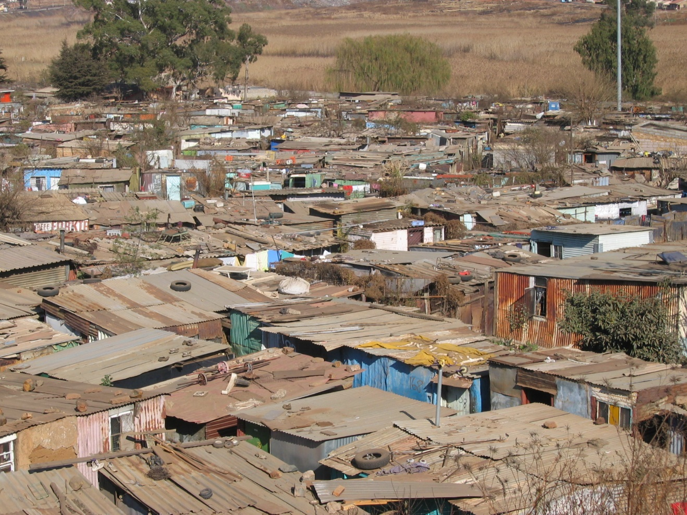
© 2014 Brain Wrinkles

Slide 14
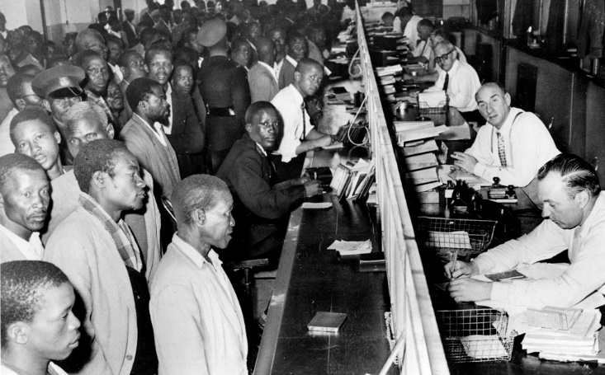
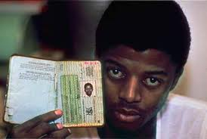
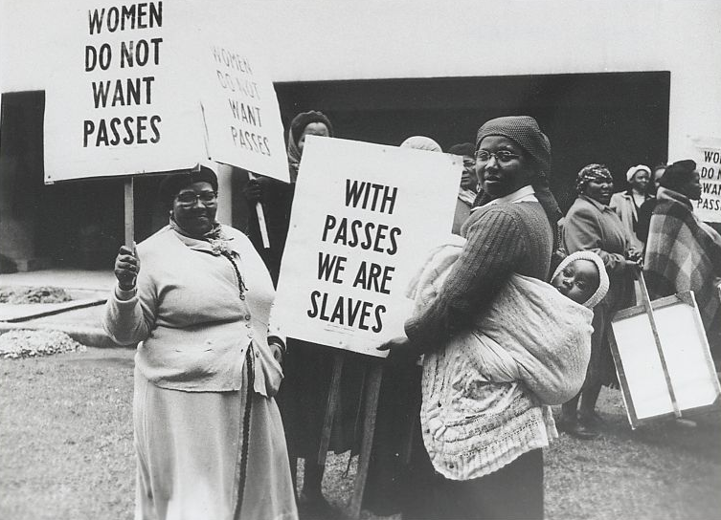
Black South Africans line up at the counter of a government office to get their new passbooks in Johannesburg, South Africa, April 7, 1960.
© 2014 Brain Wrinkles

Slide 15
A.N.C.
In the 1950s, the African National Congress, or ANC, began to actively fight apartheid.
The goal of the ANC was to increase rights of native Africans, although the group had no real power in government.
Eventually, the ANC was declared illegal by the South African government and members were often arrested.
© 2014 Brain Wrinkles

Slide 16
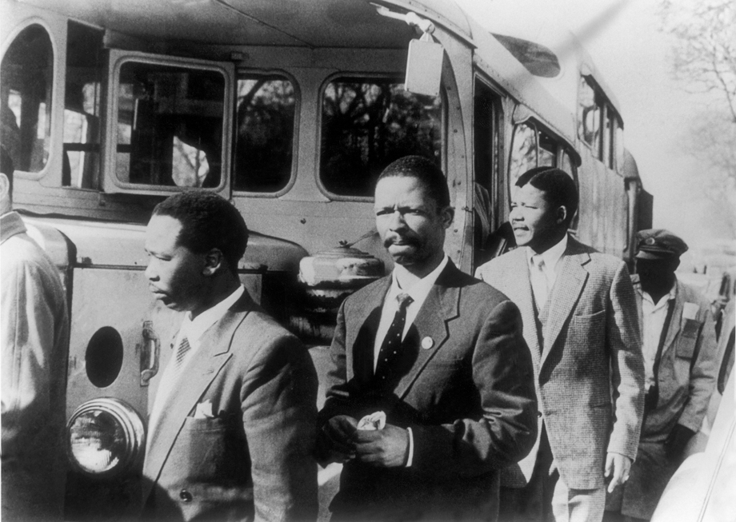
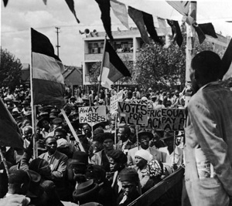
ANC Members (Nelson Mandela, second from right)
© 2014 Brain Wrinkles

Slide 17
Nelson Mandela
Rolihlahla Mandela was born on July 18, 1918 in South Africa.
He was a member of the Thimbu tribe, and his father was chief of the city of Mvezo.
His father died when he was 9, and he was sent to live with a tribal chief who took care of his education.
On his first day of school, his teacher gave him the name of Nelson.
Even though he was the first person in his family to attend school, he was an excellent student.
After graduating college, he became a lawyer.
Mandela became a prominent member of the African National Congress and participated in numerous ANC-led protests against apartheid.
© 2014 Brain Wrinkles

Slide 18
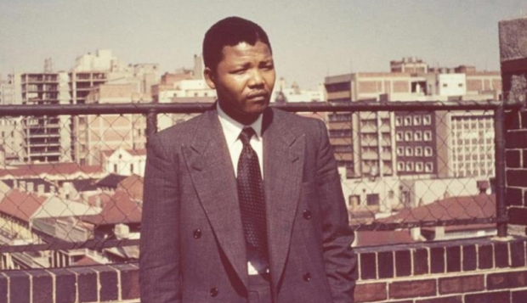
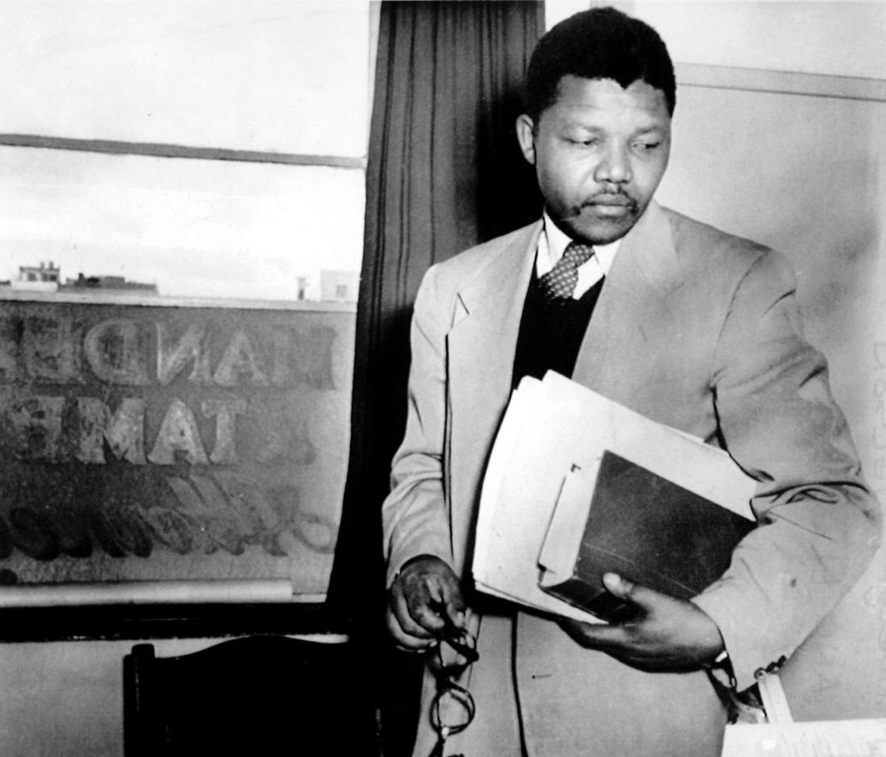
© 2014 Brain Wrinkles

Slide 19
Sharpeville
Nelson Mandela admired Gandhi, who had used peaceful protests in India.
He urged the ANC members to follow Gandhi’s beliefs in non-violent protests.
In 1960, a peaceful protest of apartheid at the town of Sharpeville turned violent as South African policemen fired on the protestors.
69 people were killed and 180 were wounded.
After this, the ANC and Mandela began to advocate more violent methods of protesting the government.
© 2014 Brain Wrinkles

Slide 20
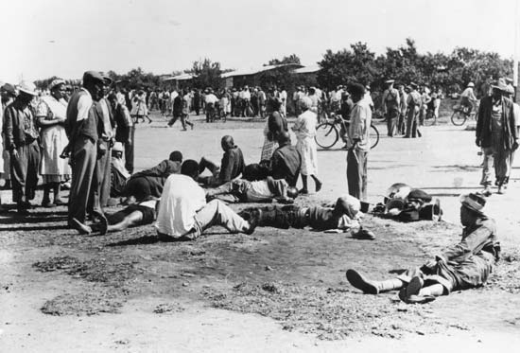
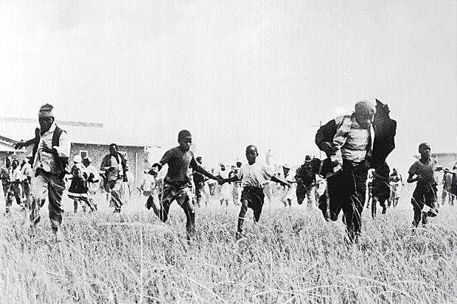
© 2014 Brain Wrinkles

Slide 21
Imprisoned
In 1962, Mandela was captured and accused of sabotage and plotting to overthrow the government.
In 1964, at the age of 46, he was found guilty and sentenced to life in prison.
Mandela was sent to prison on Robben Island.
There, he had to do hard labor and was allowed one visitor every six months.
© 2014 Brain Wrinkles

Slide 22
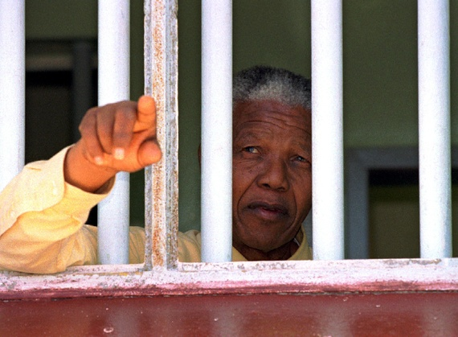
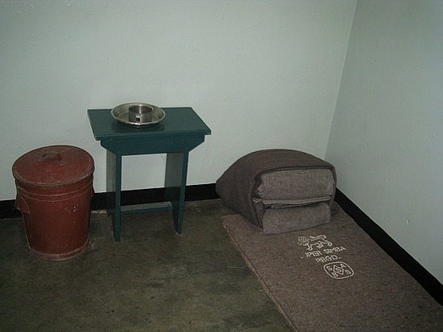
© 2014 Brain Wrinkles

Slide 23
F.W. de Klerk
In 1989, F.W. de Klerk came to power in South Africa and began to dismantle the apartheid system.
Almost immediately, de Klerk renounced the ban on the ANC and announced that Mandela would be released from prison.
In 1990, Mandela was pardoned by de Klerk and became a free man after serving 27 years in prison.
© 2014 Brain Wrinkles

Slide 24
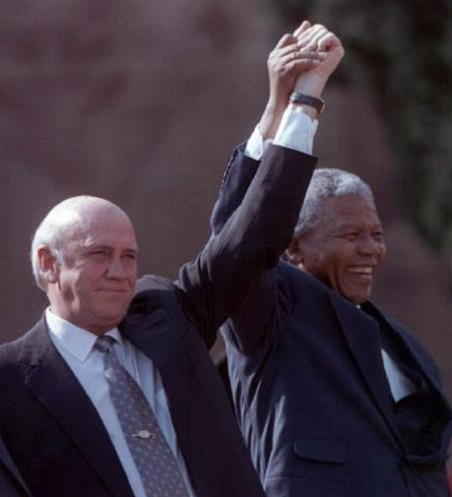
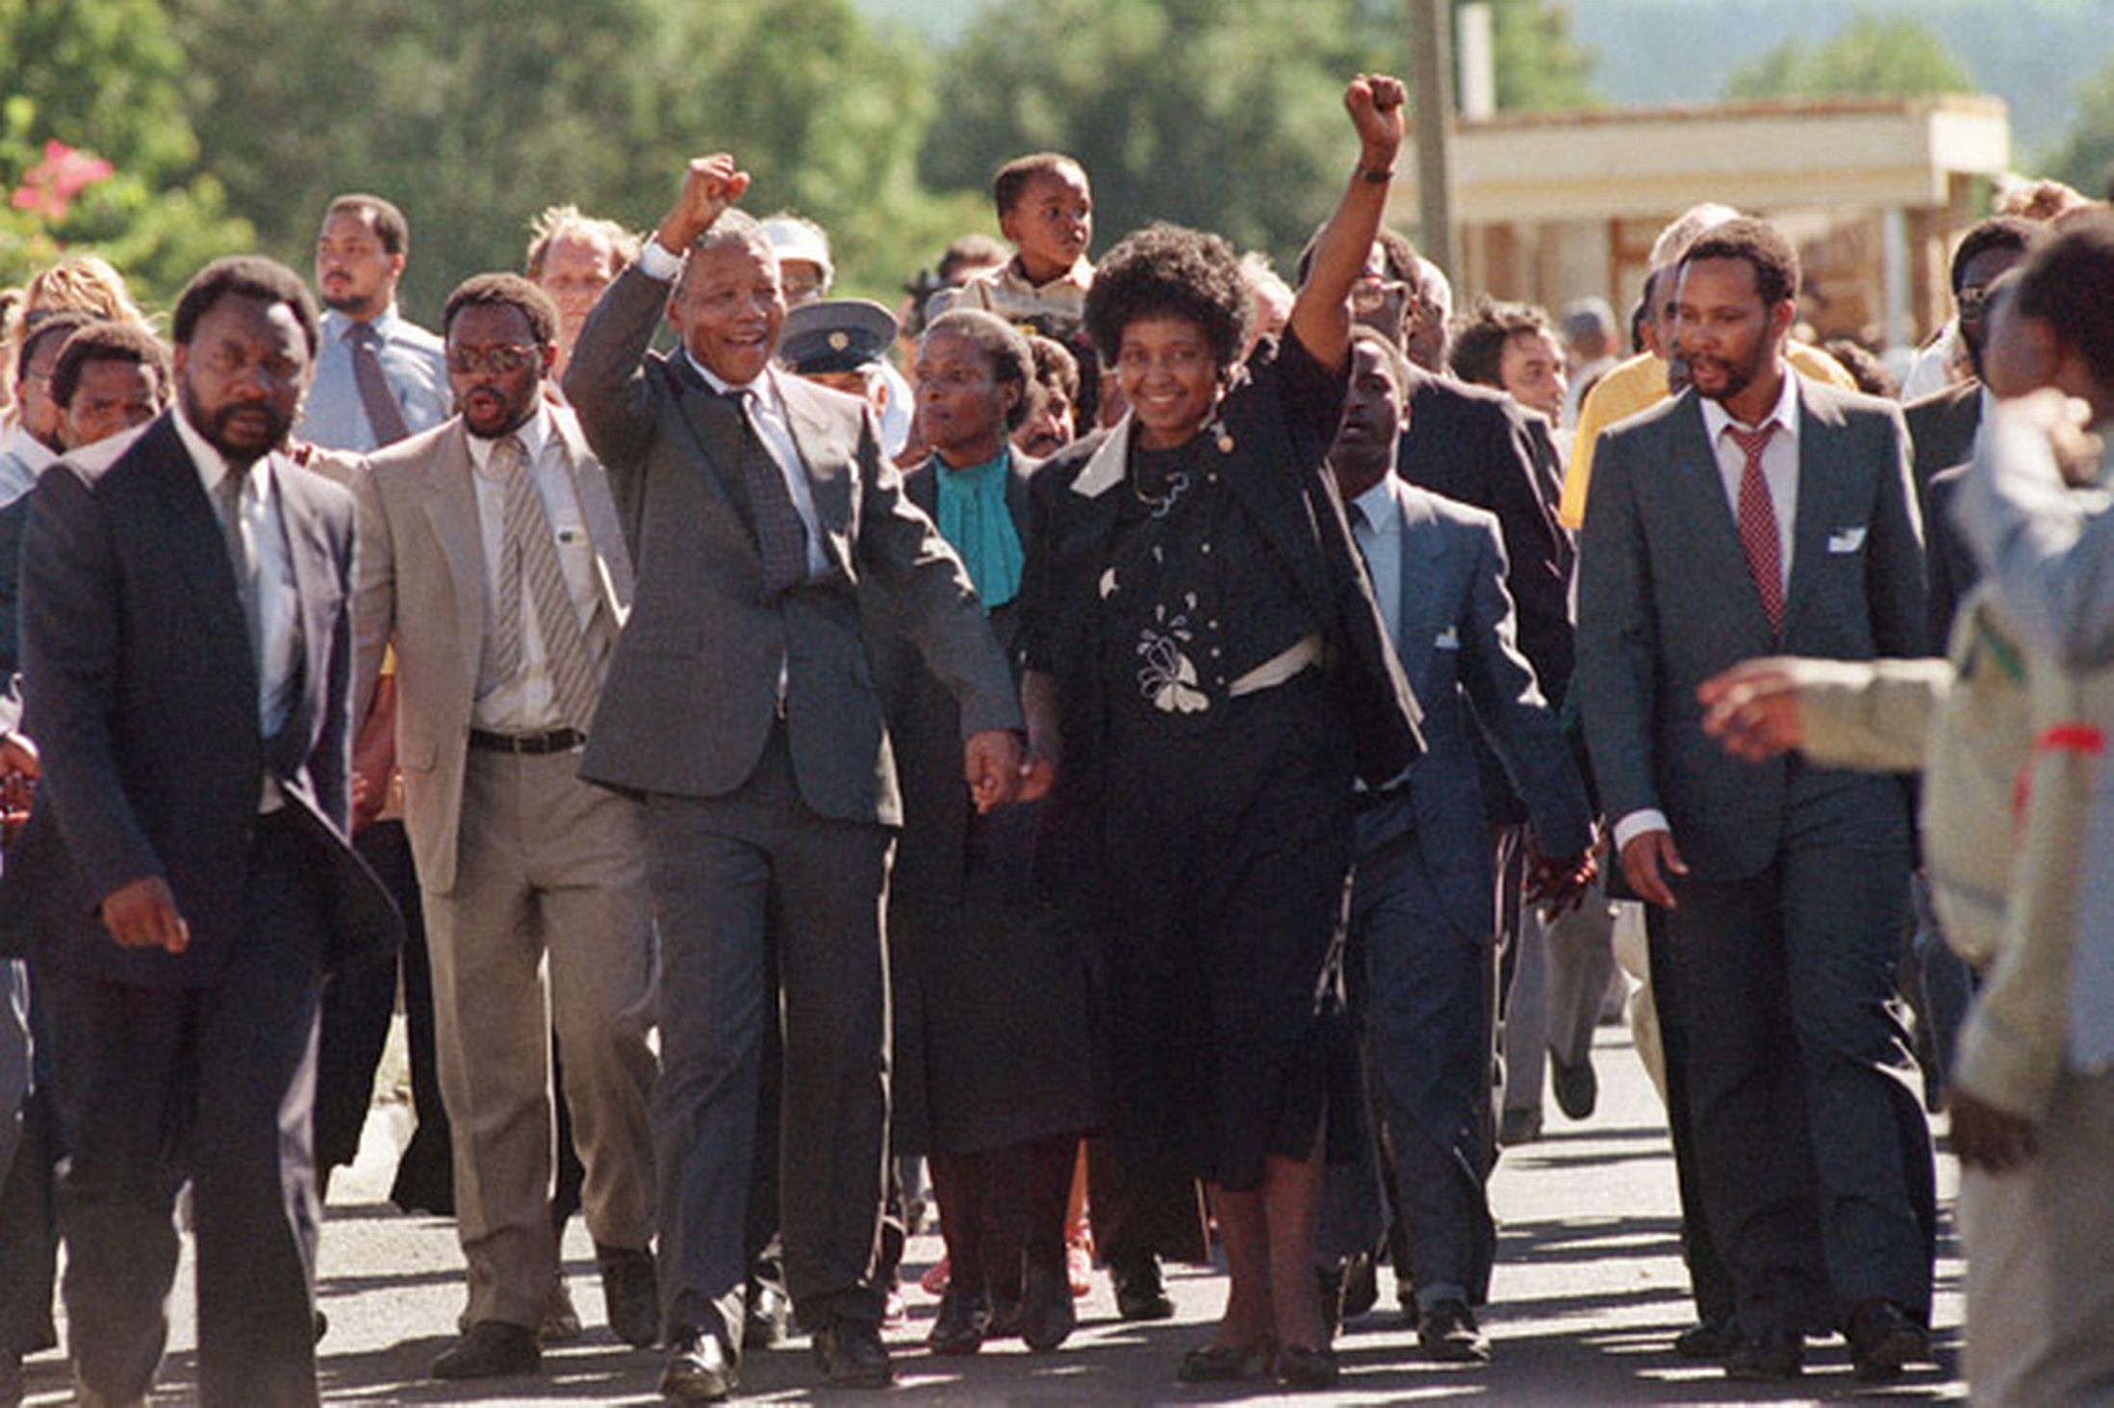
De Klerk and Mandela
Mandela Released from Prison
© 2014 Brain Wrinkles

Slide 25
The End
President de Klerk worked from within the government to end apartheid, while Mandela resumed his position as president of the ANC, and worked to end apartheid from the outside.
In 1993, de Klerk and Mandela shared the Nobel Peace Prize for moving the country peacefully to a nonracial democracy.
In 1994, South Africa held its first election open to all races.
Nelson Mandela was elected the first black president of South Africa.
© 2014 Brain Wrinkles

Slide 26
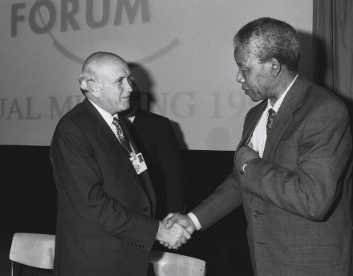
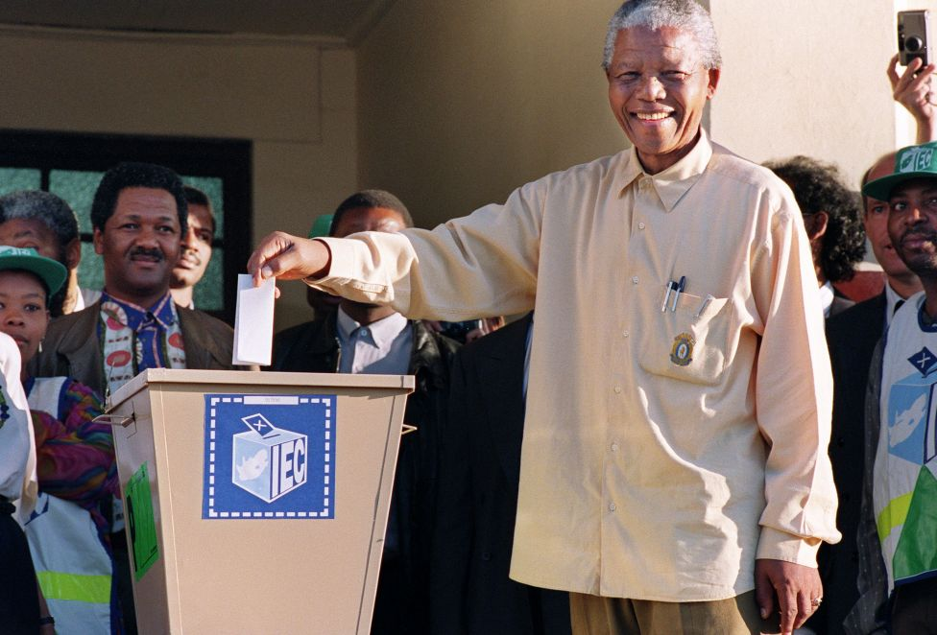
De Klerk and Mandela, 1992
Mandela Voting, 1994
© 2014 Brain Wrinkles

Slide 27
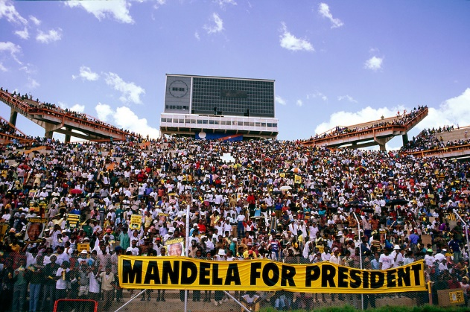
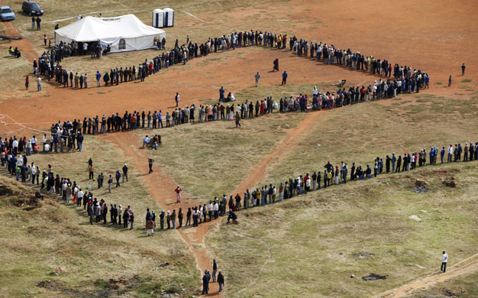
Waiting in line to vote, 1994
© 2014 Brain Wrinkles

Slide 28
Today…
Despite having a stable democratic government and the strongest economy in Africa, South Africa still has major issues.
There is still economic inequality and poverty throughout the country.
Most of the wealth is concentrated in predominately white urban areas.
The rural areas where blacks predominate are still terribly poor.
© 2014 Brain Wrinkles

Slide 29
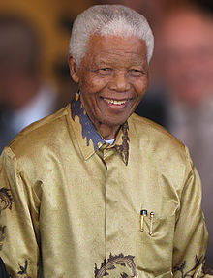
Nelson Mandela
July 18, 1918 – December 5, 2013
© 2014 Brain Wrinkles

Slide 30
Teacher Info – Capturing Apartheid
Print off the Capturing Apartheid handout for each student.
In the camera lens, the students will draw one of the events from the apartheid era in South Africa. In the textbox, they will write a paragraph from their perspective of the event—as if they were right there capturing the picture.
© 2014 Brain Wrinkles

Slide 31
Capturing Apartheid
© 2014 Brain Wrinkles

Slide 32
Teacher Info – Facebook
Give each student a copy of the blank Facebook handout and project the direction slide onto the screen. I like to leave this up while the students work so that they know exactly what goes in each box.
The students should create a profile as if they are either Nelson Mandela or F.W. de Klerk during (or right after) the apartheid era.
© 2014 Brain Wrinkles

Slide 33
What’s on your mind?
Three important things that you should know about me…
I believe in…
Name:
Age:
Birthday:
Location:
I am fighting against…
© 2014 Brain Wrinkles

Slide 34
Name of a related person, place, group, etc.
Country
Draw picture of something that represents the person
Write a status about something the person could be doing.
Write the name of it
Draw a picture of the person
Three important things that you should know about me…
What are important things that we should know about the person? Write a status about those things.
#2
Write the name of it
#3
Write the name of it
I believe in…
Name:
Age:
Birthday:
Location:
Write a status about the person’s goals and beliefs.
Draw picture of possible friend
#2
I am fighting against…
Write a status about what the person does NOT believe in.
#3
#4
© 2014 Brain Wrinkles

Slide 35
Teacher Info – Ticket Out the Door
Print off the #Summary Ticket Out the Door for each student. (There are 4 to a page.)
They should write a hashtag for the important vocabulary words on the ticket. They may write more than one for each word.
Example: Mandela: #nevergiveup #equalrightsforall
© 2014 Brain Wrinkles

Slide 36
#Summary
#Summary
Directions: Write a hashtag for each of the following terms:
@National Party:
@Apartheid:
@Nelson Mandela:
@Sharpeville:
@F.W. de Klerk:
Directions: Write a hashtag for each of the following terms:
@National Party:
@Apartheid:
@Nelson Mandela:
@Sharpeville:
@F.W. de Klerk:
© 2014 Brain Wrinkles
© 2014 Brain Wrinkles
#Summary
#Summary
Directions: Write a hashtag for each of the following terms:
@National Party:
@Apartheid:
@Nelson Mandela:
@Sharpeville:
@F.W. de Klerk:
Directions: Write a hashtag for each of the following terms:
@National Party:
@Apartheid:
@Nelson Mandela:
@Sharpeville:
@F.W. de Klerk:
© 2014 Brain Wrinkles
© 2014 Brain Wrinkles

Slide 37
Thank You!
Thank you so much for downloading this file. I sincerely hope you find it helpful and that your students learn a lot from it! I look forward to reading your feedback in my store.
If you like this file, you might want to check out some of my other products that teach social studies topics in creative, engaging, and hands-on ways.
Best of luck to you this school year,
Ansley at Brain Wrinkles
© 2014 Brain Wrinkles

Slide 38
Terms of Use
© 2014 Brain Wrinkles. Your download includes a limited use license from Brain Wrinkles. The purchaser may use the resource for personal classroom use only. The license is not transferable to another person. Other teachers should purchase their own license through my store.
This resource is not to be used:
By an entire grade level, school, or district without purchasing the proper number of licenses. For school/district licenses at a discount, please contact me.
As part of a product listed for sale or for free by another individual.
On shared databases.
Online in any way other than on password-protected website for student use only.
© Copyright 2014. Brain Wrinkles. All rights reserved. Permission is granted to copy pages specifically designed for student or teacher use by the original purchaser or licensee. The reproduction of any other part of this product is strictly prohibited. Copying any part of this product and placing it on the Internet in any form (even a personal/classroom website) is strictly forbidden. Doing so makes it possible for an Internet search to make the document available on the Internet, free of charge, and is a violation of the Digital Millennium Copyright Act (DMCA).
Thank you,
Ansley at Brain Wrinkles
Clipart, fonts, & digital papers for this product were purchased from:
© 2014 Brain Wrinkles

